Slide 1
Introducing the
Measures Registry User Guide:
Individual Diet
Teaching Slide Deck
Notes:
A top priority for the National Collaborative on Childhood Obesity Research (NCCOR) is to encourage the consistent use of high-quality, comparable measures and research methods across childhood obesity prevention and research.
This presentation reviews key concepts from the Measures Registry User Guide for Individual Diet.
The presentation is organized such that the full set or subsections of slides can be used, depending on the interests and purposes of the user. Further details on each of the topics are available in the User Guide.

Slide 2
Measures Registry User Guides
The User Guides are designed to:
Provide an overview of measurement
Describe general principles of measurement selection
Present case studies that walk users through the process of using the Measures Registry to select appropriate measures
Direct researchers and practitioners to additional resources and sources of useful information
The User Guides cover the four domains for the Measures Registry:
Individual Diet
Food Environment
Individual Physical Activity
Physical Activity Environment
The User Guides aim to help move the field forward by fostering more consistent use of measures, which will allow for standardization, meta-analyses, and synthesis.
Notes:
NCCOR’s Measures Registry, a free, online repository of articles about measures, is widely recognized as a key resource that gives researchers and practitioners access to detailed information on measures in one easy-to-search location.
However, even with this resource, it can be challenging for users to choose the most appropriate measures for their work.

Slide 3
Measures Registry User Guides
Designed to:
Provide an overview of measurement
Describe general principles of measurement selection
Present case studies to walk users through the process of using the Measures Registry to select appropriate measures
Direct researchers and practitioners to additional resources
Aim to help move the field forward by fostering more consistent use of measures, which will allow for standardization, meta-analyses, and synthesis
Notes:
To address these challenges, NCCOR began the Measures Registry User Guides project in 2015.
Organized by the same four domains as the Measures Registry, the User Guides are designed to provide an overview of measurement, describe general principles of measurement selection, present case studies that walk users through the process of using the Measures Registry to select appropriate measures, and direct researchers and practitioners to additional resources and sources of useful information.
The User Guides will help move the field forward by fostering more consistent use of measures, which will allow for standardization, meta-analyses, and synthesis.

Slide 4
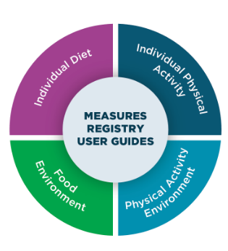
Measures Registry User Guides
The User Guides cover the four domains for the Measures Registry:
Individual Diet
Food Environment
Individual Physical Activity
Physical Activity Environment
Notes:
The Registry’s measures and the corresponding User Guides focus on four domains that can influence childhood obesity on a population level:
Individual Diet
Food Environment
Individual Physical Activity
Physical Activity Environment

Slide 5
Measures Registry User Guides
The User Guides cover the four domains for the Measures Registry:
Individual Diet
Food Environment
Individual Physical Activity
Physical Activity Environment
Notes:
This presentation describes the User Guide for Individual Diet, for which a plethora of measures are available.
Dietary behavior is complex, and so is its measurement. Nonetheless, measuring dietary behaviors can provide extremely useful information. However, due to the varying characteristics, strengths, and weaknesses of different measures, and corresponding degrees of appropriateness for particular applications, choosing the most appropriate tool for a given population and purpose can be a challenging task.
The goal of this User Guide is to help researchers and practitioners make effective use of the Individual Diet domain within the Measures Registry, as well as complementary resources, to select the best possible measures to conduct population surveillance of dietary behavior, to assess dietary determinants of disease and health outcomes, and to evaluate policy and program interventions. The User Guide also aims to help users consider salient issues related to administration of measures, data analysis, and interpretation and reporting of the resulting data.
The User Guide does not provide a comprehensive summary of each of the measures, an evaluation of the measures, or a compilation of research using the measures, but rather, addresses concepts associated with the measurement of dietary behaviors broadly.

Slide 6
Overview of this presentation
Introduction to NCCOR and the Measures Registry
Conceptualizing individual diet
Measurement characteristics
Measuring individual diet
Measurement in action
Additional considerations
Putting it all together
Notes:
This presentation reviews the topics below:
Introduction to NCCOR and the Measures Registry
Conceptualizing individual diet
Measurement characteristics
Measuring individual diet
Measurement in action
Additional considerations
The presentation is organized into corresponding sections within the PowerPoint file – sections can be collapsed or deleted as desired, depending on the user’s purposes.

Slide 7
Introduction to NCCOR and the Measures Registry

Slide 8
NCCOR Mission and Goals
Mission:
Accelerate progress in reducing childhood obesity
Goals:
Collaborating to turn the tide on childhood obesity
Supporting researchers with tools that help build capacity for research and surveillance
Maximizing outcomes from research and supporting evaluations
Using innovation to stimulate broad thinking to generate fresh, synergistic ideas
Increasing knowledge to find solutions by promoting new research funding mechanisms and translating and disseminating research findings
Looking to the road ahead and building new partnerships to solve problems

Slide 9
Collaboration
Building on each other’s strengths, CDC, NIH, RWJF, and USDA formed a unique public private partnership – NCCOR

Slide 10
Strategic alliance
In 2015, NCCOR formed a strategic partnership with the JPB Foundation to develop User Guides to strengthen the Measures Registry, a landmark tool to help researchers find and select measures for childhood obesity research

Slide 11
Measures Registry
http://www.nccor.org/nccor-tools/measures/

Slide 12
Conceptualizing Individual Diet
Notes:
For the purpose of this User Guide, dietary behavior is conceptualized primarily as dietary intake, though related dietary behaviors and attitudes (e.g., frequency of snacking) that may be relevant to the study of childhood obesity are also addressed.
Many of the measures within the Registry focus on quantitatively assessing intake, for example, using 24-hour dietary recalls, dietary records, food frequency questionnaires, or screeners, for the purposes of arriving at estimated consumption of foods, food groups, and nutrients, or characterizing dietary patterns.
The measures within the Registry are primarily those that involve self- (or proxy-) reporting of intake; however, objective methods for assessment are also briefly described.

Slide 13
Why measure individual diet?
Obesity is affected by many factors, including dietary behaviors
Dietary intakes and behaviors relevant to obesity begin in infancy and continue into adolescence
Notes:
An array of factors contributes to obesity among this population at the individual, familial, school, and government levels. These contributors may both include, and can influence, dietary behavior.
Dietary behaviors salient to obesity are relevant beginning in infancy. For example:
Breastfeeding has been shown to be a protective behavior against weight gain in childhood. Researchers also have paid attention to the role of timing of introduction of solid foods and subsequent development of obesity. However, this relationship remains unclear, with a recent study by researchers at the Centers for Disease Control and Prevention finding no association between timing of introduction and obesity at age 6 years.
In toddlers, low fruit and vegetable consumption and high consumption of energy-dense foods are predictors of weight status in later childhood stages.
The dietary behaviors associated with overweight and obesity among school-aged children are similar to those observed in toddlers. Additional behaviors include frequent consumption of energy-dense foods, predominantly those high in fat, sugar, and/or salt as well as sugar-sweetened beverages.
Recent research has focused on consumption of sugar-sweetened beverages in particular, as they are a primary source of added sugars among youth, and evidence suggests that these beverages significantly contribute to weight gain. Low intake of fruits and vegetables, which is influenced by food-related attitudes and taste preferences, also correlate with the consumption of highly-processed, energy-dense fast foods among this age group.
Dietary behaviors, attitudes, and related factors play a larger role in dietary intake and obesity risk as children reach adolescence. Diet-related behaviors, such as excessive snacking, frequent eating at restaurants, and intentional diet restrictions for weight loss purposes are associated with increased risk of weight gain. Dietary intake, related behaviors, and attitudes are often interlinked and influence one another, with a possible overall impact on weight. For example, an adolescent trying to lose weight may intentionally restrict food choices, which is associated with an increased likelihood of poor diet choices and eventual weight gain.
Understanding dietary behaviors, their associations with other factors related to obesity, and how these behaviors are influenced by interventions is thus an important piece of the puzzle in our efforts to advance childhood obesity prevention efforts.

Slide 14
Conceptualizing individual diet
Other dietary behaviors
and constructs
Eating attitudes
Consumption of foods, beverages, supplements
Dietary intake
Frequency of consumption
Contextual details
Food preferences
Relevant Registry measures usually also assess intake *
Notes:
Generally speaking, dietary intake refers to the foods, beverages, and potentially, supplements consumed by individuals and populations.
In assessing intake, researchers are interested in capturing specific items consumed, along with details such as how they were prepared, the quantities consumed, and the frequency of consumption.
With the necessary details to characterize foods and beverages, consumption data can be linked with food composition and related databases to estimate intakes of foods and food groups, nutrients, and other dietary components. These estimates can be used to characterize dietary intake among populations or subpopulations (e.g., prevalences meeting recommendations for nutrient or food group consumption), examine influences (e.g., age, gender, socioeconomic status, education) on dietary intake, assess associations between dietary intake and outcomes (e.g., factors associated with body weight), and investigate the impacts of interventions (e.g., nutrition education, taxation of sugar-sweetened beverages) on intake.
In conjunction with information on intake, there is often interest in the context of eating, such as when, where, and with whom meals and snacks are consumed, as well as other activities during eating, such as use of digital devices.
Other measures within the Registry are intended to capture related behaviors, such as the frequency with which individuals visit fast food restaurants or consume snacks or meals while watching television. In addition, some measures capture eating attitudes (e.g., willingness to try new foods), food preferences (e.g., for salty or sweet foods), avoidance of particular dietary components (e.g., fat), diet knowledge and perceptions (e.g., regarding foods marketed as healthy), and other constructs that may influence eating patterns and body weight.
Generally, measures within the Registry that include constructs such as attitudes also include some assessment of intake (e.g., a measure of attitudes toward fruits and vegetables may also query intake of fruits and vegetables). For some research questions, it may be necessary to use measures of dietary intake together with measures focused on related behaviors and attitudes.

Slide 15
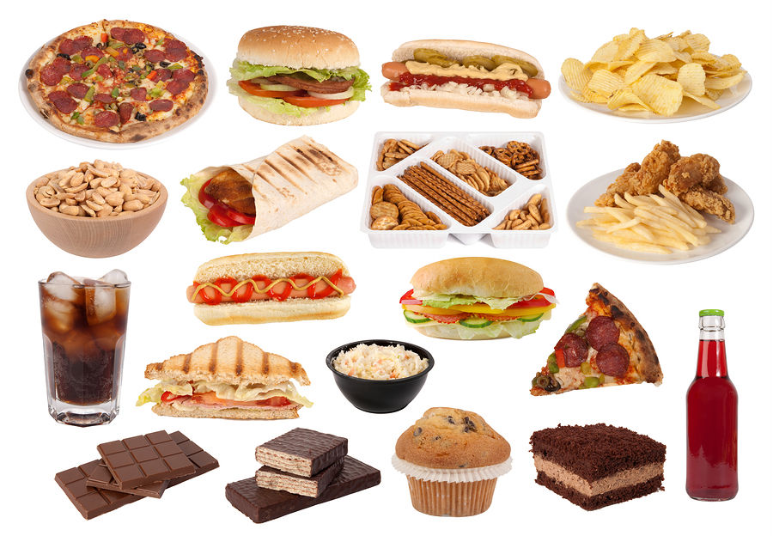
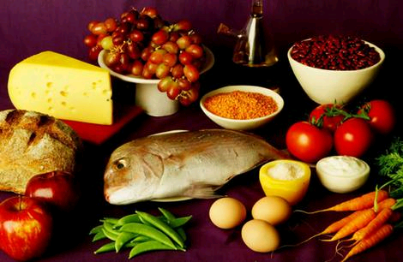
The complexities of assessing diet
Notes:
THE INFORMATION THAT APPEARS IN THESE SPEAKING NOTES IS PRESENTED ON THE FOLLOWING SLIDES – OPTION OF GRAPHIC OR TEXT VERSIONS
Measuring diet is a complicated undertaking because diet is a complex and dynamic phenomenon.
We eat and drink every day
We eat and drink different foods and beverages
Some foods/drinks and food groups are consumed most days by most people, others are consumed more episodically
Our diets change across days, seasons, and the lifecycle
Measuring dietary intake is also complex!
In measuring diet, primary interest is not typically in consumption on a given day (i.e., acute intake), but rather habitual or long-term intake over a given period of time.
For example, in surveillance, researchers and practitioners are interested in whether individuals and populations meet food group recommendations and nutrient requirements on average over time; and in epidemiology, researchers seek to examine associations between usual diet and subsequent health- or disease-related outcomes.
In some cases, such as some specific intervention studies, intake on a given day may be of interest.
However, usual intake is typically of interest and is the focus of the User Guide.
It is generally not possible to objectively assess usual intake in community-dwelling individuals. Thus, in most research relevant to dietary behaviors, self-report measures are used.

Slide 16
Conceptualizing individual diet
Diet is complex:
We eat and drink every day
We eat and drink different foods and beverages
Some foods/drinks and food groups are consumed most days by most people, others are consumed more episodically
Our diets change across days, seasons, and the lifecycle
Measuring dietary intake is also complex!
Notes:
Measuring diet is a complicated undertaking because diet is a complex and dynamic phenomenon.
We eat and drink every day
We eat and drink different foods and beverages
Some foods/drinks and food groups are consumed most days by most people, others are consumed more episodically
Our diets change across days, seasons, and the lifecycle
Measuring dietary intake is also complex!

Slide 17
Conceptualizing individual diet
Interest is often in usual intake (rather than intake on a given day or days)
Cannot be observed in most cases
➔ Reliance on self-report tools to estimate usual intake, using information on frequency of consumption and amounts consumed
Notes:
In measuring diet, primary interest is not typically in consumption on a given day (i.e., acute intake), but rather habitual or long-term intake over a given period of time.
For example, in surveillance, researchers and practitioners are interested in whether individuals and populations meet food group recommendations and nutrient requirements on average over time; and in epidemiology, researchers seek to examine associations between usual diet and subsequent health- or disease-related outcomes.
In some cases, such as some specific intervention studies, intake on a given day may be of interest.
However, usual intake is typically of interest and is the focus of this User Guide.
It is generally not possible to objectively assess usual intake in community-dwelling individuals. Thus, in most research relevant to dietary behaviors, self-report measures are used.

Slide 18
Factors affecting self-reported data
Literacy
Cognitive development
Numeracy
Recall bias
Recency
Social desirability bias
Reactivity
Proxy reporting
Notes:
Errors in the capture of intake, including among children, may include under- and over-reporting of foods and beverages, incorrect identification of foods, and portion size misestimation. Commonly-consumed foods and beverages may be reported, even if they aren’t consumed during the time period of interest. In addition, measurement of children’s dietary behavior may be affected by motivation to provide accurate information. In sum, intake may be either under- or over-estimated; and this may vary by age, dietary component, and relation to the tool used for assessment.
THIS INFORMATION IS PRESENTED IN MORE DETAIL IN THE TABLE ON THE NEXT SLIDE
Factors that affect the quality of self-report data include cognitive development or the capacity to learn, remember, and pay attention; literacy and numeracy skills; biases associated with recalling intake in the past or with monitoring intake in real-time, which can lead to changes in intake referred to as reactivity, and social desirability biases that might lead to consumption of foods and beverages perceived as less healthy, or “bad,” to be under-reported whereas consumption of foods and beverages perceived as “good” may be over-reported. Additional salient considerations for children include the need for proxy reporting for younger children, with proxies possibly having incomplete information about consumption as well as being subject to the same biases in terms of recall, reactivity, and social desirability. When children report for themselves, the quality of the data may be affected by motivation to provide accurate information. In sum, intake may be either under- or over-estimated and this may vary by age, dietary component, and relation to the tool used for assessment.

Slide 19
Factors affecting self-reported data
Factor | Description
Cognitive development | Capacity to learn, remember, and pay attention
Literacy | Ability to read and write
Numeracy | Ability to understand and manipulate numbers
Proxy reporting | Provision of data on dietary behavior by someone other than the person of interest
Recall bias | Inaccurate reporting due to imperfect memory, either short-term in reporting of intake for a recent period (e.g., yesterday) or long-term in reporting of intake for a longer period (e.g., the past year)
Reactivity bias | Tendency to change one’s behavior in response to monitoring or the expectation of being measured
Retention interval/recency | The length of time between the dietary behavior of interest and reporting of that behavior
Social desirability bias | Tendency to respond in a way perceived to be socially desirable
Notes:
Factors affecting the quality of self-report data include:
Cognitive abilities: The capacity to learn, remember, and pay attention. Immature cognitive skills in young children necessitate proxy reporting, and still-developing cognitive skills in older children may limit options for independent self-reporting.
Literacy: Ability to read and write. Essential for completion of most self-administered tools.
Numeracy: Ability to understand and manipulate numbers. Critical to self-administration of most dietary assessment tools, particularly when calculations to average frequency of intake and typical portion sizes over time are required.
Proxy reporting: Provision of data on dietary behavior by someone other than the person of interest. The extent to which the proxy has first-hand knowledge of the person of interest’s diet can impact the accuracy of reporting, as can other sources of bias such as those related to body weight or portion size estimation.
Recall bias: Lapses in memory, either short-term in reporting of intake for a recent period (e.g., yesterday) or long-term in reporting of intake for a longer period (e.g., the past year).
Reactivity: Tendency to change one’s behavior in response to monitoring or the expectation of being measured. When the intention is to capture usual intake, data collected using food records can suffer from reactivity bias. When the intention is to support self-monitoring for the purpose of enabling behavior change, reactivity is the desired effect.
Retention interval/recency: The length of time between the dietary behavior of interest and reporting of that behavior. Longer retention intervals (i.e., lower recency) may reduce children’s ability to accurately report.
Social desirability bias: Tendency to respond in a way perceived to be socially desirable. “Social desirable responding is presumed when an individual reports never performing a behavior that most everyone performs at least occasionally or reports always performing a behavior that most people usually perform but omit occasionally.” For example, consumption of foods and beverages perceived as less healthy, or “bad”, may be under-reported whereas consumption of foods and beverages perceived as “good” may be over-reported.

Slide 20
Conceptualizing individual diet
Diet is usually measured at the level of individuals
E.g., self-report measures collected from individuals within a sample
Analytic approaches allow inferences at the levels of groups and subgroups
This guide does not address assessment of diet for a given individual (e.g., for clinical purposes)
Notes:
For the purposes of childhood obesity research, data are typically captured at the level of individuals, but inferences are made at the level of groups or populations.
For example, in the National Health and Nutrition Examination Survey (NHANES), dietary intake data are collected from individuals for the purpose of generating estimates of intake of certain components, such as fruits and vegetables or sugar-sweetened beverages, among different subgroups of the population, as well as examining influences of sociodemographic or other characteristics on dietary behavior.
The measurement of dietary behavior at the level of individuals for the purposes of clinical assessment or counseling is beyond the scope of this guide, though measures within the Registry may be applicable to these purposes.
It is difficult to characterize the dietary behaviors of a given individual. However, this is not necessary for research questions related to estimating consumption of particular dietary components in a population or assessing associations between dietary intake and other variables, for example.

Slide 21
Caveats relevant to obesity research
Energy is particularly affected by misreporting:
Estimates of energy intake should not be based on self-report
Misreporting is associated with body weight, social desirability:
Complicates comparisons across groups
Notes:
There are important caveats to consider when measuring diet in the context of obesity research.
Estimates of intake based on self-report measures are known to be biased. This tendency can involve both under- and over-reporting of different dietary components.
Estimated energy intake based on self-report are badly biased and should not be used.
Error in reporting is associated with body mass index, as well as social desirability. This practice complicates comparisons of intake across groups that may differ in these or related characteristics.
It also warrants mentioning that in intervention studies, exposure to the intervention itself may elicit changes in reporting that bias results.
Keeping these considerations in mind early on in a research project can help researchers and practitioners to avoid common pitfalls and to use measures and the resulting data in the best ways possible to advance our understanding of the diets of populations, the influences on eating patterns, and the impact of interventions.

Slide 22
Measurement Characteristics
Notes:
In examining the appropriateness of different measures for assessing dietary behavior, we are interested in their psychometric properties. These include validity and reliability and the associated concept of measurement error.

Slide 23
Two critical features of measures
Validity
Reliability
Ability of a measure to assess what it intends to measure
Four kinds of validity: face validity, criterion validity, content validity, construct validity
Extent to which a measure is consistent or stable over time
Quality of questions and instructions in the measurement tool
Stability of the abstract concepts that the measurement tool is trying to assess
Three kinds of reliability: inter-rater, test-retest, internal consistency
Notes:
Validity refers to the extent to which a measurement reflects true dietary behavior. There are different types of validity, and they are tightly linked to one another.
Reliability refers to the consistency with which a behavior is measured. Different types of reliability may be particularly salient depending on the research question and study design.

Slide 24
Validity
 | Criterion | Face | Construct | Content
Definition for individual measures | The extent to which the measure agrees with an external standard measure or a more accurate instrument | The extent to which the instrument appears to be measuring what it is intended to measure | The extent to which the measure “behaves” in a manner that is consistent with other variables or theoretical hypotheses | The extent to which an instrument accurately represents the targeted underlying construct
Measure/ method | Correlation with some other valid measure | Expert judgment, not statistically evaluated | Correlation with other measures in ways that make sense | Expert judgment or factor analysis
Notes:
Criterion validity refers to the extent to which a measure agrees with an external criterion and is accurate. To assess criterion-related validity, the extent to which a measure agrees with another valid measure is assessed. An example within dietary behavior is examination of the criterion validity of intake data captured using a self-report measure compared to documented true intake ascertained using an objective measure, such as data from a recovery biomarker or observation.
Face validity is the extent to which a measure has conceptual validity, or appears to be measuring what it is intended to measure. This is often assessed through a review by expert judges. Face validity might pertain to a questionnaire about sugar-sweetened beverages, for which there is a lack of consensus on definitions.
Construct validity refers to the extent to which observed relationships between the measure (e.g., a scale) and other variables or theoretical hypotheses are as expected. For example, the relationship between measured eating attitudes and dietary intake might be assessed.
Finally, content validity refers to whether items accurately represent the underlying construct (e.g., a particular dietary behavior) that is being measured. For example, depending on the definition employed, a measure of sugar-sweetened beverage consumption should include fruit juice and flavored milk, as well as soda.

Slide 25
Reliability
 | Inter-rater | Test-retest | Internal consistency
Definition for individual measures | The extent to which two or more evaluators agree on a measurement | The extent to which measurements are repeatable over time | The extent to which items within a scale are correlated
Measure/method | Correlation coefficient; Cohen’s kappa | Correlation coefficient; subtracting 1 – r = estimate of random error | Cronbach’s alpha; Internal consistency
Notes:
Briefly, inter-rater reliability evaluates agreement among raters. Within the context of dietary behavior, this factor might be relevant in a situation in which multiple trained observers document intake. Inter-rater reliability is testing both the clarity of the instrument and the consistency and quality of data collector training. Testing an instrument for its inter-rater reliability properties should occur during pretesting of the instrument, but may also occur during data collection as a quality assurance check. Poor inter-rater reliability during data collection phase indicates that retraining of staff is needed. Inter-rater reliability can be assessed using a correlation coefficient or Cohen’s kappa.
Test-retest reliability assesses consistency between a single respondent’s answers over time and is typically tested in the pilot phase of questionnaire development to evaluate clarity of questions and directions. Test-retest reliability is of relevance in studies in which dietary behavior is measured at multiple time points, for example, to detect change before and after exposure to an intervention. Test-retest reliability can be assessed using a correlation coefficient.
Internal consistency is the extent to which items within a measure (e.g., a scale) measure the same behavior. It is important to assess when a number of questionnaire items are written to try to tap the same attitude; for example, when a scale is intended to measure various aspects of dietary patterns through different subscales (e.g., fruit/vegetables, dairy products, meats). To test the internal consistency of those items, the researcher may pilot the questionnaire and use the pilot data to assess the level of consistency using a Cronbach’s alpha. Items that are not correlated might be eliminated from the scale to improve the consistency of the rest of the items in the scale, or new items may need to be created and tested.

Slide 26
Measurement error
The difference between the true value of a parameter and the value estimated using a measure
Often reported in studies that assess the validity of a self-report measure relative to an objective marker
Notes:
Within the field of dietary intake assessment, we often discuss the extent of measurement error in self-report data.
Measurement error refers to the difference between the true value of a parameter, such as intake of a dietary component and the value estimated using a measure, such as a 24-hour recall or food frequency questionnaire.

Slide 27
Measurement error
Random error
May be in the direction of under- or over-reporting; errors average to zero if there are sufficient repeat measures
Main source: day-to-day variation (affects short-term instruments)
Related to reliability
Notes:
There are two types of measurement error.
With random error, the errors may be in the direction of under- or over-estimation.
If a sufficient number of observations are available, the errors will average to zero. Thus, the measurements are not precise, but they are not biased.
For dietary intake data, day-to-day variation in what individuals eat and drink is the main source of random error, affecting primarily short-term instruments. In other words, intake captured on a given day is affected by excess variation due to differences in what individuals consume from day to day (known as day-to-day or within-person variation). In estimating usual intake distributions, data for repeat measures are used to remove this excess variation.
Random error is related to the reliability of data collected using a measure.

Slide 28
Measurement error
Systematic error (also known as bias)
In a consistent direction; errors do not average to zero, even with many repeat measures
Main sources: recall and reactivity biases, social desirability bias, body weight status, complexity of diet
Related to validity
Notes:
With systematic error, measurements depart from truth in a consistent direction such that the data are biased (thus, systematic error is also known as bias) toward either under- or over-reporting.
Contributors to systematic error within dietary intake measures include recall biases, reactivity, social desirability biases, factors associated with cognitive abilities, such as limited attention span, food and body attitudes and perceptions, body weight status, food habits and the complexity of diet.. In capturing children’s dietary behaviors, whether the child or parent reports dietary behavior can also play a role, as can the recency of the reporting period effects and the use of portion size aids designed for adults.
Systematic error is related to the validity of data collected using a measure.

Slide 29
Validation studies
Studies using recovery biomarkers as a marker of true intake indicate that:
Data collected using FFQs are affected by bias to a greater extent than data collected using recalls
Bias is associated with body mass index
Complicates comparisons of intake in relation to body mass index and other factors (e.g., race/ethnicity) that may be correlated with body mass index
Notes:
Studies to assess the extent of error in measures are referred to as validation studies.
Validation studies include a reference measure that is a marker of true intake, such as a recovery biomarker.
A number of biomarker-based validation studies have been conducted to assess error in self-report measures.
Many of these studies have been completed among adults and tend to show that data collected using 24-hour recalls are affected by significant random error but less systematic error or bias than data captured using food frequency questionnaires. Food records share characteristics with 24-hour recalls in terms of bias, with the exception of the contribution of reactivity. Screeners cannot be assessed using recovery biomarkers because they do not capture total diet.
The findings of biomarker-based studies suggest that measuring diet is complicated when the intent is to examine relationships with body weight or characteristics related to body weight because body mass index is a strong predictor of misreporting of dietary intake, particularly of energy misreporting.
Findings from biomarker-based studies with adults, including pooled validation studies, have informed recommendations to avoid basing estimates of energy intake on self-report data given known biases. However, results for other dietary components, such as protein density and potassium, show that these are less biased, indicating that self-report data have value for understanding eating patterns more broadly.
Validation studies also have informed strategies related to combining instruments (e.g., 24-hour recalls and food frequency questionnaires within an epidemiologic study to leverage the strengths of each) and the use of appropriate analytic techniques to mitigate error.
Because of barriers to the use of recovery biomarkers and the lack of such markers for most dietary components, studies to evaluate the validity of self-report measures often use another error-prone self-report measure that is assumed to be less biased than the measure being evaluated as the reference. Such studies are sometimes referred to as comparative or relative validation studies. The findings of these studies need to be interpreted carefully because it is not only true intake but also errors in the measures that can be correlated, possibly leading to misleading results. A number of studies of this nature have been conducted to assess how well self-report tools capture intake among children. A literature review conducted by the National Cancer Institute (http://appliedresearch.cancer.gov/assess_wc/review/) provides further details of validation studies conducted in various age groups, including infants and toddlers, preschoolers, school-age children, and adolescents.

Slide 30
Measurement characteristics and the Measures Registry
The Measures Registry provides an overview of methods and tools described in published literature, including an overview of evaluations of validity and reliability
Notes:
In selecting measures to assess dietary behaviors, either intake or other behaviors, it is critical to consider psychometric properties, including whether evaluation of these properties has occurred within similar populations as the target study population and how the psychometric properties were examined (e.g., against what reference measures and using what statistics or other procedures). Different properties may be particularly salient to the study design. For example, test-retest reliability is an important component to consider in the selection of a measure used in cohort or intervention studies, in which multiple points of data collection are required. Further, measures of dietary behavior (aside from intake) should be assessed for construct validity because of the ambiguity underlying some concepts (e.g., food addiction, eating attitudes) that cannot be assessed through biological markers.

Slide 31
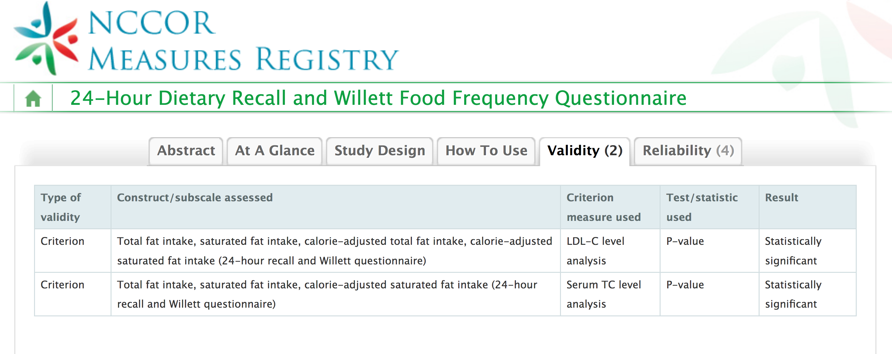
Measurement characteristics and the Measures Registry
Notes:
The Measures Registry can help you locate literature using different methods and tools, as well as information about prior evaluations of those methods and tools. It is important that researchers contemplating the use of a particular measure refer to the original citations to examine how measures were evaluated, in what populations, and the implications for the given study.

Slide 32
Measuring Individual Diet
Notes:
This section provides an overview of the characteristics of commonly-used measures of individual diet.
NOTE: The term, assessment, which “refers to an appraisal or judgment,” can be used to differentiate from measurement, which “involves collecting specific information about an object or event and typically results in the assignment of a number to that observation.” The measurement of dietary intake is typically referred to as assessment. Both terms are used in this presentation.

Slide 33
Measures of individual diet
Measures, an umbrella for:
Methods: e.g., 24-hour dietary recall, food frequency questionnaire, screener
Tools: e.g., Automated Self-Administered 24-hour Dietary Assessment Tool, Diet History Questionnaire, calcium screener
Notes:
Within the Registry, dietary behavior measures are identified as tools and methods used to assess individuals’ diets. For the purpose of the User Guide, methods relate to a particular approach to the collection of dietary behavior (e.g., 24-hour recall, food frequency questionnaire), and tools refer to a particular measure (e.g., Diet History Questionnaire). Many measures within the Registry reflect tools that are variations on the same method.
Measures of dietary behavior differ in terms of the specific dimensions or facets of dietary behavior they are able to capture.
Addressing research questions may require querying the total diet (possibly including vitamin and mineral supplements) or consumption of specific dietary components, such as fruits, vegetables, sugar-sweetened beverages, fat, fiber, or sugar. Further, there may be interest in characterizing diet quality or dietary patterns more holistically, which requires data on the multiple foods and beverages that make up eating patterns.
With respect to specific dietary components, it is salient to consider whether those of interest are consumed regularly by most members of the population of interest or are episodically-consumed. This has implications for assessment in terms of the need to capture multiple days of consumption or a long enough period of time such that consumption days are included.
Additionally, depending on the research question, there may be a need for attention to temporal patterns in consumption at the level of meals, days of the week, seasons, and across the lifecycle.
Finally, contextual factors, such as where foods or beverages are obtained, with whom meals are consumed, where meals are consumed (i.e., at home versus away from home), and the use of electronic devices while eating may be relevant to a given research question.

Slide 34
Objective versus self-report measures
 | Objective measures | Self-report measures
Examples | Recovery biomarkers Observation | 24-hour dietary recalls Food records/diaries Food frequency questionnaires Screeners Measures of related dietary behaviors
Strengths | Provide estimates of true intake for energy and a few nutrients Useful for assessing validity of self-report data | Allow for observation of eating patterns Lower burden and cost and thus, higher feasibility
Weaknesses | Costly and burdensome Do not capture what was actually consumed or context (e.g., where and when) | Prone to measurement error, sources and extent of which vary by method/tool
Areas of development | Discovery of and methods for using: Concentration biomarkers Predictive biomarkers Metabolomics Skin carotenoids | Technological innovations: Self-administered 24-hour recalls Mobile food records/diaries
Notes:
Few objective measures of diet are currently known, and these measures have limited application.
The identification of biomarkers and their application in diet assessment are active areas of inquiry.
Recovery biomarkers are recognized as objective measures of true intake for energy and a few nutrients, including protein, potassium, and sodium. The collection of recovery biomarkers is costly and burdensome for researchers and respondents and not feasible for most studies. Further, recovery biomarkers (and other types of biomarkers) do not provide information on what individuals actually eat and drink, nor contextual factors of salience to understanding how to intervene to shift eating patterns. Their usage for research in which the aim is to examine eating patterns, influences those patterns, and the potential value of interventions for altering them is thus limited. Recovery biomarkers are, however, extremely useful for validation studies to assess error in self-report measures, and they can also be used to reduce error in self-report data when they are available for a study subsample.
Observation represents an additional objective measure of dietary behavior that can be useful for documenting true intake for comparison with self-reporting. Indeed, observational assessments of children’s eating and diet-related behaviors are often used to indicate objective truth for the evaluation of other dietary assessment methods. Researchers either observe participants’ dietary behaviors directly (e.g., videotaping child’s food selection, sitting in a classroom while children eat lunch) or indirectly (e.g., discreetly weighing food containers before and after consumption to calculate precise measurement of food eaten). Importantly, observation can allow measurement of misreporting of foods (unlike recovery biomarkers). For situations in which interest is in intake for the purpose of understanding usual diet and eating patterns, however, the application of observation is limited.
In most research relevant to dietary behaviors, self-report measures are used. This is because it is not possible to objectively assess usual intake in free-living individuals. Depending on the measure, self-report data can also capture temporal patterns and contextual factors that are of interest in many studies. Commonly used self-report methods are outlined in the following slides.

Slide 35
Self-report measures
Categorize broadly as:
Long-term:
Less detailed accounting of intake for a long period
Food frequency questionnaire
24-hour dietary recall
Short-term:
Detailed accounting of intake for a day
or a few days
Screener
Food record/diary
Notes:
Commonly-used self-report measures of intake include 24-hour dietary recalls, food records/diaries, food frequency questionnaires, and brief instruments (often referred to as screeners).
A means of categorizing diet assessment tools is whether they assess short-term or long-term intake.
Tools assessing intake over the short-term include 24-hour recalls and records/diaries, whereas those assessing intake over a longer period include food frequency questionnaires and screeners.
Recalls and records/diaries are intended to capture intake over a day or a number of days.
With food frequency questionnaires and screeners, respondents are prompted to report on their usual intake of a list of foods and drinks, aiming to estimate the frequency of consumption of foods and beverages over a period such as a month or a year, perhaps also with queries regarding typical portion size.

Slide 36
24-hour dietary recalls
Capture a comprehensive and detailed accounting of all foods, beverages, and in some cases, supplements, consumed on a given day
Recalling for a past time period (e.g., yesterday)
Can enable quantification of intake, as well as examination of meal patterns, contextual factors, etc.
Notes:
The 24-hour dietary recall is aimed at capturing a comprehensive and detailed accounting of all foods, beverages consumed on a given day.
The 24-hour recall methodology may also integrate the reporting of vitamin and mineral supplement intake. This may be a separate module that follows the food and beverage recall and prompts respondents to report supplements taken the previous day, along with pertinent details such as the brand, dosage, and amount taken.
In addition to details on foods and beverages, 24-hour recalls can provide insights into patterning of food intake, such as the consumption of meals and between-meal snacks, as well as the distribution of food intake across the day. Probes can be included to capture contextual factors, such as where meals were eaten (e.g., home, school, fast food restaurant) and with whom, the source of the major ingredients for each item consumed, and the use of electronic devices during the consumption of meals and snacks.

Slide 37
24-hour dietary recalls
Multiple passes often used to capture intake comprehensively
Traditionally interviewer-administered
Cost prohibitive for large studies
Technological innovation
Web-based self-administered recalls
Notes:
Traditionally, 24-hour recalls have been administered by an interviewer.
Multiple-pass methods are used to improve accuracy and may be implemented using computerized systems.
For example, the Automated Multiple-Pass Method (AMPM), developed by the U.S. Department of Agriculture (USDA), is a computerized method for interviewer-administered recalls that employs five steps to enhance complete recording as well as reduce burden for respondents.
The steps include a quick list, which is a “mind dump” of all foods and drinks consumed the prior day; a probe for forgotten foods; a time and occasion pass that organizes the foods and drinks according to eating occasion; a detail cycle that probes for details, including how the food or beverage was prepared, the amount consumed, and anything added; and a final probe for anything else consumed, but not yet reported. For the reporting of portion sizes, aids are usually provided. These prompts may include common household items, such as measuring cups and spoons and pictures of food models. In relation to true intake determined by observation, data collected using AMPM have been found to be relatively accurate for energy, protein, carbohydrate, and fat among men regardless of body mass index. AMPM is the method used to collect dietary intake data within What We Eat in America, the dietary component of NHANES.
Other systems, such as the University of Minnesota’s Nutrition Data System for Research (NDSR), also employ multiple-pass methods to enhance the completeness of recalls. AMPM and NDSR offer the advantage of automated coding based on details provided for each food and beverage, eliminating the need for manual coding.
Recalls can also be collected by interviewers using paper or computers or mobile devices, with multiple passes recommended. In this case, manual coding of each item reported is needed to enable linkage to a food composition and other relevant databases. This is labor- and time-intensive and thus, costly.
Technological innovation has led to the development of web-based self-administered recall tools that eliminate the need for trained interviewers and coders:
For example, in the United States, the Automated Self-Administered 24-hour Dietary Assessment Tool (ASA24) has been developed and is freely available to researchers, enabling the collection of recall data in a range of studies. ASA24 adapts the AMPM, with modifications made to facilitate self-administration (e.g., respondents first report meal occasions and related details, such as time and location, move on to report the foods and beverages consumed at each meal, and then complete a detail cycle, followed by forgotten foods).
ASA24 provides the opportunity to collect data across studies using the same tool, lending to data comparison with the potential for building a stronger evidence base that can be synthesized to arrive at important conclusions regarding diet and other factors as well as the potential for interventions to affect diet. With similar tools adapted (ASA24-Canada and ASA24-Australia) or developed (e.g., MyFood24 in the UK) elsewhere, the potential for standardized data can extend beyond borders, facilitating pooling of data or cross-country comparisons.
ASA24 was initially modelled on a recall system developed for children. However, evaluative efforts with technology-based recalls, such as ASA24, used for children are far limited, the age at which children can complete a self-administered recall independently has not been clearly identified.
Prior research has suggested that children may be able to independently complete recalls beginning at the age of 10 years and in NHANES, independent reporting is used beginning at the age of 12 years.
Programs such as ASA24 may help motivate children to report their intake due to their interactive nature. However, the multiple steps in completing recalls may lead to boredom or fatigue regardless of the use of technology.
Efforts to enhance methods of administering 24-hour recalls using technology are being complemented to improve portion size estimation among children. Given that misreporting of portion size can be an important contributor to error, these efforts are likewise important advances and an area for ongoing research.

Slide 38
24-hour recall
Recent diet (repeats → usual intake)
Total diet
Previously cost prohibitive
Culturally neutral
Rely on short-term memory
Rich detail
Notes:
24-hour dietary recalls capture the total diet with rich detail. They are thought to be culturally neutral in that they do no rely on pre-specified food lists.
With interviewer-administration and manual coding, recalls were traditionally cost-prohibitive for most studies. However, this parameter has changed with technological innovation.
Sources of error in 24-recall data include imperfect short-term memory, inaccuracies in portion size estimation, and social desirability biases that may contribute to misreporting of some foods and beverages.
Recalls have been shown to capture dietary intake with less bias than do food frequency questionnaires. Thus, they are recommended for various applications, including ones in which the research question relies on quantitative estimation of intakes among a population or subpopulation.

Slide 39
24-hour dietary recalls
Considerations regarding the number of recalls
Single recall = mean usual intake for a group
Multiple non-consecutive recalls on at least a subsample = distributions of usual intake and related parameters (e.g., proportion below a cutoff)
Account for days of week and seasons in data collection and/or analyses
Notes:
Regarding usual intake, a single recall among a group can provide an estimate of mean usual intake but for estimates related to the distribution of usual intakes (e.g., prevalence below/above a threshold), it is necessary to collect repeat recalls from at least a subsample to enable accounting for day-to-day variation in intake.
For episodically consumed dietary components (e.g., components such as dark-green vegetables that are consumed irregularly by most persons in the target group), it may be necessary to collect additional replicate recalls to achieve a sufficient number of recalls that include that food or nutrient.
For non-episodically consumed components (e.g., components such as refined grains or added sugars that are consumed regularly by most persons in the target group), this is not the case.

Slide 40
Salient considerations for children
Literacy
Cognitive development
Numeracy
Knowledge of food/
food prep
Proxy
Recency/ retention interval
24-hour recall
Notes:
Young children have limited concepts of time as well as limited ability to recall prior food consumption. Recency appears to affect children’s ability to accurately report. As a result, collecting data for the past 24 hours starting from the time at which the recall begins may be preferable to reporting for the prior day, midnight to midnight. ASA24, for example, provides an option for reporting for the past 24 hours.
For young children who are unable to report their own intake, proxy reporting is necessary. The involvement of children is important as they become more independent and parents or other caregivers are not present for all eating occasions. For older children, the involvement of a proxy may be viewed as an intrusion. NHANES uses proxy reporting for children younger than age 6 years, proxy-assisted recalls for children ages 6 to 11 years, and self-report for those ages 12 years and older.

Slide 41
Food records/diaries
Capture a comprehensive and detailed accounting of all foods, beverages, and in some cases, supplements, consumed
Recording in real time, often for 1, 3, or 7 days
Can enable quantification of intake, as well as examination of meal patterns, contextual factors, etc.
Notes:
Similar to 24-hour recalls, food records or diaries (referred to as records subsequently, for simplicity) are intended to capture a detailed account of all foods, beverages, and possibly, supplements consumed on one or more days.
Records are often kept for a period of 1, 3, or 7 days.
Similar to recalls, data from records can provide insights into behaviors such as meal patterns and snacking and contextual factors such as where meals were eaten and with whom and other activities during consumption, such as television watching.

Slide 42
Food records/diaries
Recording form (paper or electronically) with instructions for details to be captured
Estimated or weighed portion sizes
Review of records with participants can help identify and address missing details
Technological innovations
Mobile device-based records
Automated coding using image-based assessment
Notes:
Typically, respondents are given a recording form along with instructions that prompt specific details, such as how each item consumed was prepared.
The completion of records requires literacy and numeracy.
Portion size can be estimated using household measures, pictures, or other aids or respondents may be requested to weigh all items using scales or volume measures.
In some studies, research staff review the completed records with participants to fill in missing details.
Food records have also been affected by technological innovation with the advent of mobile device-based records, which may rely on images taken by the respondent before and after consumption of foods or beverages.
Records require a significant coding effort. Thus, efforts are underway to automate coding using image-based assessment and image recognition.
As capabilities related to image processing and recognition continue to evolve, tools such as the Technology Assisted Dietary Assessment (TADA) have the potential to shift methods of diet assessment with adolescents, who increasingly have access to mobile devices such as smartphones.
Such advances may be useful for improving children’s engagement in dietary assessment, with potential benefits for the accuracy of the data collected. However, ongoing monitoring of the diet using a program on a mobile device may change the dietary patterns that are of interest in a study.

Slide 43
Food record/ diary
Recent diet (repeats → usual intake)
Total diet
Previously cost prohibitive
Culturally neutral
Reactivity possible
Rich detail
Notes:
Records/diaries share many characteristics with recalls.
The distinction between recalls and records is that with a recall, the respondent reports (i.e., recalls, relying on memory) what was consumed yesterday (or over the past 24 hours) whereas with a record, the respondent keeps track of (i.e., records in real time) what he or she consumes.
Data collected using records can be affected by reactivity in that individuals may change their eating behavior in response to tracking or monitoring.
For some intervention studies, this form of self-monitoring and its implications for eating patterns may be the desired effect of the use of food records. However, in studies aiming to capture usual intake, reactivity is a source of error.
As with recalls, data collected using records can be affected by inaccuracies in portion size estimation (if estimated rather than weighed) and social desirability biases likely contribute to misreporting of some foods and beverages.

Slide 44
Food records/diaries
Considerations regarding the number of administrations of records
Single administration (e.g., 1-day or 3-day record) = mean usual intake for a group
Multiple non-consecutive administrations = distributions of usual intake and related parameters (e.g., proportion below a cutoff)
Account for days of week and seasons in data collection and/or analyses
Notes:
As with recalls, regarding usual intake, a single administration (e.g., 1-day or 3-day record) among a group can provide an estimate of mean usual intake; but for estimates related to the distribution of usual intakes (e.g., prevalence below/above a threshold), it is necessary to collect repeat nonconsecutive administrations from at least a subsample to enable accounting for day-to-day variation in intake.
For episodically consumed dietary components (i.e., components such as dark-green vegetables that are consumed irregularly by most persons in the target group), it may be necessary to collect additional replicates to achieve a sufficient number that include that food or nutrient.
For non-episodically consumed components (i.e., components such as refined grains or added sugars that are consumed regularly by most persons in the target group), this is not the case.

Slide 45
Salient considerations for children
Literacy
Cognitive development
Numeracy
Knowledge of food/ food prep
Proxy
Fatigue/ boredom
Food record/ diary
Notes:
Completion of food records requires a minimum level of literacy and the ability to legibly write what was consumed (or to search or browse for foods and beverages, in the case of technology-based approaches). Children must also have some basic knowledge of foods, how they are prepared, and the ability to quantify intake.
For young children who are unable to report their own intake, proxy reporting is necessary. The involvement of children is important as they become more independent and parents or other caregivers are not present for all eating occasions.
The burden associated with the completion of food records/diaries may result in compliance issues. With multiple days of recording, boredom and fatigue are possible. As children get older and become more independent, they may be irritated by the need to record their intake at multiple points throughout the day.
Additional consideration:
The accuracy of dietary records/diaries may be improved with initial training and follow up review and verification of all details with the child or proxy. As with recalls, probes should be phrased in a neutral manner to avoid eliciting social desirability or other forms of bias.

Slide 46
Food frequency questionnaires
Gather information about the frequency with which different foods and beverages are consumed over some period of time, often the last month or year
May prompt for typical or usual portion size, sometimes using images
Questions on supplement usage may be included
Notes:
The aim of food frequency questionnaires is to gather information about the frequency with which different foods and beverages are consumed over some period of time, often the last month or year.
Frequency questionnaires may prompt for typical or usual portion size, sometimes using images intended to facilitate accuracy of reporting.
Questions regarding how often supplements are taken and usual dosages may also be included.

Slide 47
Food frequency questionnaires
Can be lengthy to capture total diet
Require tailoring to the specific target group, based on commonly consumed foods and drinks
Can cause difficulties in comparing findings across studies
Do not capture contextual factors associated with eating occasions
Notes:
Depending on the comprehensiveness of the items included and their representation of the foods consumed by the target group, they may capture total diet or particular aspects of the diet.
A questionnaire aimed at capturing total diet can be lengthy, requiring 30 to 60 minutes to complete.
Given linkage to a food composition database, estimated nutrient intakes can be generated, though these have been shown to be affected by significant bias, at least for energy and the nutrients for which recovery biomarkers have been identified. Thus, estimating mean intake among populations using frequency data is not recommended.
Given that the list of foods and beverages is finite, error can come about if the questionnaire does not appropriately cover items commonly consumed by the target population. Thus, it is important the questionnaire is tailored to the target population. However, this tailoring, resulting in many different food frequency questionnaires for use with different populations, may pose a barrier in terms of comparability across studies and pooling of data.
Unlike the short-term methods, food frequency questionnaires generally do not provide insights into aspects such as patterning of meals and snacks, where foods and beverages are eaten and sourced, other activities engaged in while eating, and similar constructs that may be salient to obesity-related research.
In terms of technology in food frequency questionnaires, this is typically limited to web-based administration.

Slide 48
FFQ
Aim to assess usual diet
May assess total diet
Previously less costly
Require tailoring
Rely on long-term memory
Lack of detail
Notes:
Contributors to error in data collected using food frequency questionnaires include imperfect long-term memory and the cognitive tasks associated with averaging frequency of consumption (and possibly amounts typically consumed) over a period of time such as a month or a year.

Slide 49
Screeners
Brief instruments that capture basic information about particular foods or beverages or other dietary behaviors
May query the frequency of intake of certain foods or beverages
May query typical dietary practices
Notes:
Screeners are brief instruments that enable the collection of basic information about particular foods or beverages or other dietary behaviors.
Screeners may query the frequency of intake of certain foods or beverages and thus may be thought of as short food frequency questionnaires, usually without questions regarding portion sizes.
Alternately, screeners may ask about dietary practices, including routine use of items such as butter on bread.

Slide 50
Screeners
Can be quick to complete
Require tailoring to the specific target group, based on commonly consumed foods and drinks
Can cause difficulties in comparing findings across studies
Do not capture contextual factors associated with eating occasions
Notes:
Similar to food frequency questionnaires, screeners tend to be self-administered. However, they can be very quick to complete (i.e., less than 15 minutes).
Also similar to frequency questionnaires, screeners must be tailored to ensure they capture the main sources of the dietary component(s) of interest.
Information regarding patterning of food consumption and other contextual information are not collected unless queried separately.

Slide 51
Screener
Aim to assess usual intake
Limited aspects of diet
Less costly
Require tailoring
Rely on long-term memory
Lack of detail
Fast
Notes:
Data collected using screeners are affected by similar sources of error as those collected using food frequency questionnaires. They cannot be used to estimate total diet. As with frequency questionnaires, the use of screeners to estimate mean intakes among populations or subpopulations is not recommended.
Screeners may be of particular use for dietary components that are not widely spread through different sources in the food supply, such as sugar-sweetened beverages, whereas they are likely to be less useful in terms of quality of data for components such as fruits and vegetables that can be consumed in many different forms and as part of mixed dishes.

Slide 52
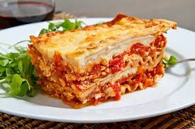
Salient considerations for children
FFQs and screeners are not well-suited due to demands associated with:
Literacy and numeracy
Concepts of time
Memory
Attention span
Understanding of composite foods
Notes:
Given their limitations, food frequency questionnaires and screeners are not likely to be the ideal measures for use with children.
They require literacy and numeracy and the ability to average consumption over time.
Young children have limited concepts of time and concepts of memory that are not fully developed. As a result, questionnaires querying a long period of time are problematic. When they are used, shorter time periods with meaningful start and end dates providing cues to memory may be helpful.
However, even over shorter time periods, children may not have developed the cognitive skills, including recalling recent intake of foods, averaging frequency of consumption over the reference period, taking into account weekday and weekend differences, and seasonal differences in frequency, to complete frequency questionnaires accurately.
The length of some frequency questionnaires may result in boredom and fatigue, leading to poor compliance or reporting quality among youth.
Children may not have a good understanding of composite foods used in such questionnaires.
In addition, when portion size is queried, the use of sizes not tailored to children can potentially result in systematic overestimation of intake.

Slide 53
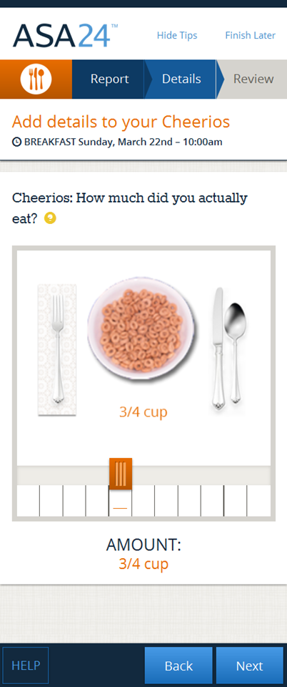
Technology-based measures
Harray et al., Nutrients 2015
https://epi.grants.cancer.gov/asa24/
Notes:
With technological innovation in the assessment of diet, such as web-based 24-hour recalls and mobile food records, it is becoming feasible to collect dietary data in a broader range of studies and settings than previously possible.
Technological developments have been targeted to engage children, in particular, in more accurately self-reporting their diets. For example, recent innovations have incorporated animated avatars or cartoon characters, interactive questionnaires, and the added narratives to engage children during the completion of assessments.
However, technology does not mitigate all of the challenges in accurately assessing diet, and it remains critical to ensure that the measure chosen is well-suited to the research question, the study population, and the setting. Despite innovation, all self-report measures capture intake with error; the type and extent of error is dependent on the tool and its characteristics.
Although the Measures Registry does not categorize methods and tools that incorporate technology, the developments in this area suggest technology as a potential focus of the Registry and a tool in the future.

Slide 54
Technology-based measures
Web- and mobile device-based approaches
Can reduce cost and burden and improve engagement
Capture comprehensive data in a range of studies; more comparable data across studies
Are not a magic bullet
Require computer/mobile device literacy in addition to other requirements related to literacy, numeracy, memory, and potential for reactivity with real-time recording
Notes:
With technological innovation in the assessment of diet, such as web-based 24-hour recalls and mobile food records, it is becoming feasible to collect dietary data in a broader range of studies and settings than previously possible.
Technological developments have been targeted to engage children, in particular, in more accurately self-reporting their diets. For example, recent innovations have incorporated animated avatars or cartoon characters, interactive questionnaires, and the added narratives to engage children during the completion of assessments.
However, technology does not mitigate all of the challenges in accurately assessing diet, and it remains critical to ensure that the measure chosen is well-suited to the research question, the study population, and the setting. Despite innovation, all self-report measures capture intake with error; the type and extent of error is dependent on the tool and its characteristics.
Although the Measures Registry does not categorize methods and tools that incorporate technology, the developments in this area suggest technology as a potential focus of the Registry and a tool in the future.

Slide 55
Other dietary behaviors
Potential complementary measures related to attitudes, perceptions, etc.
Measures vary in length and complexity and may require parental assistance
As with intake, responses may be affected by social desirability biases
Notes:
Questionnaires may be used to identify or assess diet-related behaviors, including responsiveness, enjoyment, preferences, and attitudes toward food; snacking; restrictive behaviors; social pressures and norms surrounding food consumption; and satiety and hunger.
These measures vary greatly in length and complexity, and may require parental assistance if the child does not yet have the cognitive skills to comprehend the content, or if the content has not been tailored to a younger audience.
The use of age-appropriate measures in conjunction with parental perception may be useful in capturing more involved psychological constructs.
Similar to other methods of measurement, questionnaires assessing diet-related behaviors may be influenced by the respondent’s body mass index (or that of the proxy reporter) and social desirability biases.

Slide 56
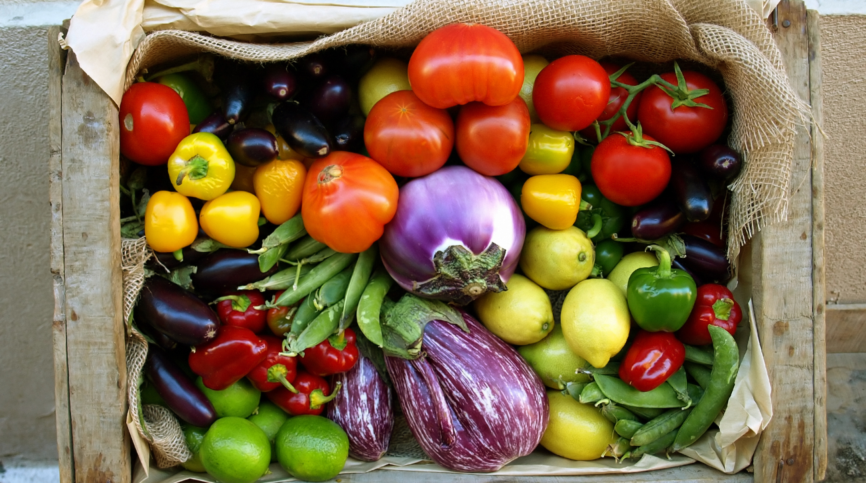
Measurement in Action
Notes:
This section provides an overview of guiding questions to help inform the selection of measures, as well as case studies illustrating measurement in action.

Slide 57
Considerations in selecting measures
Research question
Target population
Study design
Settings
Data collection
Comprehensive or focused
Diet as an exposure, outcome, or covariate
Parameters of interest
Complementary measures
Logistical considerations
Adapted from Sternfeld & Goldberg-Rosas, 2012
Notes:
To assist in selecting the most appropriate measure for assessing dietary behavior, a series of guiding questions are suggested. These questions were informed by a set of questions from Sternfeld and Goldman-Rosas, which aimed to guide the selection of appropriate measures for physical activity and sedentary behavior.
What is the primary research aim or question?
Is the target population made up of infants, toddlers, school-aged children, and/or adolescents?
What is the study design?
In what setting will the research take place and how will this affect possibilities for data collection?
What consumption settings (i.e., places in which food intake occurs) are of interest?
Is the focus on the total diet or on specific dietary components of interest?
Is diet an independent variable, dependent variable, or covariate?
What parameters are of interest?
Are related or complementary measures necessary to address the research question?
What are the logistical considerations and constraints, such as the time allocated to the measurement of dietary behaviors within a larger study, as well as budget and expertise?

Slide 58
Overview of case studies
Influences on diet among population subgroups
Associations between diet quality and markers of disease
Implications of modifications to foods offered for sale in vending machines
Differences in diet quality among subgroups with different rates of obesity
Effects of calorie-labeling on energy intake
Children’s food preferences in relation to advertising
Impact of a body image program on adolescents’ dietary behaviors and intake
Effects of a home-based obesity prevention program on children’s dietary behaviors
Influences on diet among population subgroups
Associations between diet quality and markers of disease
Implications of modifications to foods offered for sale in vending machines
Differences in diet quality among subgroups with different rates of obesity
Effects of calorie-labeling on energy intake
Children’s food preferences in relation to advertising
Impact of a body image program on adolescents’ dietary behaviors and intake
Effects of a home-based obesity prevention program on children’s dietary behaviors
Notes:
The case studies are designed to bring to light different considerations such as:
Diet as an exposure versus outcome
Differential versus non-differential error
Proxy- versus self-reporting
Dietary intake and/or behavior
Comprehensive versus narrow scope of behaviors related to diet

Slide 59
Case Study 1
Case background
Considerations
Measure selection
Estimate average intake and main sources of food groups in relation to sociodemographics; children of varying ages
Notes:
A project team wishes to estimate average intake and main sources of dietary guidance-based food groups among children of varying ages, differentiated by sociodemographic characteristics.
This is a surveillance effort with a large, cross-sectional sample designed to enable estimation among various subgroups.
The intent is to capture all foods and beverages consumed across settings.

Slide 60
Case Study 1
Case background
Considerations
Measure selection
Need quantification of multiple components
Possibility of differential bias
Varying ages
Notes:
A measure that enables quantification of intake with the least bias possible is needed.
The dietary behavior of interest includes intake of multiple dietary components, including food groups such as fruits, vegetables, and dairy products.
Given the varied ages, proxy reporting will be needed for younger children.

Slide 61
Case Study 1
Case background
Considerations
Measure selection
Possibilities:
Interviewer/web-based 24HR
Record or mobile record
Notes:
A measure that enables quantification of intake with the least bias possible is needed, suggesting a short-term measure (such as a 24-hour recall or food record).
The focus on capturing various dietary components rules out screeners, which are also not recommended for estimating mean intakes among populations due to bias (the same is true of food frequency questionnaires).
Need tools that can be completed both by proxy reporters for younger children and by older children themselves, thus, it is important to consider ease of interaction with the interface and burden.

Slide 62
Case Study 1: Summary Table
Examine influences on diet among population subgroups
Type of Case Study | Surveillance
Background | Estimate average intake and main sources of dietary guidance-based food groups among children of varying ages, differentiated by sociodemographic characteristics
Considerations | Need for a measure that can capture various dietary components and estimate mean intakes among populations of varied ages
Measure Selection | Short-term measure (recall or record/diary) preferred for the purpose of quantifying intake with less bias compared to FFQs; a single administration is sufficient for estimating mean intakes

Slide 63
Case Study 2
Case background
Considerations
Measure selection
Elucidate the relation between diet quality of adolescents and proximal markers of disease
Notes:
A project team wants to elucidate the relationship between diet quality of adolescents and proximal markers of disease, such as blood glucose levels or markers of inflammation.
The study is a prospective cohort with a large sample.
The intent is to capture all foods and beverages consumed across settings to enable the characterization of diet quality, for example, using a diet quality index.

Slide 64
Case Study 2
Case background
Considerations
Measure selection
Multiple dietary components
Consider strategies to mitigate error (e.g., multiple measures)
Adolescents: consider burden and potential for boredom
Notes:
The dietary behavior of interest includes intake of multiple dietary components.
Within the context of epidemiologic studies, strategies have been developed to mitigate error in dietary intake data. For example, by collecting multiple measures, one can use a combination of the information to take advantage of the strengths of each instrument.
With adolescents, self-administration is possible, though burden and possibility of boredom should be considered.

Slide 65
Case Study 2
Case background
Considerations
Measure selection
Possibilities:
Web-based 24HR
Mobile record
FFQ
Notes:
Feasible methods include self-administered 24-hour recalls, food records, or food frequency questionnaires. Interviewer-administered recalls would likely be cost-prohibitive, and unless the food record involves technology-enabled automated coding, manual coding would require considerable resource.
This narrows the choices to a self-administered 24-hour recall, mobile device-based (or otherwise automated) food record, or a food frequency questionnaire. A combination of methods could also be used.
Analytic techniques to mitigate error in such cases include regression calibration, which uses data from a reference measure from a calibration sub-study to reduce error in the intake data collected using the main dietary measure for the study. For example, in a study using 24-hour recalls, biomarker data could be collected from a subsample to allow for calibration of the recall data, whereas in a study using food frequency questionnaires, 24-hour recall data may be collected from a subsample to allow for mitigation of bias in the frequency data.
In such studies, food frequency questionnaires traditionally have been used, at least with adults. Food frequency questionnaires need to be tailored to the population of interest and this can limit comparability as well as the potential for pooling and harmonization across studies. Further, food frequency questionnaires may be cognitively difficult for children depending on their age.
With web-based tools, it is possible to use recalls or records either as the main instrument (which is desirable given that short-term data have been shown to be less biased than frequency data) or as a reference instrument for calibration purposes. Recalls and records also offer the advantage of greater comparability across populations and studies given that there is no finite food list.

Slide 66
Case Study 2: Summary Table
Examine associations between diet quality and markers of disease
Type of Case Study | Epidemiologic
Background | Prospective cohort study to investigate the relationship between diet quality of adolescents and proximal markers of disease
Considerations | Short-term measure to quantify intake of multiple dietary components preferred Burden and potential for boredom
Measure Selection | Preferred methods including recalls and records; traditional method is food frequency questionnaire Analytic techniques (e.g., regression calibration) to reduce error

Slide 67
Case Study 3
Case background
Considerations
Measure selection
Assess intake of sugar-sweetened beverages and alternatives before and after changes to vending machine policies
Notes:
A project team wishes to assess intake of sugar-sweetened beverages and alternatives before and after changes to vending machine policies in an institution, such as a school, university, workplace, or recreation center.
This is an intervention study involving swapping out of energy-dense choices in vending machines for more nutrient-dense options, including replacing sodas and energy drinks with water.

Slide 68
Case Study 3
Case background
Considerations
Measure selection
SSBs only or total diet more broadly
Quantification versus frequency
Self- versus proxy-reporting
Intervention-related biases?
Notes:
The dietary behavior of interest could be conceptualized narrowly as intake of snacks and beverages, or broadly as the total diet. This approach would enable characterization of how the intervention relates to changes (if any) in sugar intake overall or diet quality more holistically. For example, reductions in soda consumption may be offset by increases in juice intake or possibly in other foods or beverages.
In addition, intake could be conceptualized either as quantitative estimates, requiring querying amounts consumed, or frequency of consumption of energy-dense snacks and beverages.
Depending on the target population in the institution of interest, investigators will need to consider whether self-reporting is possible. This consideration will affect which measures can be selected. For example, self-administration is not possible for younger children.
In this project, dietary intake is the outcome, and the study design is an intervention. As a result, respondents could potentially report differently after the intervention due to exposure to the intervention itself. However, given the environmental focus of the intervention (as opposed to nutrition education or counseling about reducing intake of energy-dense foods), this matter is not as salient of an issue unless the intervention is accompanied by an intensive marketing campaign.

Slide 69
Case Study 3
Case background
Considerations
Measure selection
Possibilities:
Narrow: screener
Broad: 24HR, record, FFQ
Consider complementary data sources
Notes:
If the project team chooses a narrower focus, screeners could be used, which would reduce team and respondent burden but increase bias. This bias may be less of an issue for items like sugar-sweetened beverages than for other dietary components (e.g., sugars, fruits and vegetables) that are distributed throughout many contributing food and beverage sources. Screeners may be difficult for children, depending on cognitive abilities to average intake over a long period of time.
If the team chooses a broader focus, a more comprehensive tool, such as 24-hour dietary recalls, food records, or food frequency questionnaire, is needed as such a tool allows interrogation of different aspects of the diet.
To address the potential for intervention-related biases in reporting, the project team could complement the intake data with sales data from the vending machines. However, these data would be limited to the single setting in which the vending machines were modified, not to changes in consumption behaviors more broadly.

Slide 70
Case Study 3: Summary Table
Examine implications of modifications to foods offered for sale in vending machines within an institution
Type of Case Study | Intervention
Background | Assess intake of sugar-sweetened beverages and alternatives before and after changes to vending machine policies
Considerations | The dietary behavior of interest could be conceptualized narrowly or broadly, and the target population will influence the measure to be selected
Measure Selection | Depends on focus: narrower (screener possible) or broader (24-hour dietary recalls, food records, or food frequency questionnaire possible) with different implications for burden, bias, etc.

Slide 71
Case Study 4
Case background
Considerations
Measure selection
Assess the effects of a home-based obesity prevention program on pre-school children’s dietary behaviors
Notes:
A project team is interested in examining the effects of a home-based obesity prevention program on pre-school children’s meal and snacking behaviors.
This case is an intervention study with control and intervention groups.
The control group receives minimal exposure to the study team (including nutritionists), whereas the intervention group receives intensive programming related to healthy eating patterns, parenting, and other potential influences on dietary intake among children and the family, as a whole.

Slide 72
Case Study 4
Case background
Considerations
Measure selection
Proxy-reporting is needed
Potential intervention-related biases
Notes:
Given that the target population is pre-school children (and their parents and families), any questionnaires of general behaviors (e.g., frequency of snacking) or specific intake need to be completed by proxy-reporters, with necessary considerations regarding error in reporting.
With this intervention design, parents may report their children’s diets differently as a result of being exposed to the intervention than they did at baseline. Thus, complementary measures, such as in-home observation, may be beneficial to provide a means of corroborating (or not) changes in meal and snacking patterns from pre to post.

Slide 73
Case Study 4
Case background
Considerations
Measure selection
Possibilities:
Questionnaire re: meal/snacking behaviors
Dietary intake (24HR, FFQ)
In-home observations
Notes:
The diet behaviors of interest could be conceptualized as patterns, in terms of meals and snacks (e.g., frequency of between-meal snacks), which could be measured using a questionnaire querying these specific behaviors to be completed by the parent or other proxy reporter.
Alternately, with more intensive measures such as 24-hour recalls and records, the foods consumed at different meals and snacks and contextual factors, such as with whom the child ate and whether he or she was using an electronic device (e.g., eating a snack in front of the television) could be considered.
With a food frequency questionnaire, the foods consumed over a period of time (before and after the intervention) could be assessed but contextual factors could not.
Finally, home observation could be used, with trained interviewers documenting meal and snack behaviors during times at which they are present in the home, though this approach is intensive and burdensome.

Slide 74
Case Study 4: Summary Table
Assess the effects of a home-based obesity prevention program on pre-school children’s dietary behaviors
Type of Case Study | Intervention
Background | Assess impact of home-based obesity prevention program on pre-school children’s meal and snacking behaviors
Considerations | Questionnaires need to be completed by proxy-reporters/parents, who may report their children’s diets differently following the intervention compared to baseline
Measure Selection | Dietary behaviors of interest could be conceptualized as patterns (e.g., meal and snack timing) and captured by a questionnaire Collection of intake data using 24-hour recalls and records or a food-frequency questionnaire would allow more intensive analysis Home observation could be used to capture behaviors

Slide 75
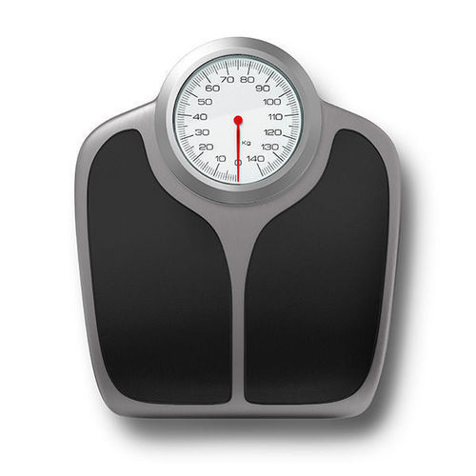
Case Study 5
Case background
Considerations
Measure selection
Assess differences in diet quality among subgroups with different rates of obesity (using NHANES data)
Notes:
A project team desires to assess whether diet quality differs among adolescent children with varying rates of obesity who are from different racial and ethnic subpopulations.
The study makes use of NHANES data.

Slide 76
Case Study 5
Case background
Considerations
Measure selection
Body weight strongly associated with misreporting
→ Differential misreporting
Notes:
This case highlights that the team will need to take various considerations into account when comparing the dietary intake of groups that are differentiated by factors potentially related to body weight.
Because body weight is strongly associated with misreporting, any such analyses must be undertaken and interpreted cautiously.
It is necessary to consider differential reporting among populations grouped by factors potentially related to body weight (e.g., race/ethnicity).

Slide 77
Case Study 5
Case background
Considerations
Measure selection
Measure is predetermined (24HR)
Need to interpret comparisons across groups carefully
Notes:
Since NHANES data are being used in this study, the measure is predetermined (24-hour recalls).
However, in interpreting results and analyzing these data, it is important to consider the previously mentioned differential reporting of BMI across groups.

Slide 78
Case Study 5: Summary Table
Assess differences in diet quality among subgroups with different rates of obesity
Type of Case Study | Surveillance
Background | Use NHANES data to assess whether diet quality differs among adolescent children with varying rates of obesity who are from different racial and ethnic subpopulations
Considerations | Since body weight is associated with misreporting, the team will need to interpret the analyses cautiously
Measure Selection | NHANES data are collected using 24-hour recalls (pre-determined for this illustration of possible differential error across groups)

Slide 79
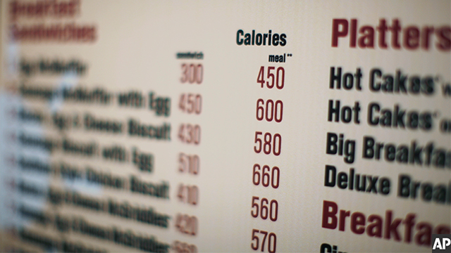
Case Study 6
Case background
Considerations
Measure selection
Evaluate the effects of calorie labeling on energy intake
Notes:
A project team wishes to examine whether adolescents change their calorie intakes when calorie labeling is instituted, for example, in a cafeteria.
This case is a natural experiment, intended to illustrate the caveats related to measuring calorie intake using self-report data.

Slide 80
Case Study 6
Case background
Considerations
Measure selection
Self-report data should not be used for absolute estimates of energy
Notes:
Given the known biases with self-report data, it is generally recommended that they not be used to arrive at absolute estimates of energy.

Slide 81
Case Study 6
Case background
Considerations
Measure selection
Possibilities:
Intercept surveys, sales data
Broader measure of dietary intake
Notes:
Researchers could potentially use other measures to assess energy intake, such as:
Intercept surveys
Sales data
It is also possible to measure dietary intake more broadly to allow assessment of implications for overall diet quality.

Slide 82
Case Study 6: Summary Table
Evaluate the effects of calorie-labeling on energy intake
Type of Case Study | Natural experiment
Background | Examine whether people change their caloric intake after implementation of menu calorie-labeling
Considerations | Self-reported data are not recommended to arrive at absolute estimates of energy
Measure Selection | Potential intercept surveys, sales data to assess effects of labeling on purchasing Dietary intake measures to assess implications for diet quality more broadly

Slide 83
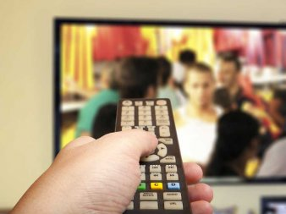
Case Study 7
Case background
Considerations
Measure selection
Assess children’s food preferences in relation to advertising
Notes:
A project team sets out to assess the preferences of preschool children for fruits, vegetables, and snacks after they were exposed to food advertising of different types of foods, with and without cartoon characters and celebrities.
The study is a cross-sectional experimental design with control and comparison groups. Recruitment and study collection occur in a childcare center. Children are invited to play a video game on an iPad that features or does not feature cartoon character or celebrity endorsements related to food.
The diet behavior of interest, food preferences, is the dependent variable.

Slide 84
Case Study 7
Case background
Considerations
Measure selection
Age of children
Notes:
Given the age of the children, a questionnaire regarding food preferences is not feasible.

Slide 85
Case Study 7
Case background
Considerations
Measure selection
Possibilities:
Assess choice using photos of foods or types of snacks
Feeding study
Notes:
Given the age of the children, a questionnaire regarding food preferences is not feasible, though they could be prompted to choose between photos of different types of foods, indicating the one they would choose out of dyads differentiated by energy- and nutrient-density.
Alternatively, children may be offered different snacks (fruit, vegetables, and other snacks, some of which were highlighted by the cartoon characters or celebrities), with weighing of snacks served and left over (i.e., plate waste) so that intake can be quantified as an indicator of preferences.

Slide 86
Case Study 7: Summary Table
Title: Study to assess children’s food preferences in relation to advertising
Type of Case Study | Intervention
Background | Assess the preferences of preschool children for fruits, vegetables, and snacks after exposure to food advertising of different types of foods, with and without cartoon characters and celebrities
Considerations | A questionnaire regarding food preferences is not feasible for the age group
Measure Selection | Use photos to assess preferences Offer children different snacks and infer preferences using documented intake

Slide 87
Case Study 8
Case background
Considerations
Measure selection
Assess the impact of a body image program on adolescents’ dietary behaviors and intake
Notes:
The primary aim of this study is to assess changes in diet-related behaviors and intake before and after the implementation of an intervention to improve body image.
This case is included to illustrate the potential impact of social desirability on youth’s reporting of dietary intake and reasons this should be considered in analyses and interpretation of findings.

Slide 88
Case Study 8
Case background
Considerations
Measure selection
Concerns surrounding body image become a greater issue with increasing age
Notes:
Older children and adolescents have greater concerns surrounding body image as compared to younger children.
Among adolescents, it is important to consider the role of social desirability in reporting of diet-related behaviors and intake since social desirability bias may be associated with body image.

Slide 89
Case Study 8
Case background
Considerations
Measure selection
Include a measure of social desirability bias
Stratify analyses if reporting of diet differs by social desirability
Notes:
To account for social desirability bias, researchers may assess this construct using established measures and stratify diet-related analyses by social desirability categories.
If reporting of diet differs by social desirability, it should be considered in the analysis of the intervention’s effectiveness.

Slide 90
Case Study 8: Summary Table
Title: Study to assess the impact of a body image-based program on adolescents’ dietary behaviors and intake.
Type of Case Study | Intervention
Background | Assess changes in diet-related behaviors and intake before and after an intervention to improve body image
Considerations | Concerns surrounding body image increase with age and may affect reporting
Measure Selection | Use a measure of social desirability and stratify analyses

Slide 91
Additional Considerations

Slide 92
Improving the quality of dietary data
Ensure tools are tailored to the specific target group
Use proxy- or proxy-assisted reporting for young children
Provide clear instructions, complemented by hands-on training if necessary
Allow adequate time for completion
Pay attention and aim to minimize and account for social desirability bias
Be attentive to potential for boredom
Take advantage of technology, if applicable to increase engagement
Notes:
For any population, choosing the best possible measure is the first step to ensuring the highest quality data.
For studies specific to children, the following strategies may be considered in implementing the measure to reduce bias to the extent possible:
Ensure tools are tailored to the specific target group in terms of demands related to attention span, literacy, and numeracy.
Provide clear instructions, complemented by hands-on training if necessary. This extends to proxy reporters in studies in which children cannot report independently.
Allow adequate time for completion, recognizing that children may need more time to work through steps (e.g., multiple-pass recall) than adults, due to less mature cognitive skills.
Use techniques to reduce social desirability bias, such as using neutral probing and querying an array of food and drink items rather than focusing narrowly on specific items of interest, particularly when these may be perceived as unhealthy (e.g., sugar-sweetened beverages).
Be attentive to potential for boredom and thus, low compliance.
Take advantage of technology, if applicable to the target group. However, it is critical to consider that although technology can overcome some challenges associated with traditional approaches to data collection, such as reduced researcher and respondent burden, it may introduce new challenges related to internet connectivity or computer literacy.
Be aware of potential sources of error and interpret and report the data accordingly!

Slide 93
Food and nutrient databases
Quantifying intake of foods, food groups, and nutrients requires linkage to databases
Quality of databases, including currency and comprehensiveness, should be considered in analyses and interpretation of findings
Notes:
Also of importance are databases linked to measures of dietary intake to arrive at estimates of nutrient and food consumption.
These databases should be current and comprehensive, to the greatest extent possible, given that this occurrence is usually out of the control of researchers.
Key limitations for the estimation of certain dietary components should be outlined when reporting research results.

Slide 94
Considerations in analyzing data
Minimizing the effects of measurement error requires appropriate analyses:
Surveillance: estimation of usual intake distributions, accounting for day-to-day variation
Epidemiology: regression calibration, using data for a subsample collected using a reference measure to capture intake with less bias than the main measure, to mitigate the effects of error
Possible use of biomarker data in conjunction with self-report data
Notes:
Measure selection is critically important but is only one part of the process in terms of research related to dietary behavior.
Considerations for how data will be analyzed should come into play early in the study design process. This practice is fundamental due to interconnections between the most appropriate analyses to arrive at the desired estimates, the measures used, and parameters for their administration (e.g., number of repeat measures of short-term instruments, timing of repeat measures within an intervention study, incorporation of biomarkers).
Detailed recommendations regarding the collection and analyses of dietary data for different types of studies are outlined in the National Cancer Institute’s (NCI’s) Dietary Assessment Primer. For example, the Primer notes consider whether or not addressing the research question of interest requires estimation of usual intake distributions. If so, it is necessary to collect repeat recalls on at least a subsample of the target population and to conduct statistical modelling to account for day-to-day variation. In cohort studies aimed at enabling analyses between dietary exposures and outcomes, it is advisable to collect data using a recovery biomarker if possible, or a less-biased self-report measure compared to the main dietary instrument, among a subsample. Data from this calibration sub-study can then be used to conduct regression calibration to reduce error in data from the main dietary instrument. For epidemiologic studies, collecting concentration biomarker data also may be helpful in mitigating error. In intervention studies, it is important to consider the potential for differential biases in that those exposed to some intervention designed to alter eating patterns may misreport diet differently than those who were not exposed. Means of dealing with differential bias are not well developed. Thus, it is advisable to collect objective measures to corroborate dietary intake data whenever possible within intervention studies. This differential error can also come into play in observational studies in which groups compared differ with respect to factors that might affect reporting error.
Consulting the Dietary Assessment Primer in combination with the Measures Registry can help researchers identify the broad range of considerations that should be taken into account when planning a study, choosing measures, and analyzing and interpreting data.

Slide 95
Putting it all together!

Slide 96
Key messages
Diet is complex and so is dietary assessment
Choosing the best possible measure of diet requires weighing many considerations, including those salient to children
Using the Registry and other resources to inform measure selection → a more cohesive evidence base
Notes:
Dietary behavior and its measurement are incredibly complex. However, measuring dietary behaviors can provide useful information on their associations with other factors related to childhood obesity and how these behaviors are influenced by interventions.
Currently, a range of different tools are used in nutrition research with relevance to childhood obesity. This variability, combined with the use of tools that may not be optimal for the purpose and population, hinders the development of a cohesive evidence base to inform policies and programs for reducing childhood obesity.
To further this area of research, it is critical to use the best possible methods, along with appropriate analysis, interpretation, and reporting. This Guide, along with other resources highlighted, is intended to help with this goal.
Selection of measures will involve weighing various considerations, including logistical considerations that may limit the feasibility of some measures in particular environments or populations, with the overall aim of arriving at the best measure for the given research study. The use of the Measures Registry along with this User Guide can also contribute to a greater standardization of measures, with positive implications for study comparison, potential for pooling of data to address questions that might not be feasible within any given study, and syntheses of evidence to inform interventions.
As noted throughout this presentation, assessing dietary behavior in children requires attention to unique considerations, such as cognitive abilities, that must be accounted for in the selection and implementation of a measure.
Improving methods of dietary assessment remains an active area of inquiry and this extends to research with children. Enhancing existing methods using technology is an area that will undoubtedly continue to develop, with implications for reducing respondent burden and more effectively engaging children.

Slide 97
Additional considerations
Consult colleagues with expertise in dietary assessment
Get advice on appropriate analytic techniques from a statistician
Interpret findings in light of what is known about dietary data
Clearly report methods to ensure research is replicable and interpretable
Notes:
Take advantage of expertise in dietary assessment among colleagues or take the opportunity to reach out to those working to advance this area.
Further, beyond data collection, it is essential that the dietary data are analyzed and interpreted appropriately and within the context of the existing evidence on dietary assessment. Early in the research process, researchers should carefully consider the measures to be utilized for all variables and collaborate with statisticians. This helps to ensure that data are collected, analyzed, and interpreted in a way that lends to the most robust evidence possible for informing obesity prevention efforts.
In interpreting the results of studies making use of measures of dietary behavior, it is key that measurement error, which is unavoidable in self-report measures, and its implications for study results are considered and discussed.
Despite the fact that error implicit in the measurement of dietary intake among children has been long recognized, this factor is often not indicated when data are reported and inferences based upon them made. This can lead to a confusing and contradictory body of literature.
In the context of obesity, it is critical to consider potential interactions between body weight, or factors linked with body weight, and self-reporting of dietary behavior and the potential implications for the results (as well as whether a particular analysis is advisable given the likelihood of differential bias).
In developing publications to share research findings, attention to the Strengthening the Reporting of Observational Studies in Epidemiology–Nutritional Epidemiology (STROBE-nut) guidelines (http://www.strobe-nut.org) may assist in achieving improved transparency in terms of measures used, how they were administered, their psychometric properties in relation to the target population, and other salient issues necessary for the critical appraisal of any study making use of dietary behavior measures.

Slide 98
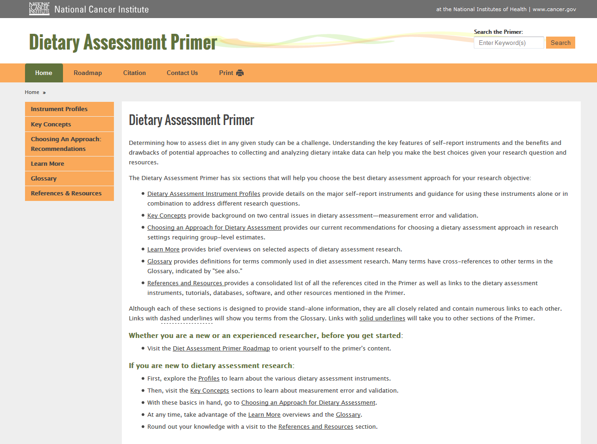
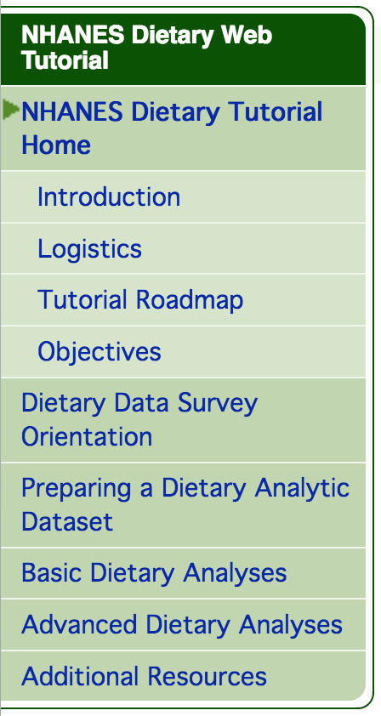
Selected additional resources

Slide 99
Select additional resources
National Cancer Institute:
Dietary Assessment Primer https://dietassessmentprimer.cancer.gov/
Measurement Error Webinar Series http://epi.grants.cancer.gov/events/measurement-error/
CDC:
NHANES Dietary Tutorial (basic & advanced) http://www.cdc.gov/nchs/tutorials/dietary/
Notes:
Additional resources are outlined in the User Guide.

Slide 100
Questions?
For More Information:
http://nccor.org/tools-mruserguides/individual-diet/introduction/
nccor@fhi360.org

