Slide 1

National Collaborative on Childhood Obesity Research
Title of presentation
DATE
NAME
Title
Funder/Organization

Slide 2

Overview
Childhood obesity:
A changing landscape
NCCOR: A strategic, innovative
approach to making progress
Projects advancing the field
  NCCOR tools
  Key activities
Exploring new frontiers
NCCOR’s reach
Notes:
Today, I will discuss:
Childhood obesity and the changing landscape; and
NCCOR’s strategic, innovative approach to making progress. We will provide an overview of NCCOR and particularly focus on what makes it unique.
I will also share some NCCOR projects advancing the field, touching on some of NCCOR’s resources. I will unpack NCCOR’s latest focus on exploring new frontiers and highlight emerging areas of interest, including the study of childhood obesity declines, healthy food incentives, and lessons learned from global efforts.

Slide 3
Notes:
Childhood obesity is an epidemic. More than 1 in 3 children is considered obese or overweight by age 5.

Slide 4
Notes:
Though after 30 years of increases in childhood obesity, we’re seeing signs of a turnaround.
We’re seeing declines in some areas, but the declines are not equal across groups and in some cases there may be increasing disparities.

Slide 5
Notes:
NCCOR wants to build on the momentum brought on by the declines and ultimately reverse the childhood obesity epidemic.
To do this, we need evidence.

Slide 6
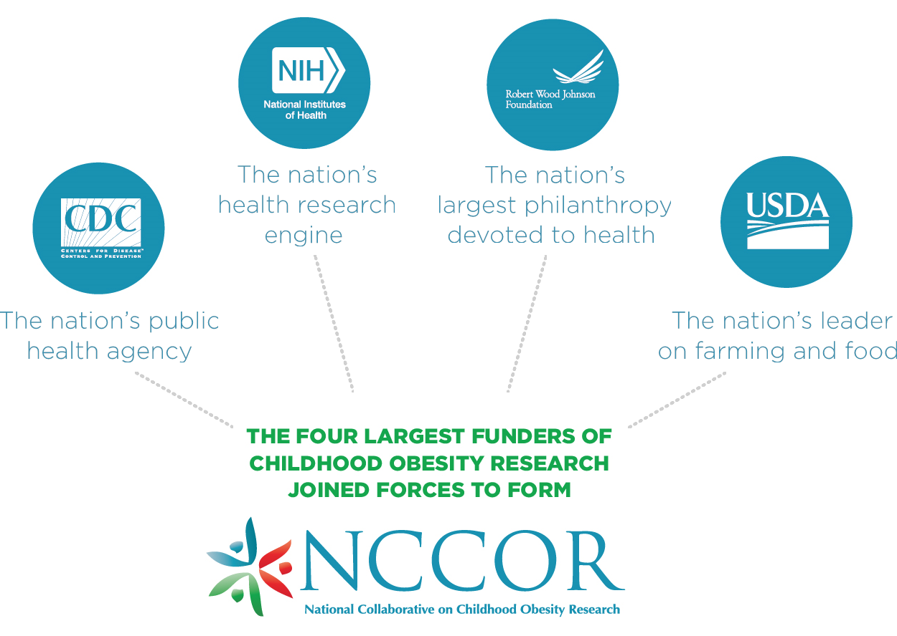
Notes:
NCCOR includes four of the largest funders of childhood obesity research.

Slide 7
NCCOR Steering Committee
CDC
  Laura Kettel Kahn, PhD, MIM
  Lisa McGuire, PhD
NIH
  Rachel Ballard, MD, MPH
  Deborah Young-Hyman, PhD
RWJF
  Laura Leviton, PhD
  Tracy Orleans, PhD
USDA
  Jerold Mande, MPH
  Jay Variyam, PhD

Slide 8
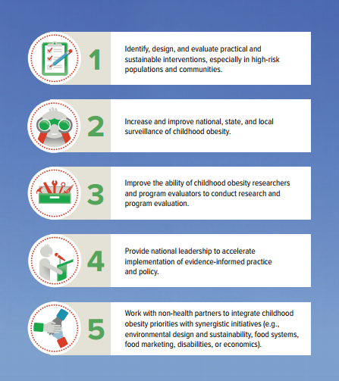
NCCOR Goals
To accomplish its mission, NCCOR’s projects and activities align with one or more of its five goal areas.

Slide 9
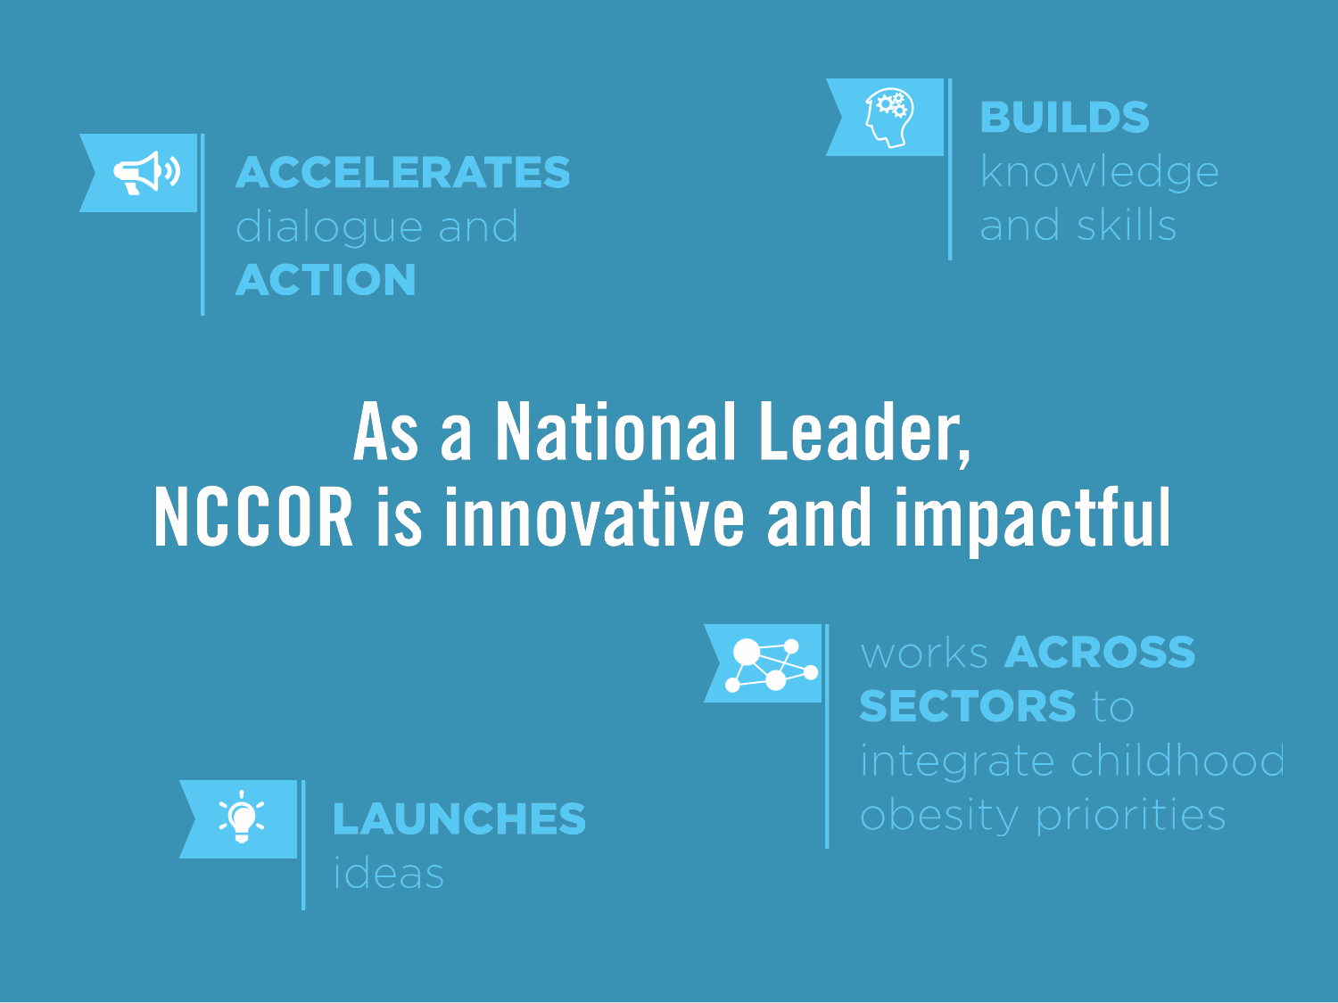
Notes:
These leading national organizations work in tandem to:
Manage projects and reach common goals;
Combine funding to make the most of available resources; and
Share insights and expertise to strengthen research.
Importantly, this collaborative model offers the unique ability for joint strategic planning that is flexible, responsive, and quick to action.
Through this model, NCCOR focuses on :
Building the knowledge-base through research, evaluation, and surveillance;
Spurring action with tools that support scientists in their work; and
Creating synergies with non-health initiatives.

Slide 10
Notes:
How do we make progress?
NCCOR’s funders contribute four types of capital in flexible combination to carry out projects that have an impact.

Slide 11
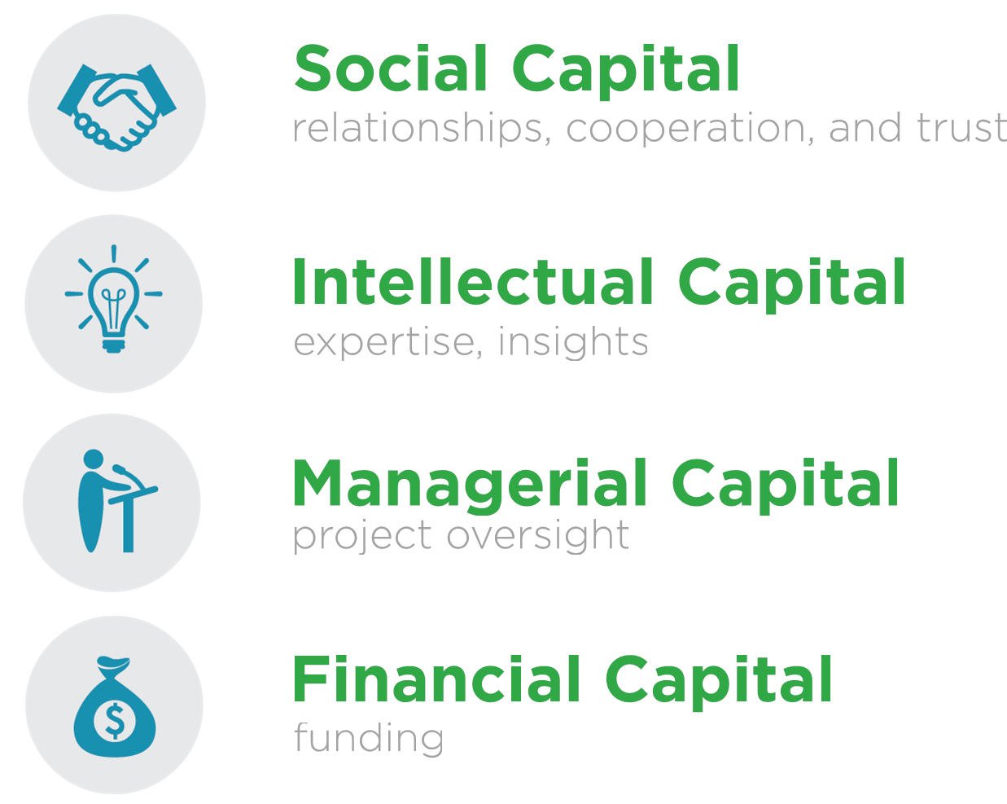
Notes:
Here are the four types of capital I’m referring to—Intellectual, managerial, and financial. And social capital, the relationships, cooperation, and trust we’ve established, serves as the base.

Slide 12
Notes:
During today’s presentation I would like to highlight some of the ways that NCCOR can support scientists with tools that amplify work and findings.

Slide 13
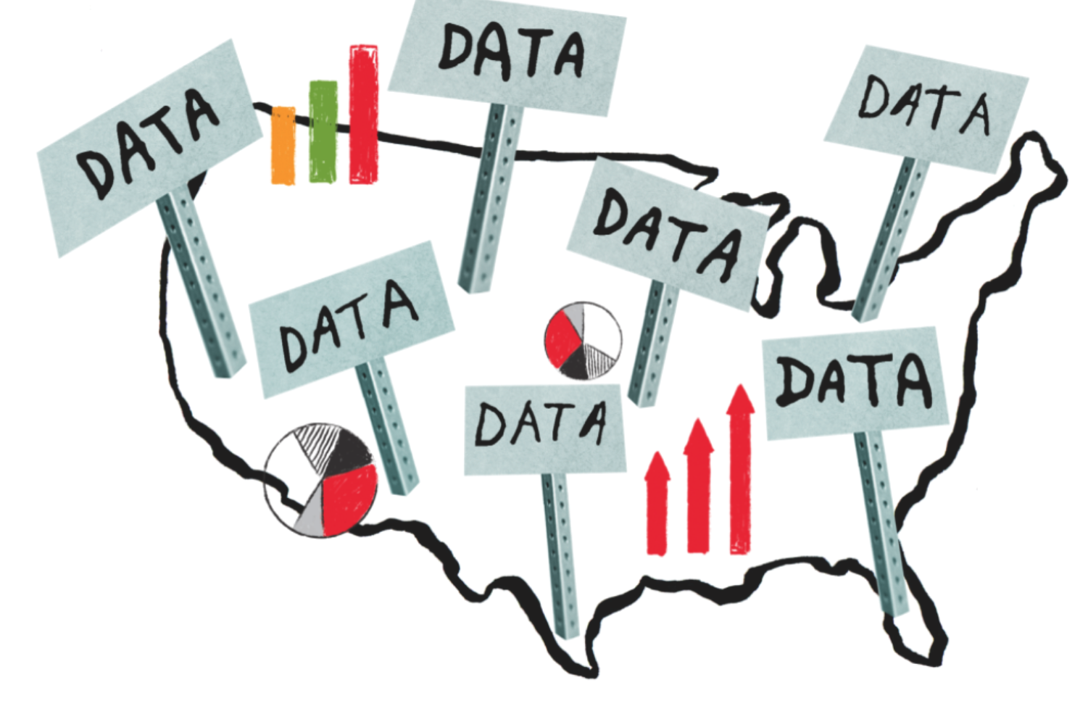
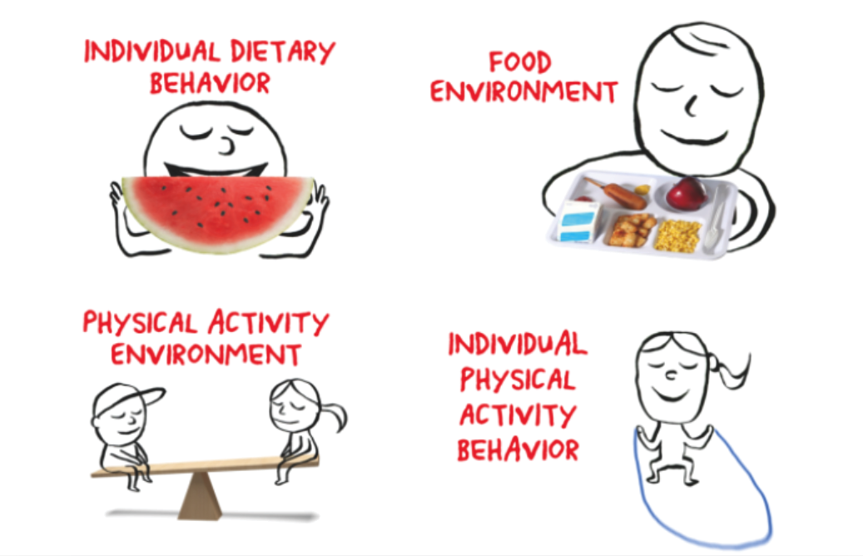
NCCOR created the
Available online at www.nccor.org/nccor-tools
Notes:
These tools include the Catalogue of Surveillance Systems and the Measures Registry. Both launched in 2011 and aim to provide standardization and comparability of measures and systems for the field.

Slide 14
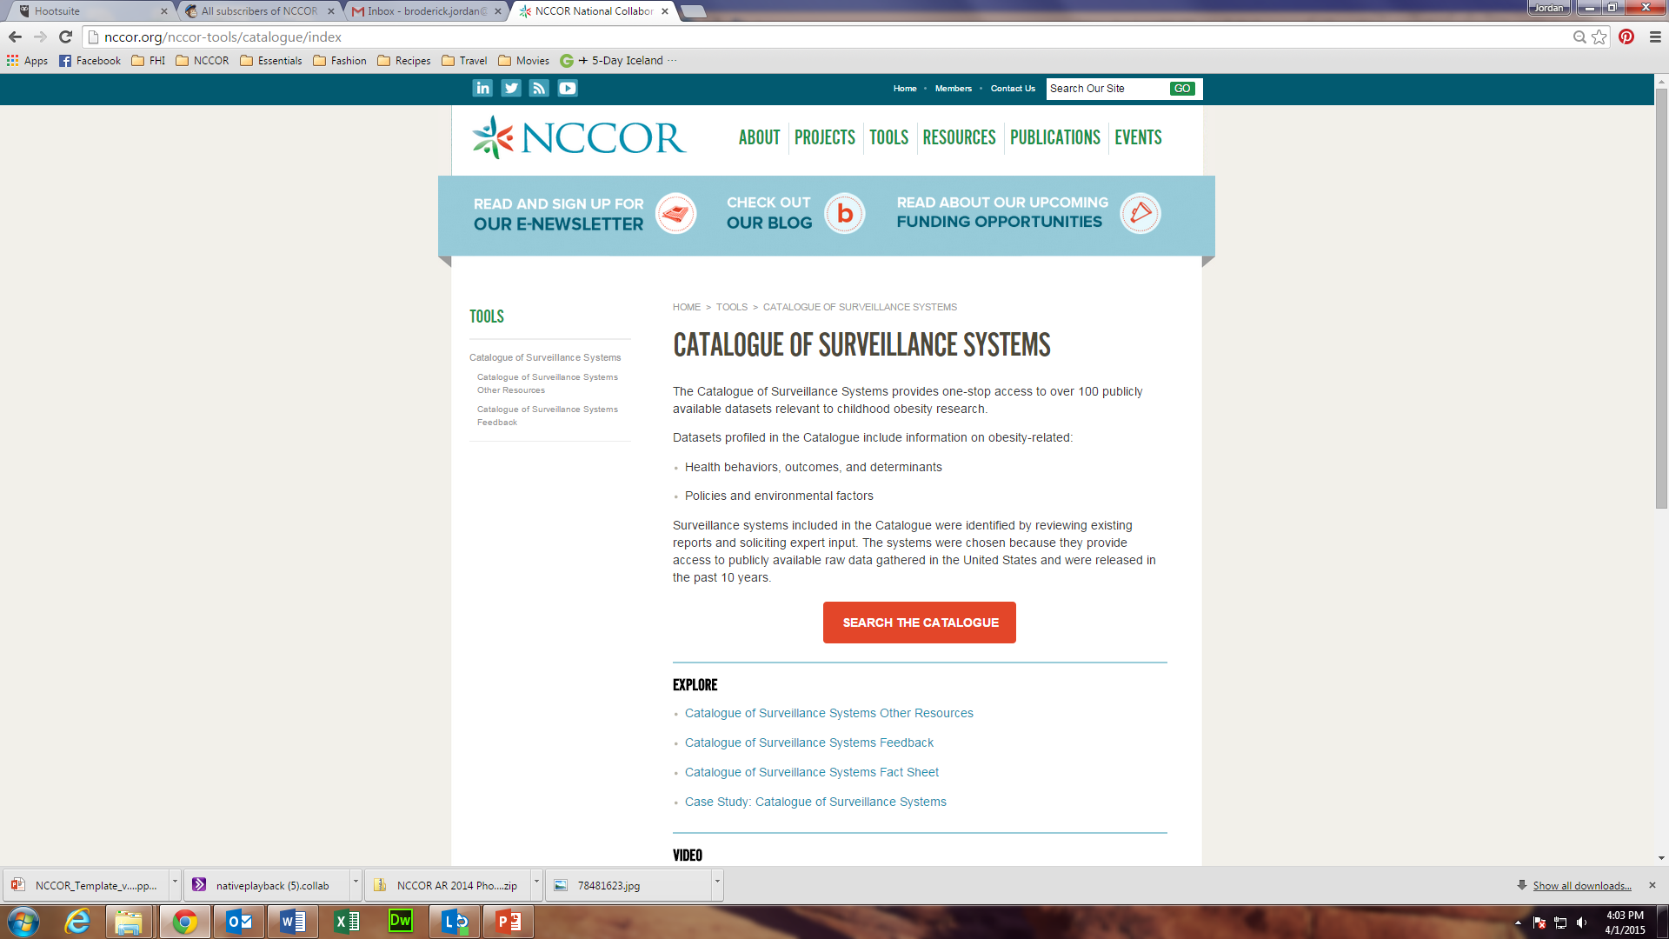
Notes:
The Catalogue of Surveillance Systems can be accessed by going to the Tools tab on the NCCOR website.
The Catalogue provides one-stop access to more than 100 federal, state, academic, and private sector data resources related to health behaviors, outcomes, and determinants of obesity.
The Catalogue also contains systems that track environmental and policy factors.

Slide 15

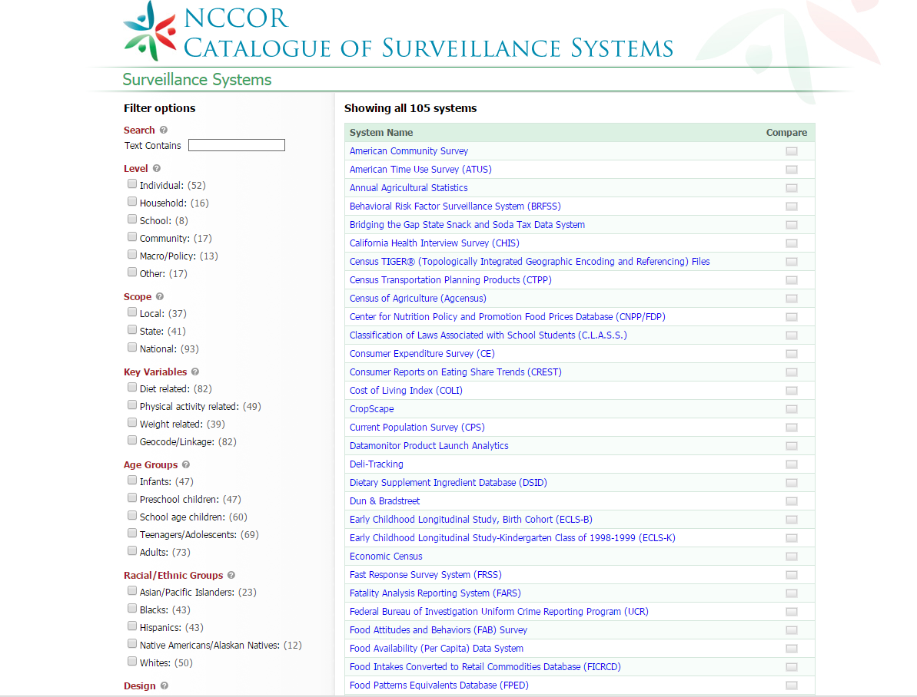
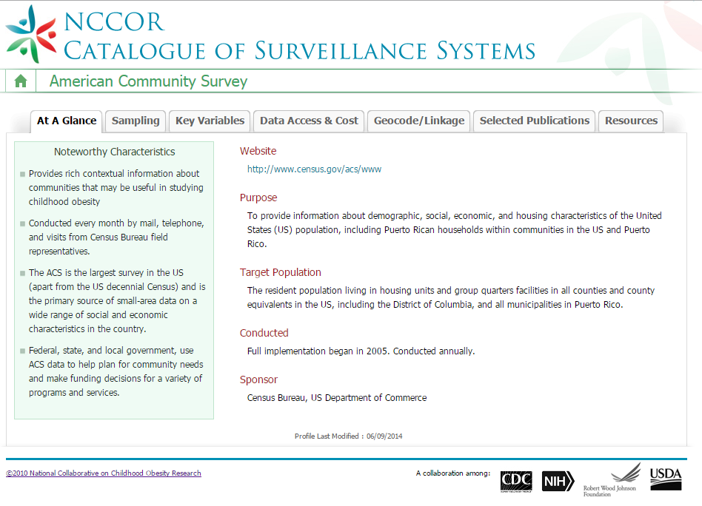
Notes:
The Catalogue offers a number of filtering options based on your research needs, including:
level of surveillance, scope, key variables, age groups, racial ethnic group, and study design.
In addition, it provides detailed information on each surveillance systems, including:
key characteristics, sampling method, variables, geocode linkage, selected publications, and related resources.

Slide 16
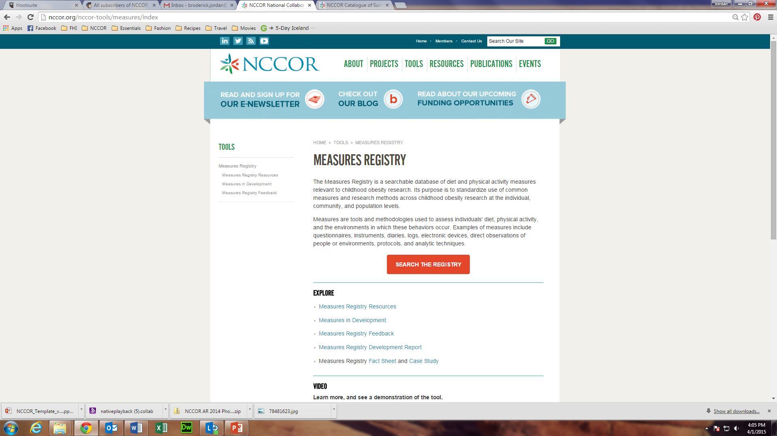
Notes:
The Measures Registry can also be accessed through the Tools tab on our website.
The Measures Registry is a web-based portfolio with more than 1,000 measures related to diet and physical activity.
The tool allows researchers to more efficiently find and select measures based on certain characteristics.

Slide 17
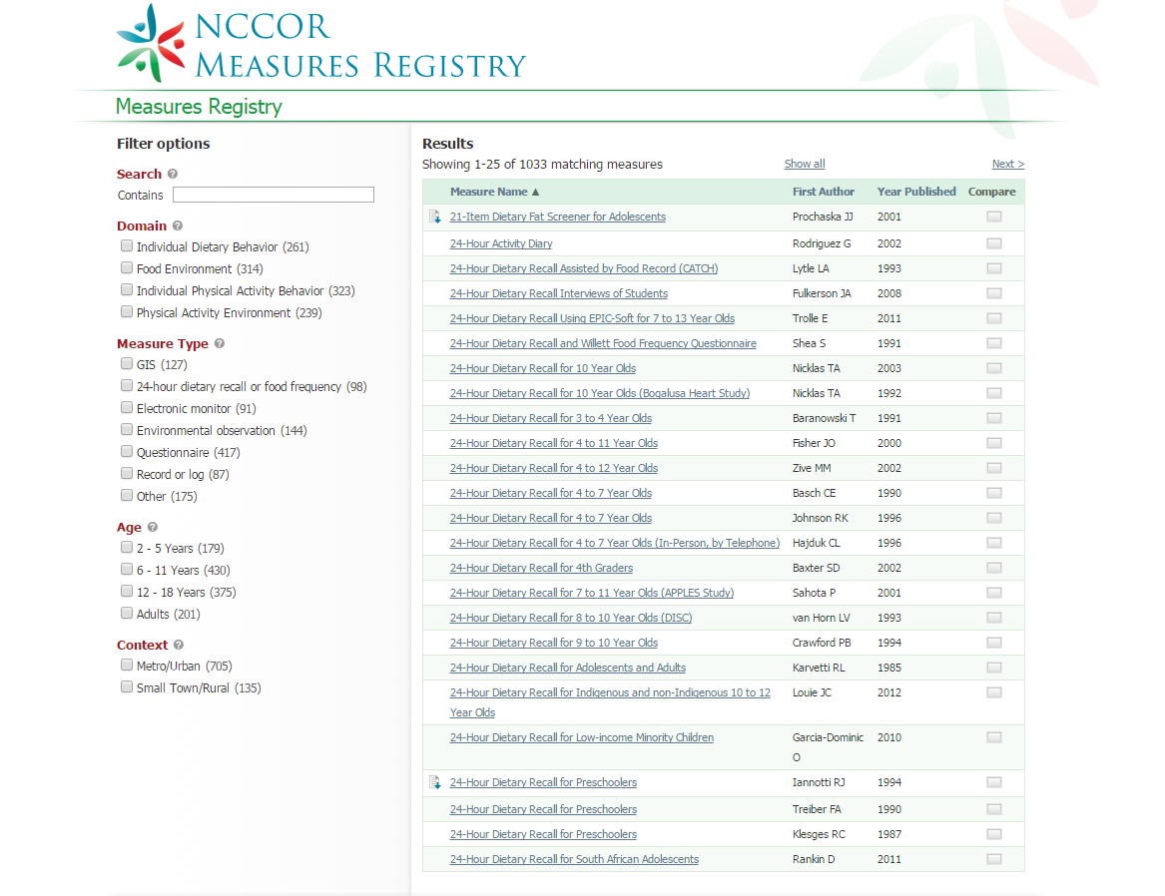
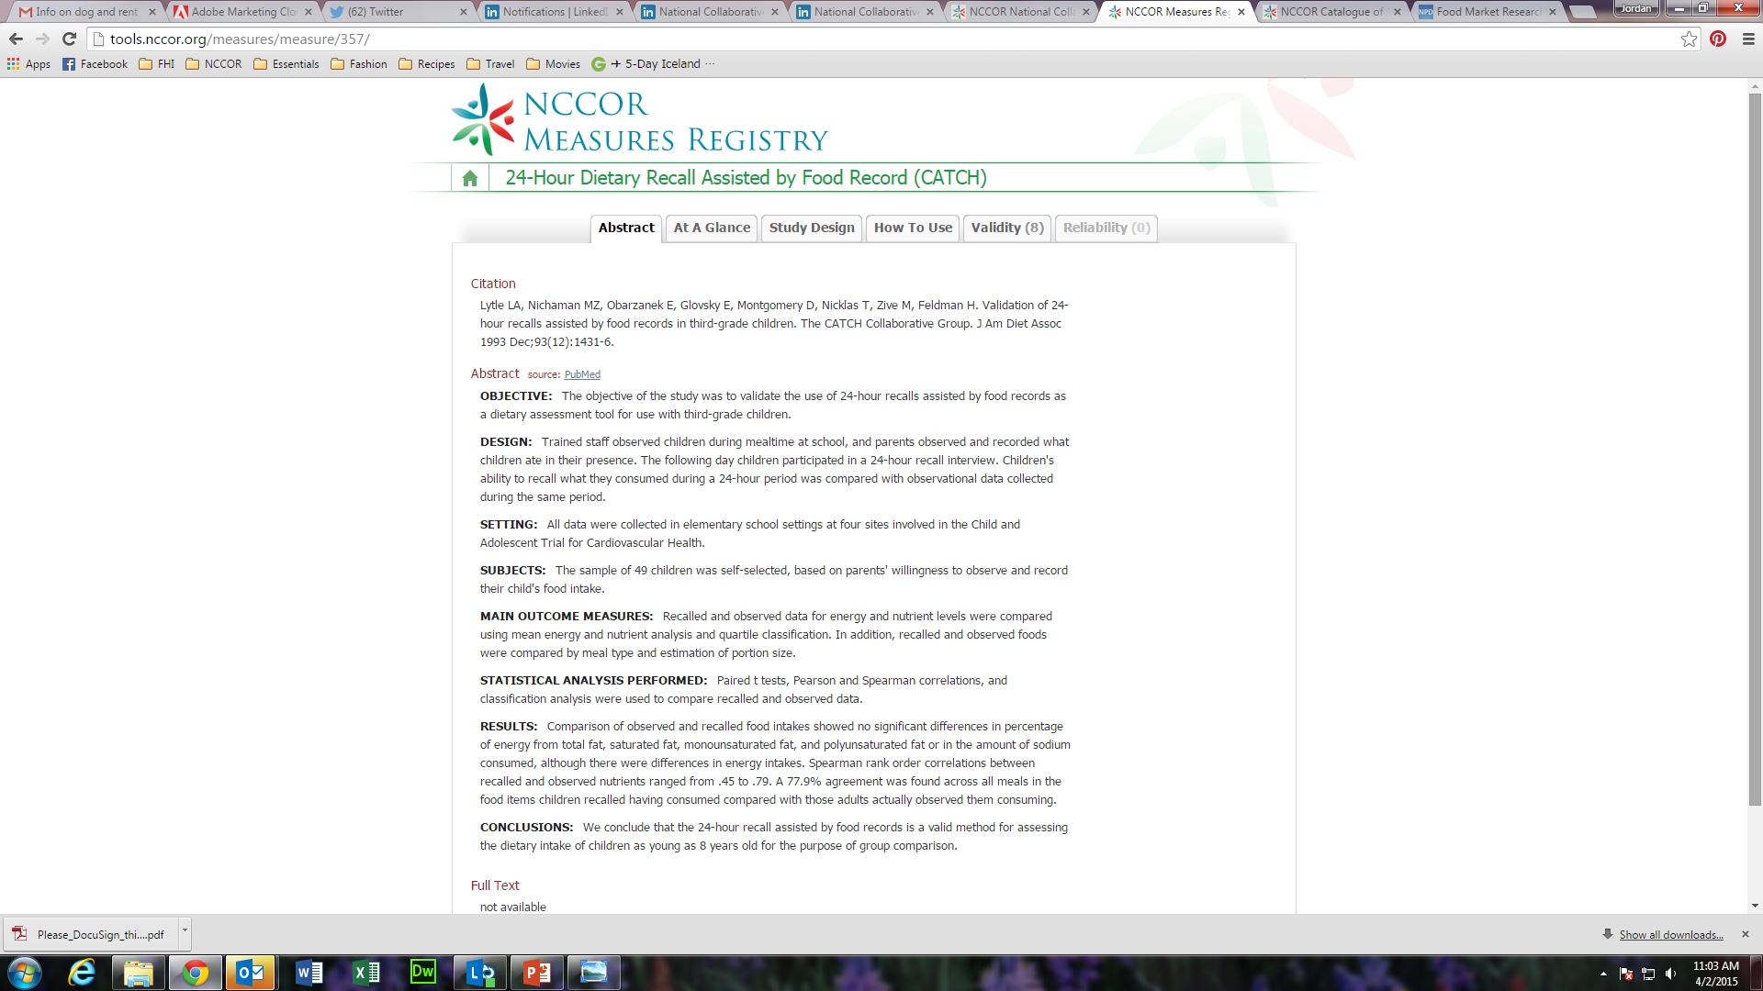
Notes:
The Measures Registry can also be easily filtered based on your research needs by domain, measure type, age, and context.
For each measure in the registry, detailed information is available including information on its validity and reliability.
In 2015, NCCOR will begin developing the Measures Registry User Guides.
The user guides will:
provide an overview of measurement in specific domains,
describe general principles of measurement selection,
present case studies on selecting measures,
describe challenges to measures harmonization, and
highlight additional resources.

Slide 18

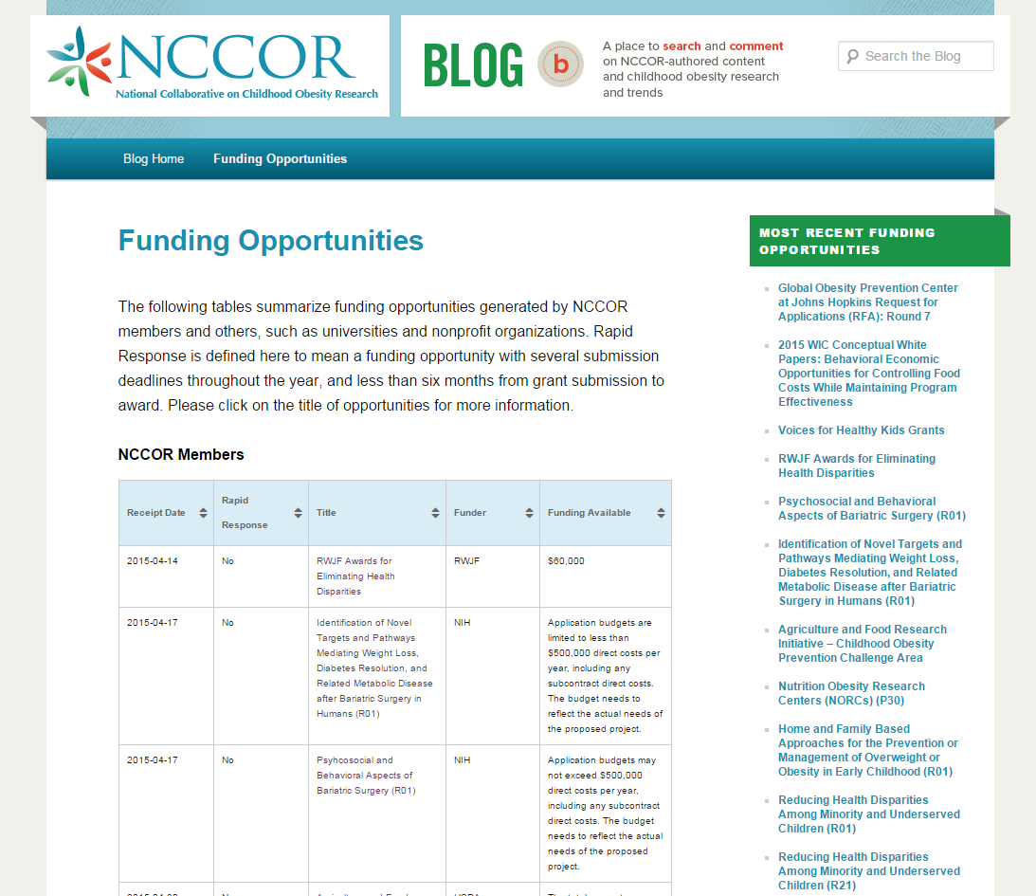
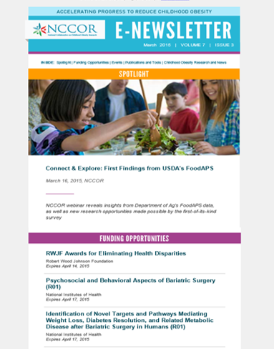
NCCOR created mechanisms
Rapid
Response
Funding
Mechanism
Tools to
Connect Researchers
to Funding
Available online at www.nccor.org
Notes:
NCCOR supported the establishment of a Rapid Response Funding Mechanism at both NIH and the Johns Hopkins Global Obesity Prevention Center.
These complementary mechanisms allow for an accelerated review and award process to support time-sensitive research.
NCCOR also strives to connect researchers to funding.
It keeps researchers abreast of the latest funding opportunities with a regularly updated blog and monthly e-Newsletter. Our blog and monthly e-Newsletter also highlight the latest childhood obesity events, news, and research.

Slide 19

Notes:
All of the resources I have mentioned are available on our website: www.nccor.org.
You will also find additional tools and resources ranging from infographics that translate the latest research findings to insights into emerging areas like the intersection between childhood obesity and the built environment.

Slide 20

Key Activities
Notes:
Briefly, I’ll mention a few other existing NCCOR projects.

Slide 21
Supplemental Nutrition Assistance Program-Education (SNAP-Ed)
NCCOR helped USDA develop guidance to SNAP agencies and states following a major shift in the national approach and delivery of SNAP-Ed.
  Collection of evidence-based, actionable tools consistent with the context and policies of SNAP and incorporating evidence-based obesity strategies
USDA continues to work with NCCOR to refine the toolkit to ensure it provides a current list of strategies, interventions, and resources.
Notes:
NCCOR helped USDA develop guidance to SNAP agencies and states following a major shift in the national approach and delivery of SNAP-Ed.
Collection of evidence-based, actionable tools consistent with the context and policies of SNAP and incorporating evidence-based obesity strategies
USDA continues to work with NCCOR to refine the toolkit to ensure it provides a current list of strategies, interventions, and resources.

Slide 22
Youth Energy Expenditure
NCCOR knows efforts to reduce childhood obesity must emphasize healthy eating and physical activity.
A compendium of youth physical activity measures was published in 2008, but its data was limited.
An NCCOR workgroup is:
  Updating the compendium
  Working toward consensus on
  methods, measurements for
  improving youth energy
  expenditure estimates
Notes:
NCCOR knows efforts to reduce childhood obesity must emphasize healthy eating and physical activity.
A compendium of youth physical activity measures was published in 2008, but its data was limited.
An NCCOR workgroup is:
Updating the compendium
Working toward consensus on methods, measurements for improving youth energy expenditure estimates

Slide 23
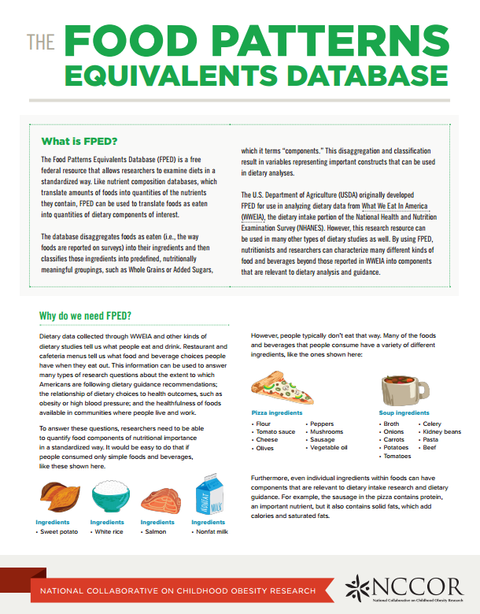
Food Patterns Equivalent Database (FPED)
Dietary databases constitute the infrastructure of dietary studies, allowing researchers to translate foods and beverages into nutrient quantities relevant to dietary guidance.
  NCCOR supported critical updates
  to USDA’s FPED for the 2007-2008
  and 2009-2010 NHANES survey cycle,
  which will enhance goals related to
  intervention, evaluation, and other
  research at the individual and
  community levels.
Notes:
Dietary databases constitute the infrastructure of dietary studies, allowing researchers to translate foods and beverages into nutrient quantities relevant to dietary guidance.
NCCOR supported critical updates to USDA’s FPED for the 2007-2008 and 2009-2010 NHANES survey cycle, which will enhance goals related to intervention, evaluation, and other
research at the individual and community levels.
The NCCOR Coordinating Center developed a related plain-language fact sheet to complement the updates.

Slide 24
Notes:
Exploring emerging topics in childhood obesity is a major focus for NCCOR.
In 2014, NCCOR brought together leading experts to share their experiences and perspectives, determine complementary goals, and identify critical gaps in knowledge in emerging areas.
These multidisciplinary explorations paved the way for strategic planning, collaborative action, and substantial impact.
I’ll briefly share some examples.

Slide 25

Healthy Food Incentives
Purpose: Convene practitioners, researchers, and government officials to explore interventions that increase purchases of healthy foods among low-income and SNAP-eligible populations
Workshop Series
Perspectives from the field
  Focus: Practitioner perspective
Exploring ways to nudge healthy purchases among SNAP shoppers
  Focus: Research and evaluation perspective
Moving the field forward
  Focus: Summarize current knowledge, gaps, and opportunities
Notes:
In 2014, NCCOR held a three-part workshop series with the purpose being to convene practitioners, researchers, and government officials to explore interventions that increase purchases of healthy foods among low-income and SNAP eligible populations.
The Workshop Series included:
Perspectives from the field
Focus: Practitioner perspective
Exploring ways to nudge healthy purchases among SNAP shoppers
Focus: Research and evaluation perspective
Moving the field forward
Focus: Summarize current knowledge, gaps, and opportunities

Slide 26
Healthy Food Incentives
Key Insights
Workshop 1
More collaboration between implementers, retailers, and researchers is needed to better understand the impact of incentives
There are opportunities to learn more about how different incentives (financial vs. non-financial) work in different settings
Workshop 2
Successful behavioral economics strategies must be acceptable to supply-side stakeholders, retailers, and consumers
Workshop 3
Multiple sectors play a role and must be engaged in supporting incentives (e.g., improving technology to track incentives in retail settings)
Common measures are needed to better evaluate and scale up programs
Notes:
The series offered several key insights.
The first workshop highlighted that:
More collaboration between implementers, retailers, and researchers is needed to better understand the impact of incentives.
There are opportunities to learn more about how different incentives (financial vs. non-financial) work in different settings (retail, farmers markets, etc.).
The second workshop found that:
Successful behavioral economics strategies must be acceptable to supply-side stakeholders, retailers, and consumers.
The third workshop emphasized that:
Multiple sectors play a role and must be engaged in supporting incentives (e.g., improving technology to track incentives in retail settings).
Common measures are needed to better evaluate and scale up programs.
In 2015, the workshop series will continue with a white paper summarizing findings and next steps as well as a fourth workshop focused on the retail setting.

Slide 27

Childhood Obesity Declines
Purpose: Explore potential drivers of reported declines in childhood obesity, especially those that influence disparities
Four cities/counties selected:
  Anchorage, AK
  Granville County, NC
  New York, NY
  Philadelphia, PA
Notes:
Another example of how NCCOR is exploring an emerging area is our work with the Robert Wood Johnson Foundation on the Childhood Obesity Declines project.
Its purpose is to explore potential drivers of reported declines in childhood obesity, especially those that influence disparities.
Four cities/counties were selected: Anchorage, Alaska; Granville County, North Carolina; New York, New York; and Philadelphia, Pennsylvania.

Slide 28

Childhood Obesity Declines
  Site visits began in early 2015
  and include:
  Inventory of strategies
    Schools
    Early childhood education
    Health care
    Community
  Interviews with leaders
    Policy/program developers
    Policy/program implementers
    Community members
    Evaluators
Notes:
Site visits began in early 2015 and include:
An inventory of strategies across four settings: schools, early childhood education, health care, and community.
And interviews with four types of leaders:
Policy/program developers
Policy/program implementers
Community members
Evaluators

Slide 29

Lessons Learned from Global Efforts
Purpose: One-day meeting funded by RWJF to convene international and interdisciplinary researchers to explore promising and innovative strategies for promoting healthy eating and active living from around the world to accelerate progress in the United States and abroad
Cross-Cutting Topics
Emerging international environmental and policy strategies
Approaches to reduce health disparities and address inequities
Strategies to build demand around policies that improve health
Public health and business partnerships that foster health
Notes:
NCCOR began to look toward the international community for insights into addressing childhood obesity.
We held a one-day meeting funded by Robert Wood Johnson Foundation to convene leading international and interdisciplinary researchers and practitioners to explore promising and innovative strategies for promoting healthy eating and active living from around the world to accelerate progress in the United States and abroad.
Cross-cutting topics covered at the meeting included:
Emerging international environmental and policy strategies
Approaches to reduce health disparities and address inequities
Strategies to build demand around policies that improve health
Public health and business partnerships that foster health

Slide 30
Lessons Learned from Global Efforts
Key Insights
Changing the paradigm from individual responsibility to common good
Many countries view health as a human right, providing a mandate for action and broad thinking about programs and interventions
The importance of thinking big and thinking differently
Broad, systems thinking that takes a long-term view is needed
Communicating with and learning from others are the touchstones of progress
The field can learn a lot from other fields, countries. Building connections is essential to better understand problems and identify solutions.
Notes:
The meeting resulted in several key insights including:
Changing the paradigm from individual responsibility to common good
Many countries view health as a human right, providing a mandate for action and broad thinking about programs and interventions.
The importance of thinking big and thinking differently
Broad, systems thinking that takes a long-term view is needed.
Communicating with and learning from others are the touchstones of progress
The field can learn a lot from other fields and countries. Building connections is essential to better understand problems and identify solutions.

Slide 31

NCCOR’s Reach

Slide 32
Communications and Outreach
Highlights from 2014 to spring 2015
  900+ Twitter followers
  A September 2014 NCCOR Twitter Chat reached 2M unique individuals, had 34M+ impressions
  2,600+ subscribers to monthly e-Newsletter
  Active on LinkedIn, YouTube, NCCOR blog
Shared ~800 resources at conferences in 2014
Numerous meetings, workshops, webinars
  Connect & Explore Webinar Series in second year

Slide 33
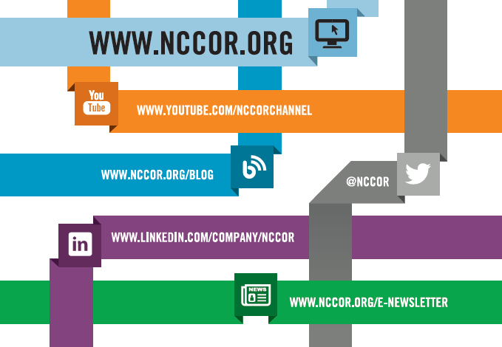
Connect with NCCOR
Notes:
We hope you will connect with us online by visiting our website (www.nccor.org) and blog, signing up for our e-Newsletter, and following us on LinkedIn and Twitter.

Slide 34

For More Information
Learn more about
the Collaborative at www.nccor.org
Contact
Todd Phillips,
Project Director, tphillips@fhi360.org

