Slide 1
Food Marketing in the Digital Age: Emerging Trends and Research Priorities
Kathryn C. Montgomery, PhD
American University
Jeff Chester, MSW
Center for Digital Democracy

Slide 2
Digital Display Advertising Expenditures 2009
Coca-Cola: $20,954,000 - up 163%
General Mills: $39,535,000 – up 105.6%
Dr. Pepper: $4,997,000 – up 427.9%
Kellogg’s: $51,720,000 – up 225.3%
McDonald’s: $26,662,000 – up 47.4%
Nestle: $44,197,000 – up 174.9%
Pepsi: $30,254,000 – up 68.6%
Wendy’s: $12,804,000 – up 355.7%

Slide 3
S
Social Media & Marketing
Mobile Marketing
Place-based & Experiential Retail Marketing
Digital Video & Gaming

Slide 7
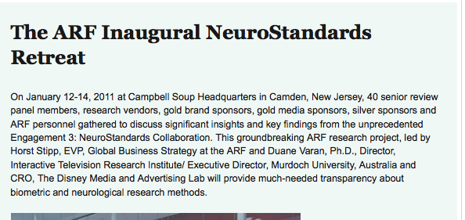

Slide 9
The growth of digital media has fundamentally transformed food marketing.

Slide 10
Key Concepts – Research Implications
Ubiquitous connectivity – synergistic, cross-platform - difficult to isolate “medium” or “message”
Engagement - beyond “exposure” – need to understand interactions, emotional connections
User-generated – ads not just directed at youth, but also created and distributed by them
Personalization – targeting individuals, based on data collection - behavioral and psychological profiles
Social graph – seeding “influencers,” activating networks, distributing virally
Immersive environments – subjective, “flow,” play, unconscious

Slide 11
New Metrics
“Real-time optimization”
“Influencer identification”
“Virality of spread”
Engagement measures – e.g., “dwell rate”
Facebook - “sentiment research” ➔“mood targeting”
Smart phones – “taps” & “tap-through rate”

Slide 12
Rethinking the Research Paradigm
Theoretical frameworks - beyond cognitive – social, emotional, unconscious, implicit, etc.
New methods – qualitative & quantitative, informed by industry research and metrics
Interdisciplinary field building – new-media scholars, tech experts, information scientists, market analysts, etc.
Short-term, high visibility, agenda setting studies

Slide 13
Critical issues – gaps in research
Adolescents
Multicultural youth
Identity formation - socialization
Impulsivity and addictive behaviors
Research to inform policy – problematic practices, new legal theories

