Slide 1
Relevant NIH Funding Opportunities
Reducing Health Disparities Among Minority and Underserved Children
(R01: PA-11-104; R21: PA-11-105)
Behavioral and Social Science Research on Understanding and Reducing Health Disparities
(R01: PAR-10-136; R21: PAR-10-137)
Obesity Policy Research: Evaluation and Measures
(R01: PA-10-027; R21: PA-10-028; R03: PA-10-029)
Impact of Health Communication Strategies on Dietary Behaviors
(R01: PA-08-239; R21: PA-08-240 – Expires September 2011)
For these and other funding opportunities, see:
http://obesityresearch.nih.gov/funding/funding.htm

Slide 2
Measures Registry &
Catalogue of Surveillance Systems
Research Roundtable III: Food Advertising and Marketing to Children and Youth
Washington DC
April 5, 2011
Robin A. McKinnon, PhD, MPA
National Cancer Institute, National Institutes of Health
Notes:
Note to presenter: Add meeting name, location, date , presenter name and organization to slide

Slide 3

Strategic Plan Goal Areas
Goal 1: Evaluate and identify effective interventions, with an emphasis on those that affect vulnerable populations and communities.
Goal 2: Increase and improve national, state, and local surveillance of childhood obesity.
Goal 3: Increase ability of childhood obesity researchers and program evaluators to conduct research and program evaluation.
Goal 5: Foster research to improve integration of childhood obesity prevention and synergistic initiatives that provide co-benefits for obesity (e.g., agricultural research, environmental sustainability, disabilities).
Goal 4: Provide national leadership to accelerate implementation of evidence-informed practice and policy.
Notes:
3

Slide 4
Issues Facing Researchers…
What data resources exist?
How do I access the data?
What are the costs?
How has a specific measure been validated?
What measures have been validated?
Where can I find a specific measure?
Where can I find more details?
What variables can I link across systems?
Notes:
In brief, the Catalogue collects and summarizes data resources relevant to childhood obesity in one convenient location. It provides access to data related to environmental and policy factors, as well as health behaviors, outcomes and determinants of obesity. It currently includes over 75 systems with national, state and local data resources maintained by federal, state, academic, and private sector institutions. Information on geocoding and other linkage variables is provided for each system, encouraging data-linkage between systems.

Slide 5
Measures Registry

Slide 6

Measures Registry Overview
Searchable registry with almost 750 measures
Measures are categorized into four domains:
    Individual dietary behavior
    Individual physical activity behavior
    Food environment
    Physical activity environment
Details about each measure include:
    Domain(s) measured
    Validity and reliability
    Protocols on use
    Settings, geographic areas, and populations for which the measure has been used
Website to launch in April 2011
Notes:
This front-engine, web-based registry of valid and reliable measures to assess independent, dependent, and key moderating variables in childhood obesity prevention research will improve and accelerate the ability to learn what works within and across individual studies.
Standard measures are needed to describe and evaluate interventions, particularly policy and environmental interventions, and factors and outcomes at all levels of the social ecological model (e.g., national, state, local, institutional, home, individual). This registry will evaluate measures based on the degree to which they are valid, culturally sensitive, and feasible for administration and use by a variety of end-users (i.e., researchers, community advocates, teachers, health care practitioners) and in a variety of settings (e.g., schools, retail outlets, neighborhoods, community organizations).
The registry will help identify gaps in measures and fuel new measurement development (i.e., measures for specific age groups, such as BMI across age groups, in puberty, etc.) for childhood obesity prevention and control research at the individual, community and population levels. Eligibility for the registry will be based on established criteria, such as reliability, validity, cost, ease of use, and diverse settings for use.

Slide 7
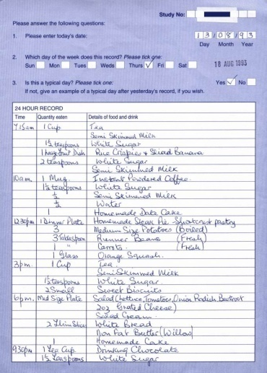
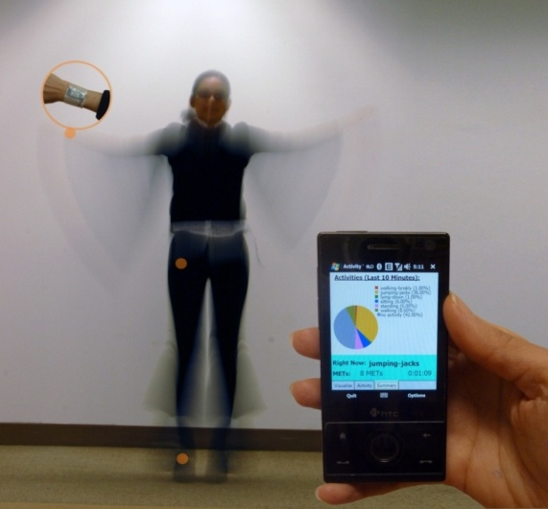
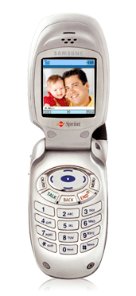
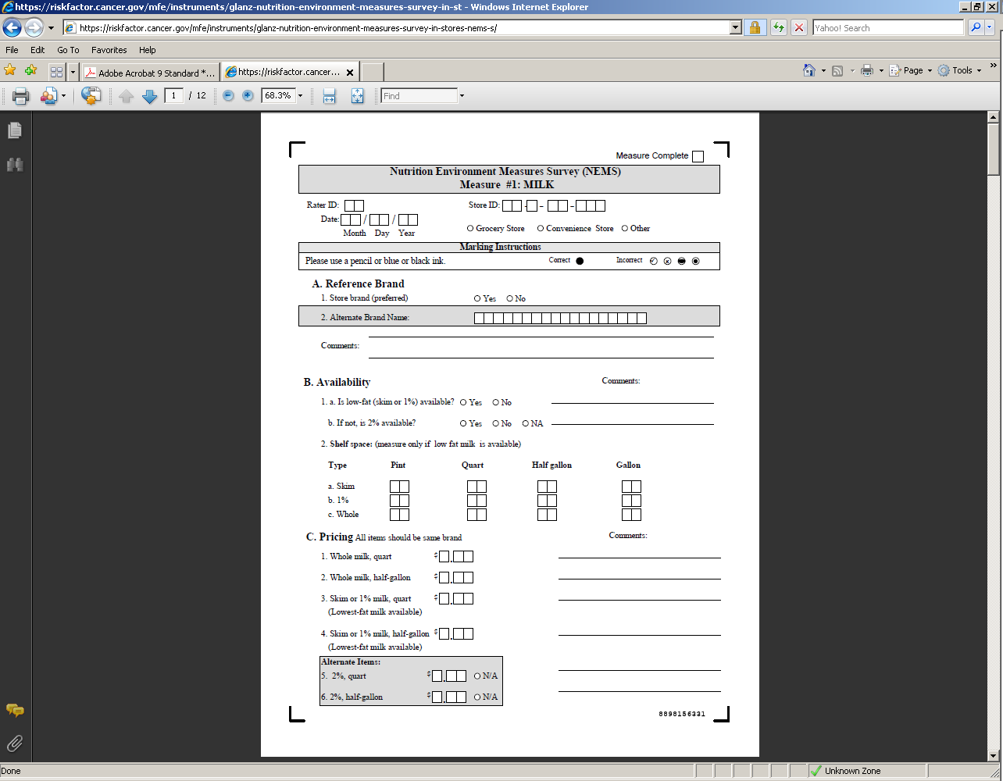
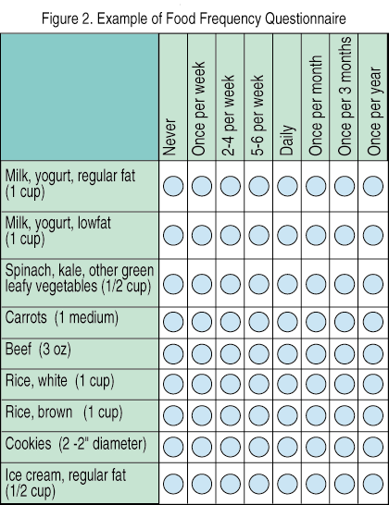
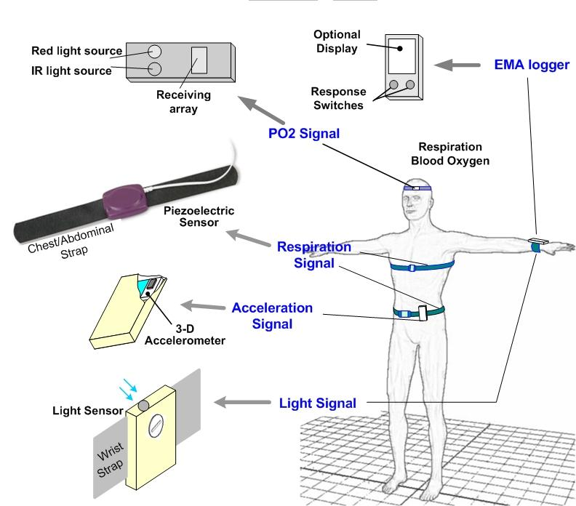
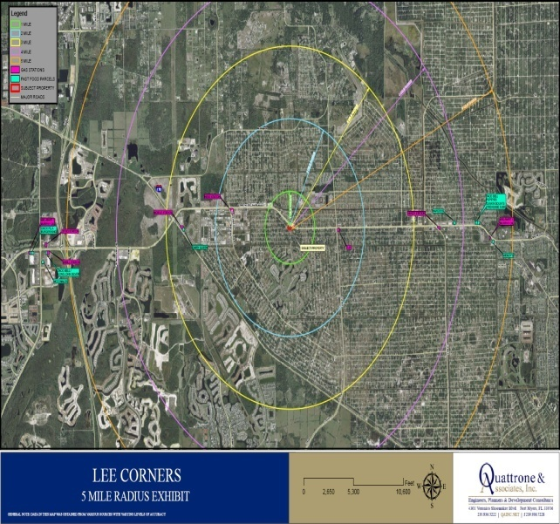
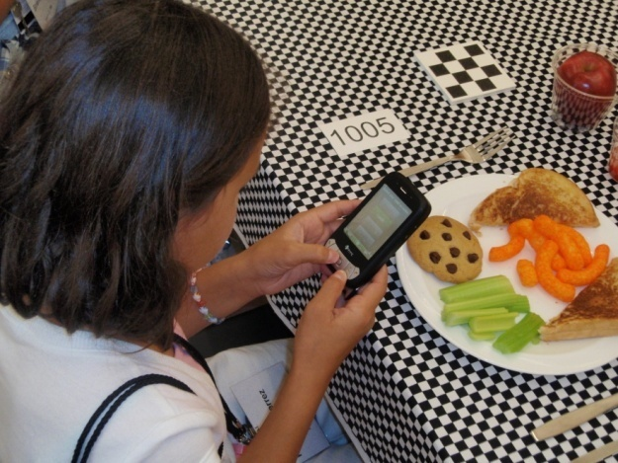
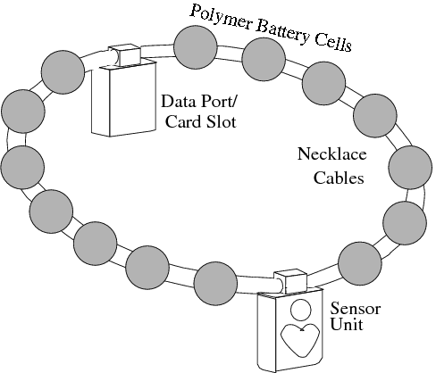
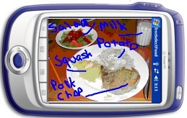
Diet and Physical Activity Behavior:
Individual-level & Environmental-level Measures
Notes:
More Measures Registry Notes
This front-engine, web-based registry of valid and reliable measures to assess independent, dependent, and key moderating variables in childhood obesity prevention research will improve and accelerate the ability to learn what works within and across individual studies.
Standard measures are needed to describe and evaluate interventions, particularly policy and environmental interventions, and factors and outcomes at all levels of the social ecological model (e.g., national, state, local, institutional, home, individual). This registry will evaluate measures based on the degree to which they are valid, culturally sensitive, and feasible for administration and use by a variety of end-users (i.e., researchers, community advocates, teachers, health care practitioners) and in a variety of settings (e.g., schools, retail outlets, neighborhoods, community organizations).
The registry will help identify gaps in measures and fuel new measurement development (i.e., measures for specific age groups, such as BMI across age groups, in puberty, etc.) for childhood obesity prevention and control research at the individual, community and population levels. Eligibility for the registry will be based on established criteria, such as reliability, validity, cost, ease of use, and diverse settings for use.
7

Slide 8
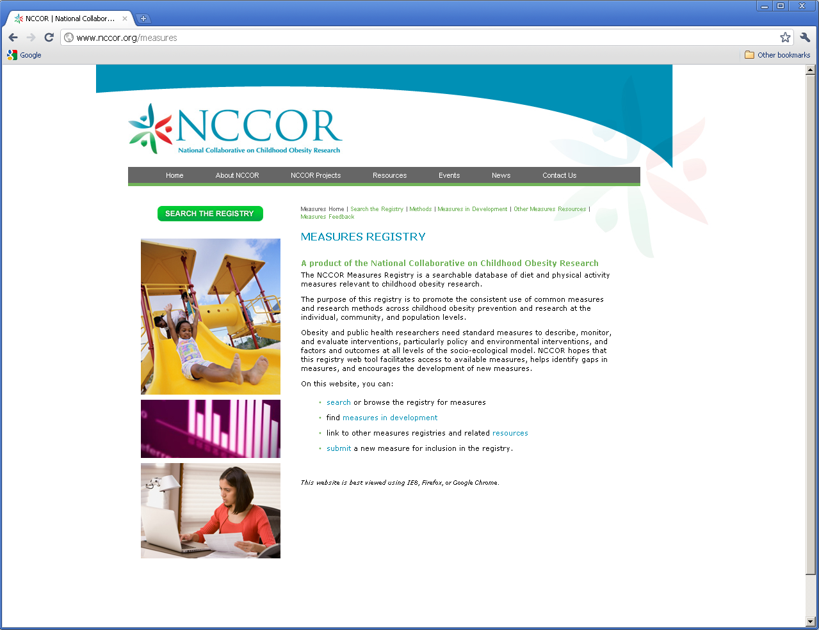
www.nccor.org/measures
Notes:
This is a screenshot of the landing page for the Measures Registry that will be housed on the NCCOR site. From this site (the green button), users will be directed to the registry tool. To date on the registry, we have:
Individual PA and Diet Measures
Diet and PA Environment Measures
600+ measures have been entered so far, and the validity and reliabilty of measures have been captured. The references and Pub Med id’s are being entered in the database. It’s diverse collection of demographic/environmental covariates.
8

Slide 9
Catalogue of Surveillance Systems

Slide 10
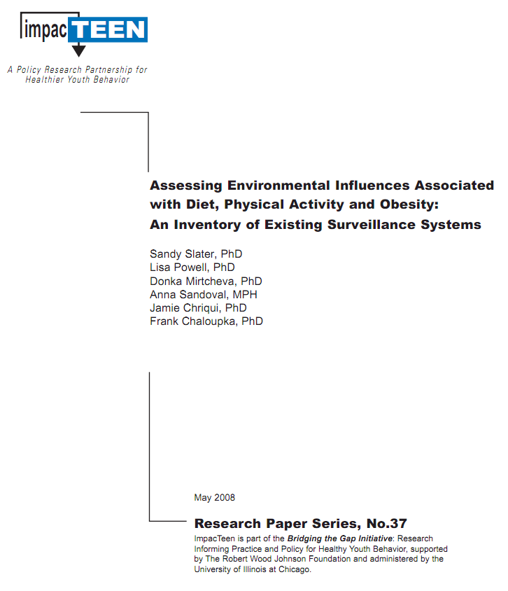

Previous Solutions…
Using familiar systems
Asking colleagues’ advice
Internet search engines
Notes:
In brief, the Catalogue collects and summarizes data resources relevant to childhood obesity in one convenient location. It provides access to data related to environmental and policy factors, as well as health behaviors, outcomes and determinants of obesity. It currently includes over 75 systems with national, state and local data resources maintained by federal, state, academic, and private sector institutions. Information on geocoding and other linkage variables is provided for each system, encouraging data-linkage between systems.

Slide 11

Catalogue Overview
First-ever online directory of obesity-related data resources
One-stop access to data related to environmental and policy factors, as well as health behaviors, outcomes and determinants of obesity
Includes over 75 systems
Provides information on national, state and local data resources
Encourages data-linkage across multiple levels
Launched February, 2011
Notes:
In brief, the Catalogue collects and summarizes data resources relevant to childhood obesity in one convenient location. It provides access to data related to environmental and policy factors, as well as health behaviors, outcomes and determinants of obesity. It currently includes over 75 systems with national, state and local data resources maintained by federal, state, academic, and private sector institutions. Information on geocoding and other linkage variables is provided for each system, encouraging data-linkage between systems.

Slide 12
Catalogue Breadth of Resources
Examples
Macro/Policy
Price Data on Groceries, Transportation
School and Community
Medical Expenditure
Household
School Nutrition, Activity
Community Crime Statistics
Individual
Diet
Online Activities, Behavior
Physical Activity
Household Travel
Federal Nutrition Assistance Program Participation
Agricultural production
School Wellness Policies
Traffic Fatalities
State Snack and Soda Tax Policies

Slide 13
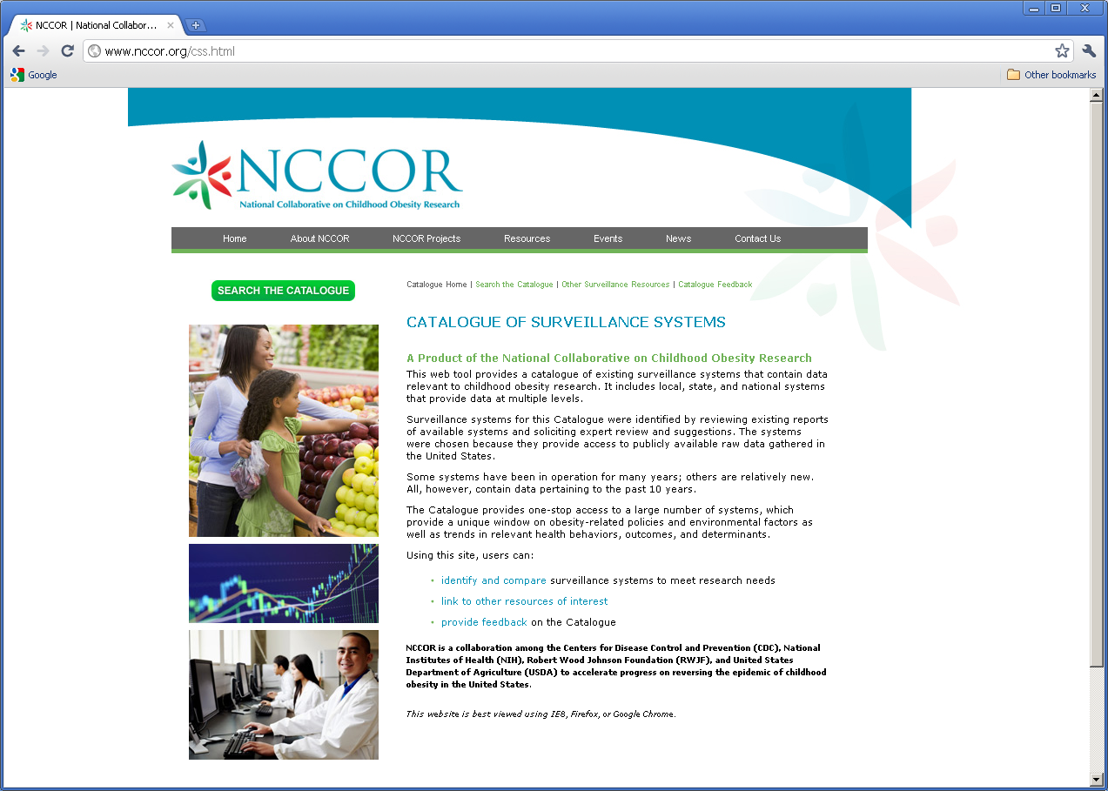
www.nccor.org/css
Notes:
This slide shows the screen shot of the Catalogue of Surveillance Systems landing page:
Catalogue URL: www.nccor.org/css

Slide 14
Intended Outcomes of the
Registry & Catalogue
Awareness and use of resources
Standardization of measures
Productivity
Redundancy
Identify gaps
Innovation in research
Effectiveness of research
And ultimately…
Reduce rates of childhood obesity
Notes:
Feedback on the Catalogue is most welcome! Please let us know if you would like to suggest a system for inclusion in the Catalogue, if you would like to suggest an update to a system profile, or if you have any other feedback on the Catalogue, such as a suggestions on additional features, or simply information on how you are using the Catalogue.

Slide 15

Questions?
mckinnonr@mail.nih.gov

