Slide 1
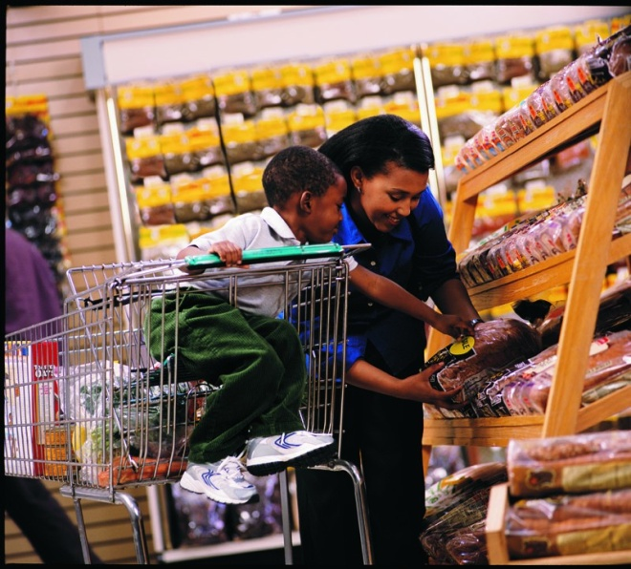

Food Marketing and Health
A Snapshot of Relevant Research Activities
at the
Economic Research Service
U.S. Department of Agriculture
Joanne F. Guthrie
Food Economics Division
Economic Research Service
U.S. Department of Agriculture

Slide 2
Major Categories of Activities
Intramural Research
Data Development
Extramural Research Support
Fostering Research Communication

Slide 3
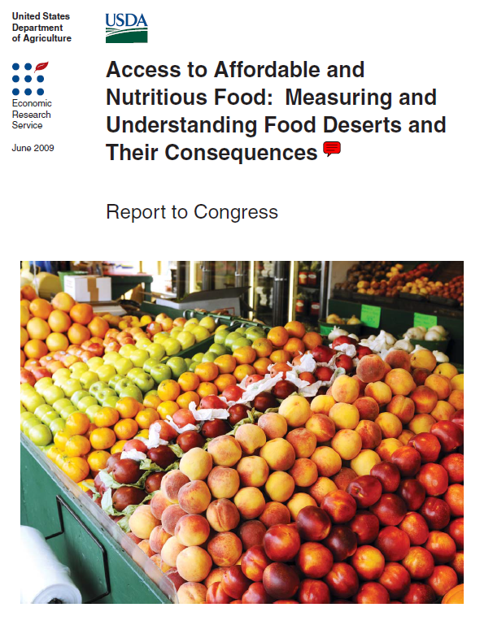
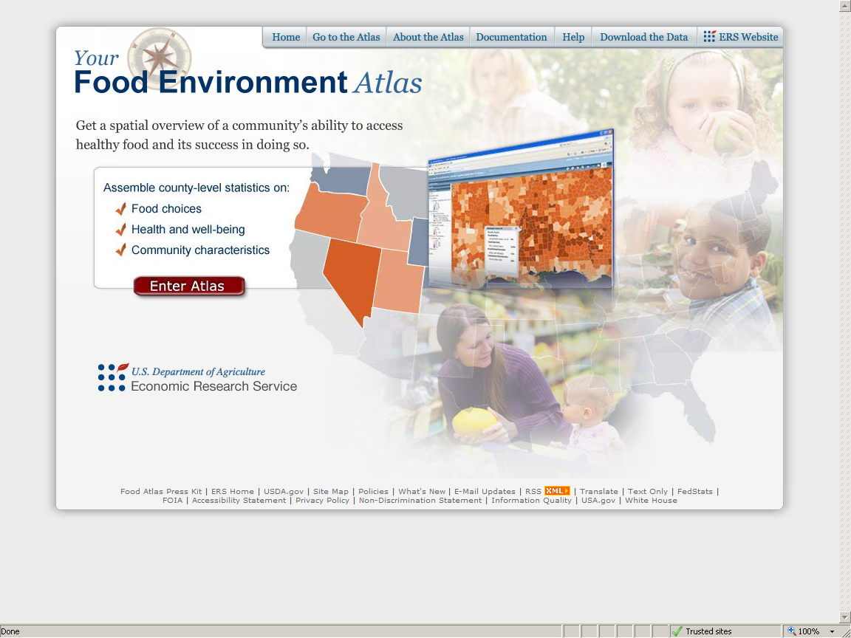
Intramural Food Marketing Research
ERS Publications and Webproducts
Food Access

Slide 4
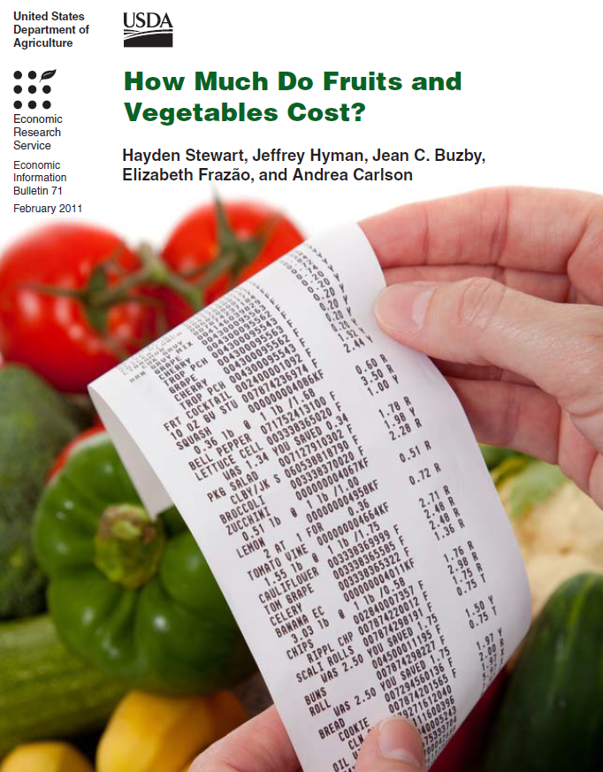
Intramural Food Marketing Research
ERS Publications and Webproducts
Costs of healthy foods
Effects of combining information and incentives
Market response to nutrition labeling
Exploring ideas from behavioral economics
Sources:
How Much Do Fruits and Vegetables Cost? By Hayden Stewart, Jeffrey Hyman, Jean C. Buzby, Elizabeth Frazão, and Andrea Carlson Economic Information Bulletin No. (EIB-71) 37 pp, Feb 2011
Promoting Fruit and Vegetable Consumption: Are Coupons More Effective than Pure Price Discounts? By Diansheng Dong and Ephraim Leibtag. ERR-96, 2010.
“Food Policy: Check the List of Ingredients,” by Elise Golan, Lisa Mancino, and Laurian Unnevehr, in Amber Waves, Vol. 7, Issue 2, USDA, Economic Research Service, June 2009.
Making Healthy Food Choices Easier: Ideas From Behavioral Economics. By Lisa Mancino and Margaret Andrews. EIB-29-7, 2007.

Slide 5
Data Development
Expanded use of Nielsen’s Homescan (household panel) data
Creation of Quarterly Food-at-Home Price Database (QFAHPD)
  Available on ERS website
Innovative linkage of QFAHPD to National Health and Nutrition Examination Survey (NHANES) data to examine relationship of food choice to consumer characteristics, food prices, and access

Slide 6

National Household Food Acquisition and Purchase Survey—FoodAPS
Nationally representative survey of US households
  Oversample of low-income and SNAP recipient households
  Comprehensive data on household food acquisition
    Food sources, prices, nutrient composition
Allow assessment of impacts on food choice and dietary quality of:
  SNAP participation
  Prices and income
  Access and retail outlet choice
  Knowledge about health, diet, and nutrition
  Food insecurity
Notes:
Nationally representative sample of 5,000 U.S. households
1,500 SNAP participants
2,000 low-income non-participants
1,500 higher income > 185% FPL
Food Acquisition includes
--foods purchased—quantities and prices
--food away from home
--USDA food assistance program participation
Look at how use of SNAP and cash resources varies over the course of a benefit month
All of the above by subgroups (e.g., elderly, households with children, income level)

Slide 7
Extramural Research Support
Food Assistance and Nutrition Research Program
Current Projects
WIC Food Package Revisions: Impact on Food Purchases and Access to Healthy Foods; Follow-Up Study on Access to Healthy Foods: The Role of Market Competition, WIC Policy, and Vendor Attitudes; Tatiana Andreyeva, Yale University.
Food Security and Access to Retail Food Establishments Among Emergency Food Program Recipients; James Mabli, Mathematica Policy Research, Inc.
Local Economic Conditions, Food Assistance and Food Insecurity Among Households With Children; Qi Zhang, Old Dominion University.
RFP for current year closed April 4th

Slide 8
Fostering Research Communication
Using Scanner Data to Answer Food Policy Questions Conference
June 1-2, 2011
ERS Headquarters
1800 M St NW,
Washington, DC.
The conference will investigate how proprietary scanner data can contribute to food policy research. It will also address methodological issues and the future potential of scanner data.
Call for Papers closed April 1st.
Agenda forthcoming.

Slide 9


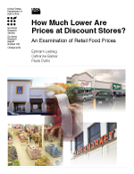
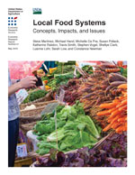


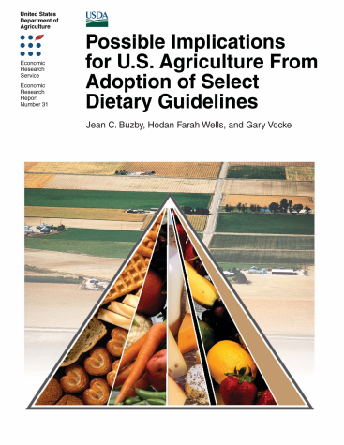

For More Information from ERS
Visit our website at www.ers.usda.gov

