Slide 1

CATALOGUE OF
SURVEILLANCE SYSTEMS
One-stop access to review, sort, and compare over 100 surveillance systems relevant to childhood obesity research and the evaluation of policy and environmental interventions
All offer publicly available data collected within the past 10 years in the U.S.
Includes systems that contain data for evaluating policy and environmental interventions
Makes manuscript development easier
Great resource for teaching and for students
Video overview of features and how to use
Updated annually
Find the catalogue at www.nccor.org/css

Slide 2
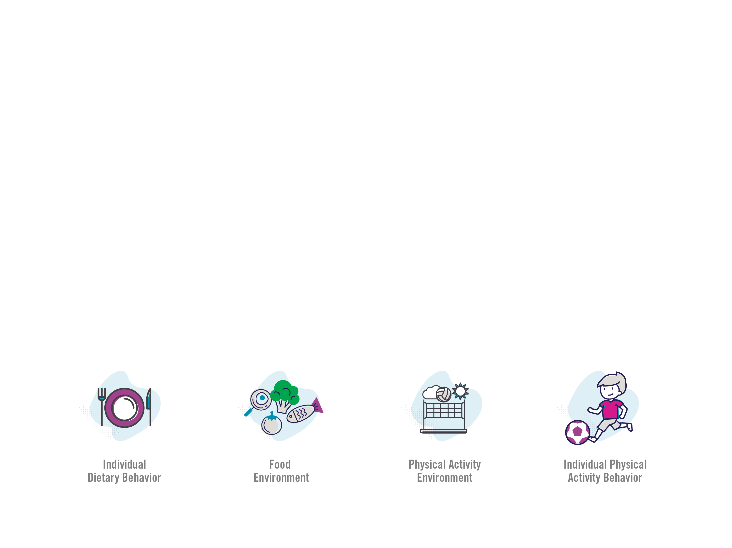
MEASURES REGISTRY
Searchable database of articles on diet and physical activity measures relevant to childhood obesity research
Search for existing measures and measures in development and details about how to use them
Includes information on validity, reliability, protocols
on use, settings, geographic areas, populations
Supports manuscript development, reports, and
grant applications
Great resource for teaching and for students
Video overview of features and how to use
Updated regularly
Find the Registry at www.nccor.org/measures

Slide 3

MEASURES REGISTRY USER GUIDES
Four User Guides explain measurement, discuss measure selection, and present “how-to” case studies
Provide guidance for choosing the most appropriate measure for a research question or evaluation project
Include key considerations for measurement, selecting measures, collecting, and analyzing data
Help move the field forward by fostering more consistent use of measures
Case studies illustrate considerations influencing selection of the most appropriate method given the study aims
Slide decks available for faculty and student use
Find the User Guides at www.nccor.org/mruserguides

Slide 4

YOUTH COMPENDIUM OF PHYSICAL ACTIVITIES
Searchable tool of 196 common activities and the estimated energy cost associated with each activity
Provides energy costs for sedentary activities, standing, household chores, playing in games and sports, walking and running
Reports energy expenditure levels in youth METs; a youth MET (MET_{y}) is a MET that has been adjusted to account for the unique physiological characteristics of children and adolescents
For use by researchers, health care professionals, teachers and coaches, fitness professionals, and more
Use for research, public health policy making, education, and interventions to encourage physical activity in youth
Represents group-level estimates for energy expenditure
Find the youth compendium at
www.nccor.org/youthcompendium

