Slide 1
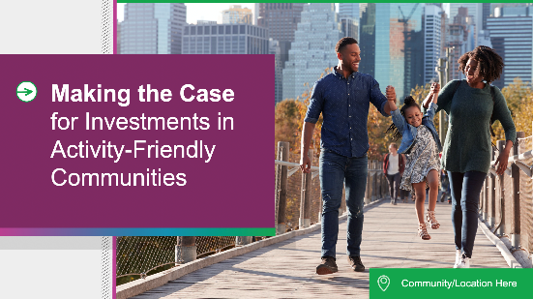
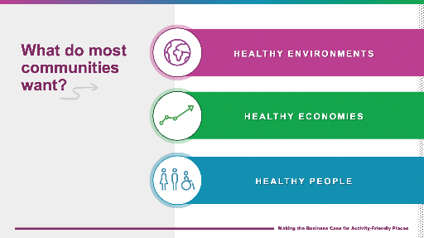
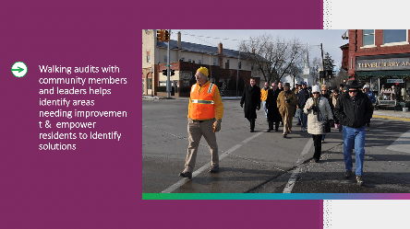
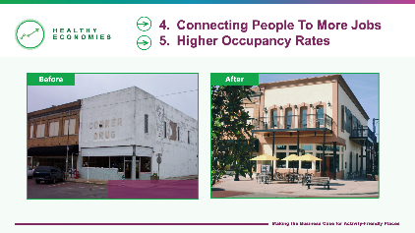
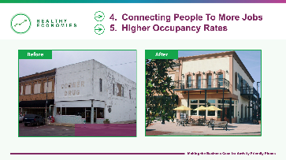
Instructions for how to use this presentation
Presentation begins on Slide 6. Instructions for use on
slides 1-5.
Notes:
Thanks for using our template PowerPoint presentation to talk about creating thriving, activity-friendly communities!
Before you use this as a base for your presentation, we wanted to offer some things to consider:
Slides 1-5 provide background information on how to use this customizable template. The customizable PowerPoint template starts on slide 6. Remember to remove the instruction slides 1-5 after reading them. Suggestion: Move them to the back of the presentation if you would like to save them for future reference.
Each community is unique, and this deck was built for you to pick and choose what benefits are of most value to your own community. Some content and discussion points in this slide deck may not be applicable to your community. For example, some communities may prioritize healthy environments and healthy people, whereas others want to prioritize healthy economies. Feel free to select which slides to incorporate into your presentation based on what your communities priorities and needs are.
We provided discussion notes for each slide; however, you should feel empowered to add stories and discussion points that are relevant to your community.
We have also provided example images that you can use, however, we encourage using actual photos from your community to make your presentation even more powerful. We have added a note on each slide that would be a great spot to use your own photo.

Slide 2


Notes:
Who made this presentation? What’s NCCOR?
The National Collaborative on Childhood Obesity Research (NCCOR) brings together four of the nation’s leading research funders — the Centers for Disease Control and Prevention (CDC), the National Institutes of Health (NIH), the Robert Wood Johnson Foundation (RWJF), and the U.S. Department of Agriculture (USDA) — to accelerate progress in reducing childhood obesity in America.
Why did NCCOR create this resource?
Physical activity plays an important role in obesity prevention and overall health in children. Improving walkability and encouraging regular walking can not only play a role in obesity prevention, but it can make communities safer, support social cohesion, reduce air pollution, and even benefit local economies. We wanted to create resources that would empower people to take the next step in creating thriving activity-friendly communities.

Slide 3
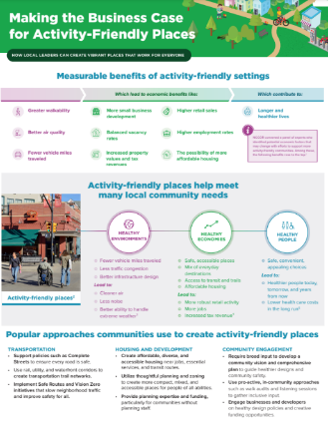
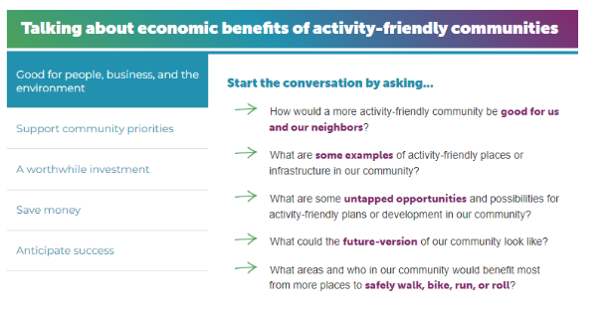
Create Thriving, Activity-Friendly Communities
www.nccor.org/activityfriendly
Notes:
(Optional – Context to describe images on the screen)
On the left is a preview of discussion points on the newly updated Building Thriving, Activity Friendly Communities Website.
These are discussion points and questions to help facilitate discussions about activity friendly communities with local leaders, policymakers, decisionmakers, and community organizations.
We organized these into categories, with key considerations to keep in mind ahead of having these conversations, main points and consistent language to emphasize in discussions, and helpful questions to prompt conversation.
On the website, you can click through each one or even view in and print these out as one document.
Making the Business Case for Activity-Friendly Places: www.nccor.org/wp-content/uploads/2022/05/Activity-Friendly-Places.pdf
On the right is a preview of the 2-pager developed in 2021 and updated for the new website.
•It’s a quick factsheet to share at a community town hall or meeting with a decision maker. It includes:
•an overview of 10 measurable benefits of activity-friendly places
•Popular approaches to creating activity-friendly places
•3 case studies & examples

Slide 4
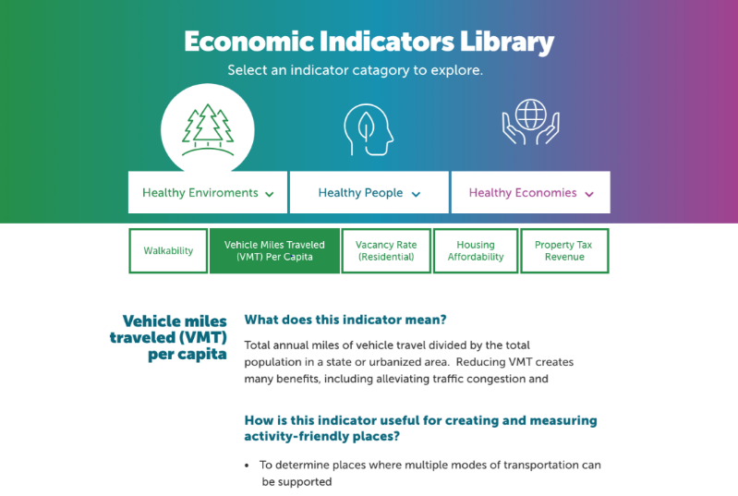
Notes:
Here’s a preview of the Economic Indicators Library. Visitors can click through the different Areas – Environments, People, Economies to learn about specific indicators.
This is a user-friendly tool that will feature information on these indicator, how they might be useful, limitations and considerations, and potential data sources where you can find measures of these indicators to use in planning, research, communication, or evaluation.
Public health practitioners, researchers, and their partners can use the Economic Indicators Library to understand and measure the benefits of activity-friendly communities and support community planning efforts.
The library includes ten economic indicators that can be applied across different communities to assess, monitor, or evaluate the economic activities important to people, prosperity, and the planet.
The goal is to provide users a solid foundation of what the indicator means and how to use it, without overloading with information. There will be future updates to, adding more info, and additional resources to improve the Library going forward.
The BIGGEST Takeaway for this Library Tool is that these 10 indicators can be applied across different communities to assess, monitor, or evaluate the economic activities. WHY it’s so key is it allows us to look across communities, make comparisons, and see those trends over time, not just a one-time snapshot.
WHY THIS MATTERS – call to action
·Now that the heavy lifting of reviewing the evidence and coming to a systematic consensus is done, how we measure economic benefits of active transportation & activity friendly communities is not changing for some time – can use these for the next decade or so at a minimum
1) Augmenting researcher’s ability to report and document common measures
2) Low cost & more feasible
3) Allows for comparisons across communities, cities, and other geographic areas
4) BUT, also, allows for comparison over time and trends – which is important because it takes times, maybe 5-10 years for effects and changes to show up in the data, for a fuller picture to emerge
5) Previously, folks might have all just done their own thing – can advance the field forward together with a more systematic, unified approach that’s going to paint a more complete picture – we’re working with the same materials & language

Slide 5
Begin presentation on next slide
Notes:
Thanks for reading the background info! The presentation for your audiences begins on the next slide.

Slide 6
Making the Case
for Investments in Activity-Friendly Communities
Community/Location Here
Notes:
Title slide
[note to presenter: this is a great spot to use your own photos!]

Slide 7
Today’s Discussion
1
What do communities want most?
What does an activity-friendly community look like?
What are the benefits of activity-friendly communities?
What are strategies that can be used to support activity-friendly communities?
2
3
4
Notes:
In today’s presentation, we will give an overview of activity-friendly communities discussing:
Why communities want to create them,
What activity friendly communities are,
The many benefits of activity-friendly communities, and
strategies that can be used to support activity-friendly communities

Slide 8



What do most communities want?
HEALTHY ENVIRONMENTS
HEALTHY ECONOMIES
HEALTHY PEOPLE
Notes:
What does your community desire? It is common for community leaders and residents to identify what is often called the “triple bottom line.” That refers to the benefits of economic vibrancy, environmental sustainability, and public health and well-being.
It’s important to recognize that all three of these goals are related to creating active routes to everyday destinations. Specifically, there are significant economic benefits to this type of work!
Communities want healthier environments, economies, and people – whether that's sidewalks and streets that are easy and accessible to use no matter what mode of transportation, ample job opportunities and available housing, cleaner air and water, or just a better quality of life.
These are great goals, yes, BUT - How do we get there?

Slide 9
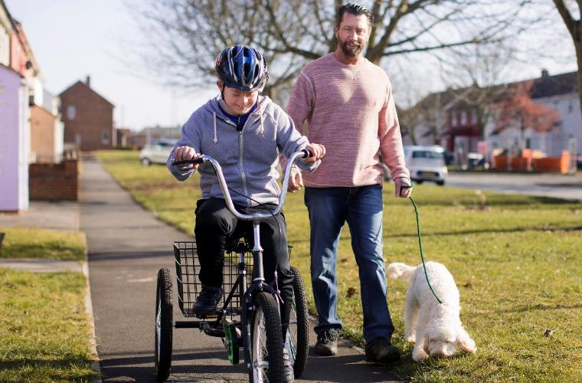
How do we do that?
By creating activity-friendly communities!
Notes:
[note to presenter: this is a great spot to use your own photos!]
One of the best approaches is to create an activity-friendly community. This refers to a community that combines transportation, land use, and community design to increase safe, convenient, and accessible opportunities for walking, biking, or simply moving in public spaces without the need for a vehicle.

Slide 10
What does an activity-friendly community look like?
A mix of nearby destinations
Quality networks for walking, biking, and transit
Accessible and safe for all ages, incomes, and abilities
Functional and inviting design
Notes:
There are four different elements that support an activity-friendly community:
A mix of nearby destinations
Quality networks for walking, biking, and transit
Accessibility and safety for all ages, incomes, and abilities
Functional and inviting settings that reward active transportation
We’ll walk through each of these elements in more detail in the next few slides.

Slide 11
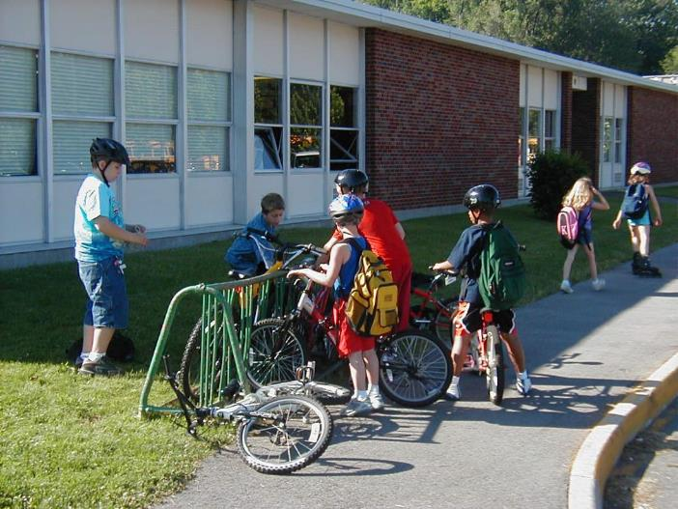
Mix of nearby destinations
Notes:
Having a mix of nearby destinations is an important way to encourage people to walk, bike, and take transit – being physically active as part of their daily travel. This can include grocery stores, schools, worksites, libraries, parks, restaurants, cultural and natural landmarks, or healthcare facilities. It is best when these destinations are designed to be functional and attractive.
[note to presenter: this is a great spot to use your own photos!]

Slide 12
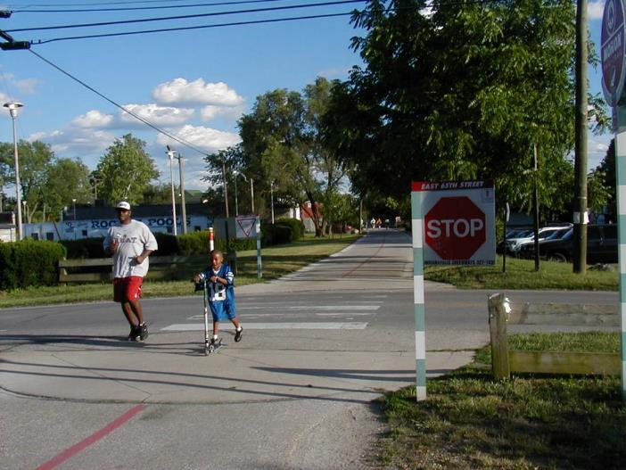
Quality Networks for Walk, Bike & Transit
Notes:
To get to those destinations, we need quality networks for walking, biking, and other transit (together, called active transportation). For example, street pattern design and connectivity (such as having shorter and better-connected blocks), pedestrian infrastructure, bicycle infrastructure, and/or public transit infrastructure and access will make active transportation more appealing and likely.
[note to presenter: this is a great spot to use your own photos!]

Slide 13
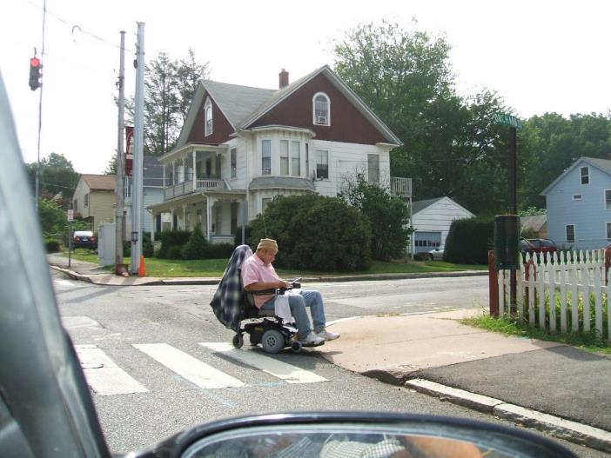
Accessible and safe for all ages, incomes & abilities
Notes:
It’s important to think about all types of users when creating an activity-friendly community. Will wheelchair users be able to use the sidewalk if there’s no ramp? Are sidewalks wide enough for families to walk safely? Are there obstacles that would challenge older or visually impaired or blind pedestrians?
Activity-friendly communities give people who cannot or choose not to drive more options for getting around independently.
[note to presenter: this is a great spot to use your own photos!]

Slide 14
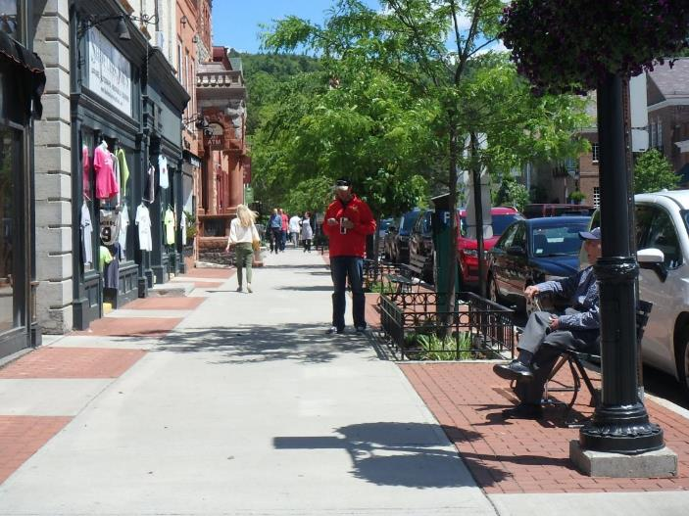
Functional and Inviting Designs
Notes:
Lastly, functional and inviting designs encourage residents to choose active transportation by orienting building access near the sidewalk (rather than behind vehicle parking), and providing streets furnishings such as benches, street trees, landscaping, lighting, bicycle parking, public art, and other features..
[note to presenter: this is a great spot to use your own photos – you can point out the functional and inviting design features in the photo to illustrate this idea!]

Slide 15
What does an activity-friendly community look like?
A mix of nearby destinations
Quality networks for walking, biking, and transit
Accessible and safe for all ages, incomes, and abilities
Functional and inviting design
Notes:
Overall, when a community has these elements that makes active transportation safe, easy, and appealing, they are creating environments that will attract residents, including both younger and older people who will value safe access to everyday needs, and the quality of life that these settings support. This will also encourage the businesses that want to employ and to serve those residents to put down roots or to remain in a community.

Slide 16



What are the benefits of activity-friendly communities?
HEALTHY
ENVIRONMENTS
HEALTHY
ECONOMIES
HEALTHY
PEOPLE
Greater Walkability
Fewer Vehicle Miles Traveled
Better Air & Water Quality
Higher Retail Sales
More Small Business Development
Connecting People to Job Opportunities
Higher Occupancy Rates
Housing Costs are Within Reach
Increased Property Tax Revenue
Longer Life Expectancy
Notes:
There are so many benefits to having an activity-friendly community, including environmental, economic, and health benefits. Again, this is sometimes referred to as the “triple bottom line,’ benefiting people, prosperity, and planet. This list of 10 indicators was identified by a national expert panel as representing some of the most important associated with designs that support active transportation. The following slides with outline more detailed information about the benefits.

Slide 17
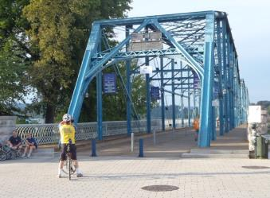
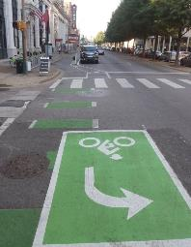
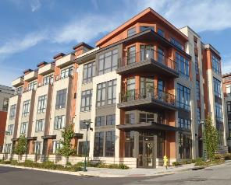
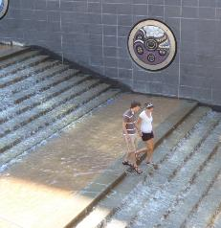
Benefits outweigh potential costs
Chattanooga, TN
Community design changes can lead to increased housing desirability and costs and concerns of displacement and gentrification.
These concerns need to be addressed in the design process through equitable affordable housing policies and tools and access to active transportation, which can offset the increased costs of living.
Notes:
Activity-friendly improvement projects can generate concerns about residential, commercial, or cultural displacement. This may cause residents to feel unsure about supporting community improvements.
Recent studies show that despite concerns about increased costs of living, there is support for community design changes that promote physical activity.
In a national survey, nearly 1 in 5 respondents expressed concerns that community design changes to promote physical activity might increase costs of living.¹
However, over half of respondents supported activity-friendly community design changes even if they do increase costs.¹
Bringing equitable investments and opportunities to all types of communities is a priority. We have to combine bringing activity-friendly opportunities to mitigate adverse effects of displacement with a comprehensive approach to high quality, diverse, affordable housing, and supportive land use and zoning policy practices. Big takeaway is that community health improvements and life expectancy have economic aspects.
Chattanooga, TN success story:
Walnut St. Bridge was converted to pedestrian & bicycle use only; a riverfront highway became a boulevard & ped/bike promenade, linking destinations (aquarium, museum, waterfront amphitheater).
Strategies: Comprehensive planning & zoning; complete streets; transportation trail network; affordable housing (walkable to downtown); interactive public art (e.g. waterfall stairs); on-street bike facilities.

Slide 18
Healthy Environment
1
Greater Walkability
Fewer Vehicle Miles Traveled
Better Air Quality
2
3
Notes:
Environmental benefits of activity-friendly communities include 1) greater walkability, which can lead to 2) fewer vehicle miles traveled (and totentially less traffic congestion), and 3) better air quality. We’ll walk through these three in more detail in the next few slides.
[note to presenter: feel free to select which benefits to present on that are most relevant to your community.]

Slide 19
1. Greater Walkability
Walkscore 5
Walkscore 45
Walkscore 72
Walkscore 92
Notes:
One of the most immediate benefits of an activity-friendly community is greater walkability. When we say walkability, we also mean people can better move by rolling, biking, and using other forms of active transport.
One simple measure of walkability is a location’s (or area’s) walkscore, which reflects the variety of destinations within walking distance. The more different destinations nearby, the higher a location’s walkscore. Check it out at www.walkscore.com
These images reflect different levels of walkscore, along with other attributes of walkability.
[Note to presenter: Walkability can be measured in different ways including walkscore and resources outlined below. You can find more information on walkscore in your community and include it on the slide with your own photos.]

Slide 20
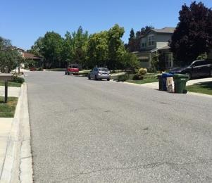
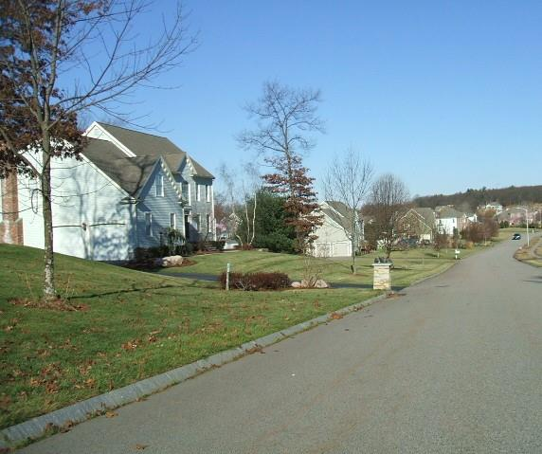
HEALTHY
ENVIRONMENT
Walkscore 5
Notes:
This example has a walkscore of 5. There is only one type of destination in this low-density residential subdivision, meaning there is no variety of destinations within walking distance – just housing.
Note that there are no sidewalks or marked bicycle lanes that that would provide more safe and inviting settings for walking and bicycling, and wide roads like these tend to invite faster driving.

Slide 21
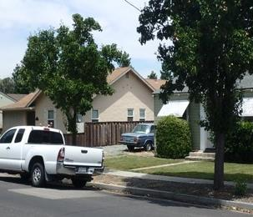
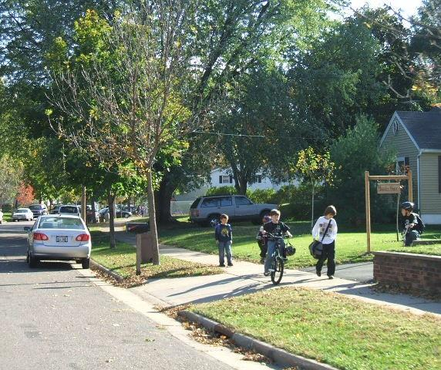
HEALTHY
ENVIRONMENT
Walkscore 45
Notes:
Here is an example that has a walkscore of 45. The smaller lots mean that things are closer together and puts more within walking distance, but it’s still mostly a residential neighborhood, so only a little bit of variety within walking distance.
The curbs and setback sidewalks provide a safe walking space for pedestrians of all ages. Street trees not only provide shade but, along with the on-street parking, tend to slow traffic in the neighborhood.

Slide 22
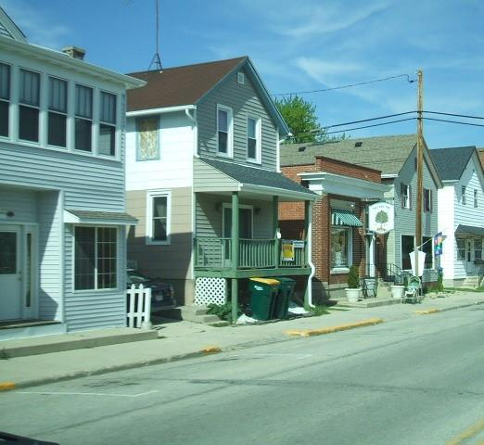
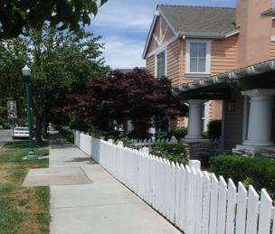
HEALTHY
ENVIRONMENT
Walkscore 72
Walkscore 72
Notes:
Here is an example of a walkscore of 72, where there is more compact and mixed development, and an intermingling of neighborhood businesses such as corner stores and restaurants; this dramatically shortens walking distance to routine daily needs.
The wide sidewalks and on-street parking also create space between pedestrians and traffic; and there is lighting to make walking at night safer which are other attributes of walkability in this neighborhood.

Slide 23
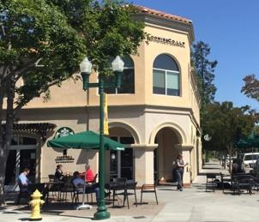
HEALTHY
ENVIRONMENT
Walkscore 92
Notes:
Here is an example of a walkscore of 92. There is a variety of businesses and retail on street level, and housing on the second floor, creating a great variety of destination in close proximity.
Additional attributes of walkability include wide sidewalks and street trees, as well on-street seating and activity that make the environment more inviting for pedestrians.

Slide 24
1. Greater Walkability
Walkscore 5
Walkscore 45
Walkscore 72
Walkscore 92
Notes:
From these examples, it’s clear that a mix of destinations and good sidewalks make a difference -- but what other features can you see here or think of from places you are familiar with that make one place more walkable than another?
Some examples include more space between the sidewalk and road, wider sidewalks, crosswalks and walk signals, landscaping to absorb emissions and storm water run-off, street furnishings such as benches, bike racks, and way-finding sign, and good connections to public transit.
By having everyday destinations and activity-friendly routes, we are improving the walkability of a community.
[Note to presenter: Walkability can be measured in different ways including walkscore and resources outlined below. You can find more information on walkscore in your community and include it on the slide with your own photos.]

Slide 25
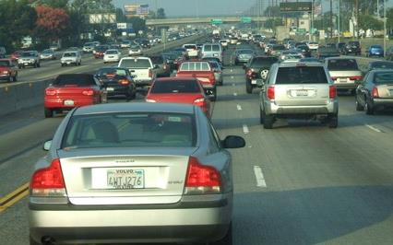
2. Fewer Vehicle Miles Traveled (VMT)
Reducing VMT creates many benefits:
lower traffic congestion
less air pollution & emissions
reduced dependence on foreign oil
Reduced commuting costs
Notes:
Vehicle Miles Traveled (VMT) is a measure of the total miles driven by vehicles in a region, state, or the country. A benefit of more people using the active modes of travel – walking, bicycling, and taking transit – is that they are driving for fewer trips, and VMT for a region will be less. The obvious benefits of vehicles driving fewer miles include:
- Less traffic congestion
Potentially reduced travel and commuting costs for residents
Over time a reduced dependence on oil, and thus greater independence from the ups & downs of international oil markets
Lower greenhouse gas emissions and overall less air pollution
As a community becomes less dependent on vehicles for travel, it’s possible to invest less in vehicle infrastructure, such as giant surface parking lots and parking structures.

Slide 26
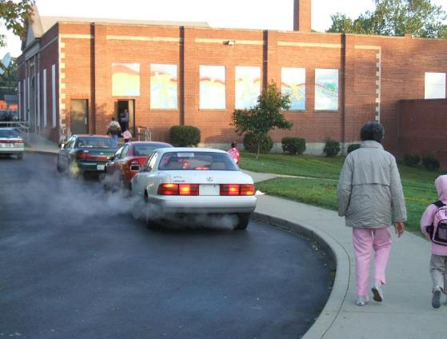
3. Better Air Quality
Poor air quality can lead to poor chronic health conditions and more healthcare costs.
Notes:
Poor air quality isn't just unpleasant, it can lead to or worsen chronic conditions like asthma, COPD, and other lung diseases. That costs all of us more in higher healthcare and insurance costs. And this can have more severe impact on children, older people, people with health conditions, and outdoor workers.
For example, studies have shown that idling vehicles around schools at dismissal can create very unhealthy air for students.
[Note to presenter: Walkability can be measured in different ways including walkscore and resources outlined below. You can find more information on walkscore in your community and include it on the slide with your own photos.]

Slide 27
Healthy Economies
1
4
Higher Retail Sales
More Small Business
Development
Increased Property
Values And Tax Revenues
Connecting More People
To Nearby Jobs
Higher Occupancy Rates
Housing Costs Within Reach
2
5
3
6

Slide 28
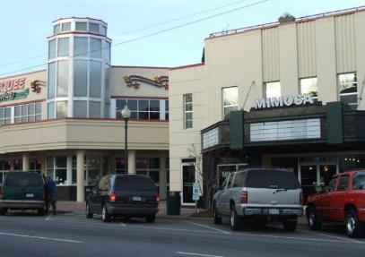
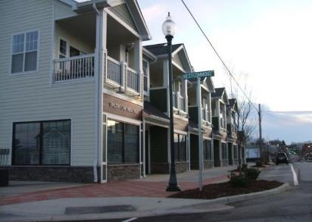
HEALTHY
ECONOMIES
Higher Retail Sales
More Small Business Development
Increased Property Values And Tax Revenues
Notes:
More walkable communities have the potential to generate more revenue per square foot of retail space because by design they allow for more destinations such as shops and restaurants that can generate higher retail sales in less space. And these types of communities have more room for business development which helps generate more tax revenues from less space!
In Raleigh, for example, it was found it would take an entire subdivision of single-family homes to equal the tax base of one commercial office building on a much smaller lot! And you’ll find this scenario play out all across the country because low-density development is a poor way to make property tax revenue and it’s also extremely expensive to maintain.
In the factsheet included with these materials is a case study from Morganton, NC that is worth highlighting. The community was able to boost retail activity, small businesses, and tax revenue by creating a downtown anchor: they linked a historic theater in a walkable downtown to adjacent buildings to create a multi-screen cinema, and support a more thriving downtown.
[note to presenter: we featured a success story here, but you might have an example in your community you want to feature. We recommend using photos to illustrate the changes.]

Slide 29
HEALTHY
ECONOMIES
Connecting People To More Jobs
Higher Occupancy Rates
Before
After
Notes:
Additional benefits of walkable communities include that they can help stimulate the economy by connecting more people to more jobs. With more destinations closer to one’s home it means more access to employment opportunities. Jobs that can be accessed easily by active or public transportation means families can also save money by reducing the transportation costs that are required when owning and maintaining a car. Walkable communities can also provide for a mix of housing types and sizes which can allow families with kids, empty nesters, young adults, and people of all ages, abilities, and incomes to live near to one other. In many cases when a community becomes more desirable and housing demand and occupancy rates increase, it is vital to have requirements in place to allow for different housing types, sizes, and costs to assure people already in the community and new residents of different income levels have housing options.
[Note to presenter: does your community already have a success story you want to share? Consider sharing them here in place of the examples provided to make a stronger case. Does your community have a "before" challenge to address? Try adding a slide with a photo on the left and a box with a big question mark on the right.]

Slide 30
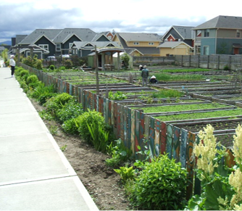
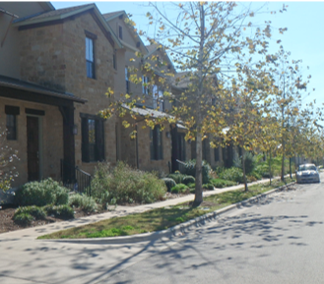
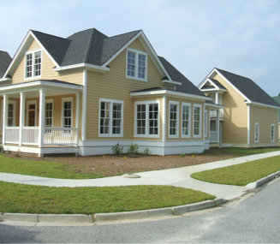
HEALTHY
ECONOMIES
6. Housing costs are within reach
E.g. cottage homes, row houses, & accessory dwellings.​
Notes:
An essential attribute of activity-friendly design is to provide a variety of different types of housing within walk, bike and transit distance of daily needs, essential services, and employment opportunities. This means not just single-family homes and apartment buildings, but also the so-called missing middle, such as:
Row houses (center picture)
Town homes
Duplexes, triplexes, quads
Cottage homes (picture on left, with a shared community garden)
Accessory dwelling units (picture on right, home with an apartment over the garage out back)
This provides the opportunity for a wider variety of residents of difference socio-economic levels to live within walk, bike, and transit distance of their daily needs and jobs. This allows less dependence on their automobiles, and perhaps even limits the costs associated with owning and operating a vehicle.
There is a lower cost associated with automobile-oriented infrastructure, individual tax burden decreases, yet this increased compact development can increase the tax base without increasing traffic congestion and sprawl.​

Slide 31
Healthy People
1
Longer And Healthier Lives
Notes:
People tend to live longer and healthier when they have easy and safe access to daily needs, healthcare, and outdoor recreation. ​Premature deaths have social and economic costs for communities and workplaces.​
Overall, the benefits lead to better overall health in the community, leading to longer and healthier lives. ​
​
​

Slide 32
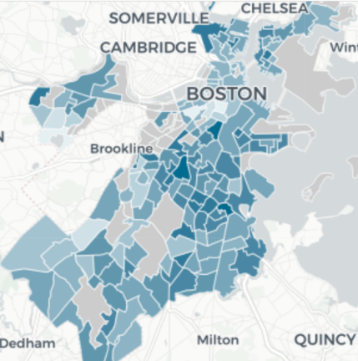
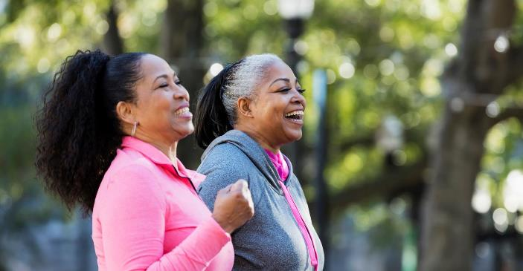
1. Longer and healthier lives
Notes:
There are significant differences in life-expectancy based on where people live – and activity-friendliness is one of the characteristics of those settings with higher life expectancies. The map on the right shows gaps as high as 16 years in life expectancy in parts of Boston that are literally only miles apart (lighter colors reflect longer life-expectancies); it is common for these areas to also be dramatically different in how supportive they are of active transportation. These types of inequities are apparent in cities and towns across the country and reflect a deep social-justice challenge in many communities.
Put simply: People live longer, healthier lives when they have easy and safe access to daily needs, healthcare, and outdoor recreation (grocery stores, post office, feel free to insert relevant and compelling examples for your community), and supportive settings for regular walking, biking, rolling, and transit.
Premature deaths have social and economic costs for communities and workplaces, while the economic benefits of living in an activity friendly place lead to better overall health in the community, leading to longer and healthier lives.

Slide 33
How can we start?
Easy
Walking audits
Empower community residents
Next steps
Traffic calming measures
Demonstration projects
Share findings
Transformative steps
Complete Streets policies
Improve infrastructure
Repurpose buildings
Zone for more housing options
Notes:
There are many ways communities can become more activity-friendly. Depending on how far along your community currently is, we’ll walk through various points of entry.

Slide 34
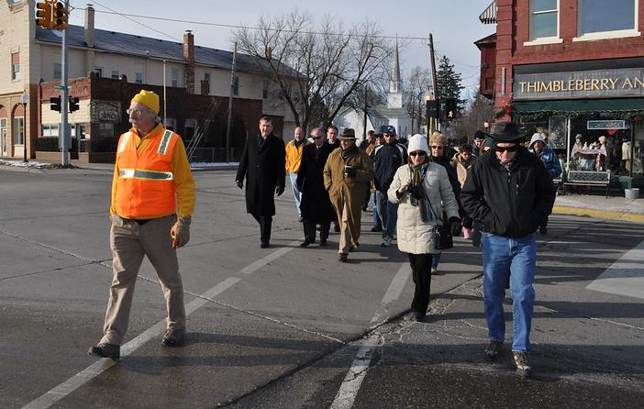
Walking audits with community members and leaders helps identify areas needing improvement & empower residents to identify solutions
Notes:
If your community has not approached this topic, an easy first step would be to go out and hold a walking audit (or a bicycling or transit audit, if working on improving those active modes of transportation).
A walking audit is when community members and decision-makers actually get out and walk through an area together to collectively identify challenges and possible solutions to improve conditions for walking, bicycling, and transit use.
Empower community residents to identify solutions helps bring together different sectors and community groups to ensure redevelopment has the community’s interest at heart. For example, you could also create local Business Improvement Districts led by local entrepreneurs, including small businesses, woman-owned businesses, and entrepreneurs of color.
[note to presenter: this slide is a good opportunity to use photos of challenges in your community or share walking audit results from your community if you have already made these steps]
Photo courtesy of Michigan Municipal League. https://www.flickr.com/photos/michigancommunities/4348622423

Slide 35
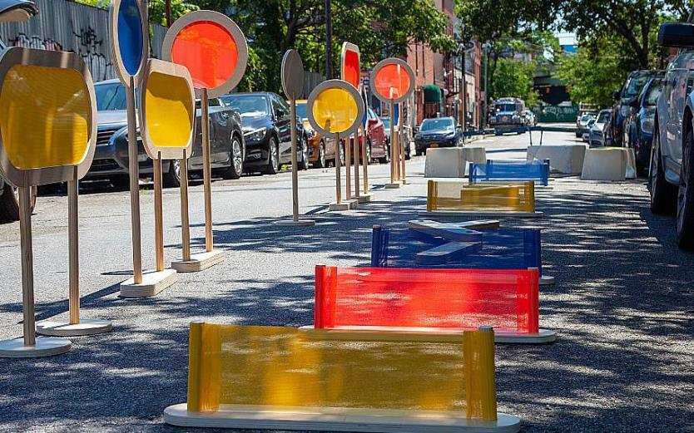
Utilize traffic calming measures
Set up
demonstration
projects
Share findings
Notes:
If you are already aware of the challenges in your community, you can start taking some next steps such as:
Utilizing traffic calming measures (improvements you can make to roads that naturally slow traffic without increasing congestion, such as curb extensions, medians, paint, flexible delineators, landscaping, etc.) to slow traffic and create safer routes to schools, parks, and other common destinations.
Setting up temporary demonstration projects (pictured above) and evaluating impacts on traffic, walking and bicycling, and overall safety
Sharing findings with planning, transportation, public works, and others to inform current and future project plans.
These types of actions will help bring more attention to the issue and create more interest in the community to take action.
[note to presenter: this slide is a good opportunity to use photos or share walking audit results from your community if you have already made these steps]
A prototype of a newly designed, no-touch obstacle course to support safe, hands-free play for children on the streets. Photo courtesy of Street Lab. https://theurbanactivist.com/idea/play-streets-in-new-york-a-safe-haven-designed-to-thrive/

Slide 36
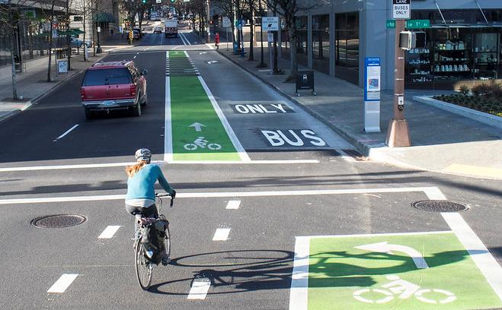
Support Complete Streets Policies
Create quality pedestrian, bicycle, and transit infrastructure
Repurpose or replace unused or underused buildings, parking lots, or other impervious areas.
Zone for a wider range of housing options and more neighborhood services & essential needs.
Notes:
Once your community is fully on board, they may be ready to make real changes. Some examples of actions communities can take are:
Support Complete Streets Policies, in which communities commit to considering all users, of all ages and abilities, using all modes (walk, bike, transit, drive) on all roadway projects; thus the planning for routine maintenance, street improvements, and new construction all include sidewalks, bike lanes, and other pedestrian-, bike-, and transit-friendly infrastructure.
Create quality pedestrian, bicycle, and transit infrastructure to improve access to businesses and destinations.
Zone for a wider range of housing options, businesses, and retail in proximity, in ways that are specific to needs and context of a community.
Repurpose or replace unused or underused buildings, parking lots, or other impervious areas, where pavement prevents drainage and causes stormwater run-off, near transportation and utility infrastructure.
[note to presenter: this slide is a good opportunity to use photos or share walking audit results from your community if you have already made these steps]
Photo courtesy of Portland Bureau of Transportation. https://www.flickr.com/photos/pbotinfo/25340195348

Slide 37
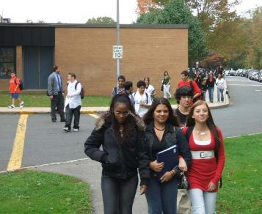
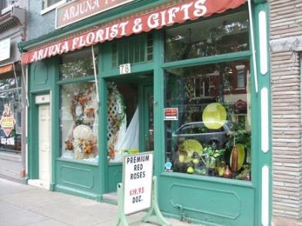
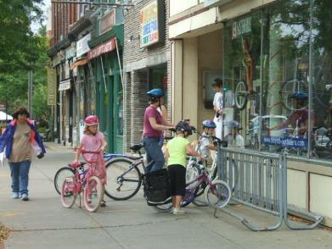
Photos
Notes:
[note to presenter: we have provided additional photos you can use throughout the presentation.]

